Slide 1
+ / Strengths
- / Weaknesses

Slide 2
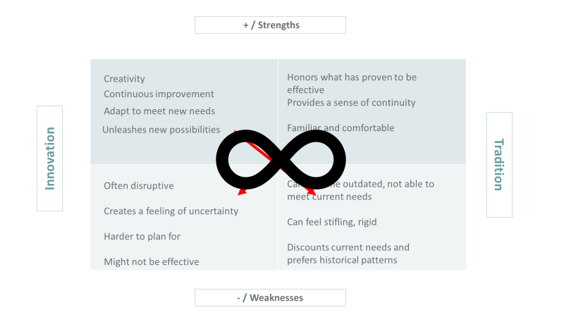
How Do We Maintain the Positive?
How Might We Both __ AND __?
How Do We Maintain the Positive?
What Are the Early Warning Signs?
What Are the Early Warning Signs?
What Do We Most Fear?

