Slide 1
Strengthening Coalition Collaboration
Ageno Otii, Jodi Hardin, Emily Holcomb, Bill Fulton and Kalie McMonagle
THE MANY WORKING AS ONE FOR THE GOOD OF ALL
January 16, 2020

Slide 2

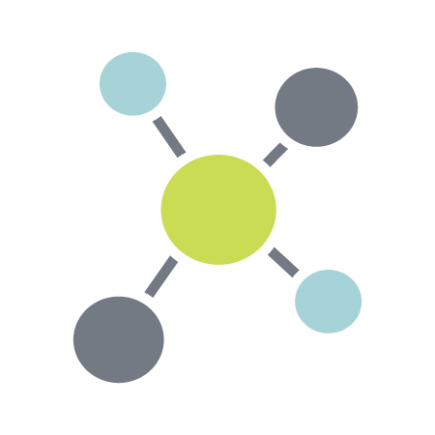
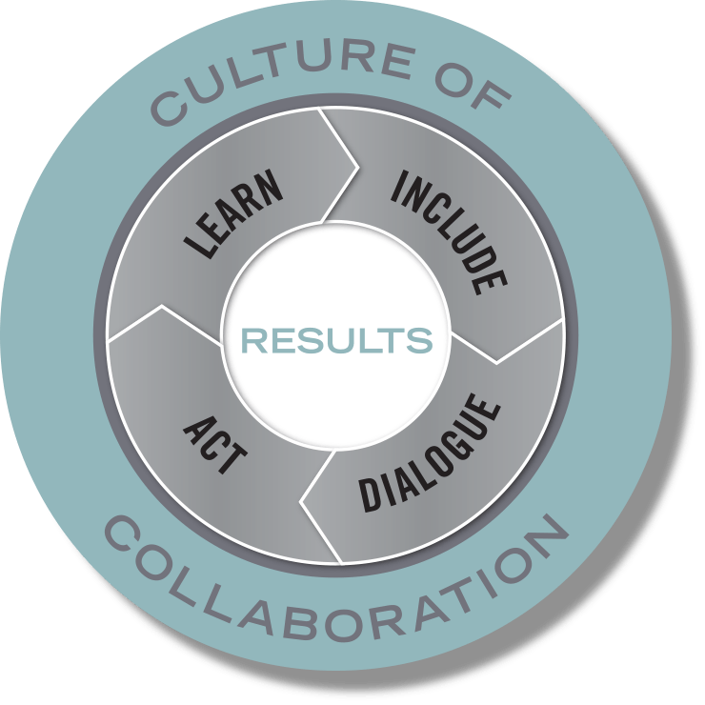


Purpose and Vision: The many working as one for the good of all
Mission: to create a culture of collaboration that drives transformative change
Build Connections
Build Capacity
Build a Movement
Notes:
The Civic Canopy transforms the way pivotal issues are solved by creating a culture of collaboration across Colorado
The Civic Canopy is a community-based nonprofit working to connect diverse groups of people seeking change in their communities
We use a research-based Community Learning Model to drive our work supporting a 3 part platform that:
Builds connections through shared technology;
Builds capacity through training and technical assistance; and
Builds a movement through engagement and advocacy

Slide 3
Intended Outcomes
By the end of the training, coalition teams will:
  have a sense of where they are on the coalition eco-cycle and what that means as they enter interim strategic planning
  understand how polarities show up in coalition work and identify tensions their coalition may be facing
  expand their viewpoints through the experiences and reflections of other Gen Wild coalitions

Slide 4
4 Layers of Complex Collaboration
Level | Description
Theoretical | Relates to underlying principles and theories that explain why we believe things happen the way they do
Strategic | Relates to intentional efforts to organize actions in a way that achieves desired results
Tactical | Relates to specific actions and concrete activities
Emotional | Relates to the personal experience of the work and the relationships involved

Slide 5
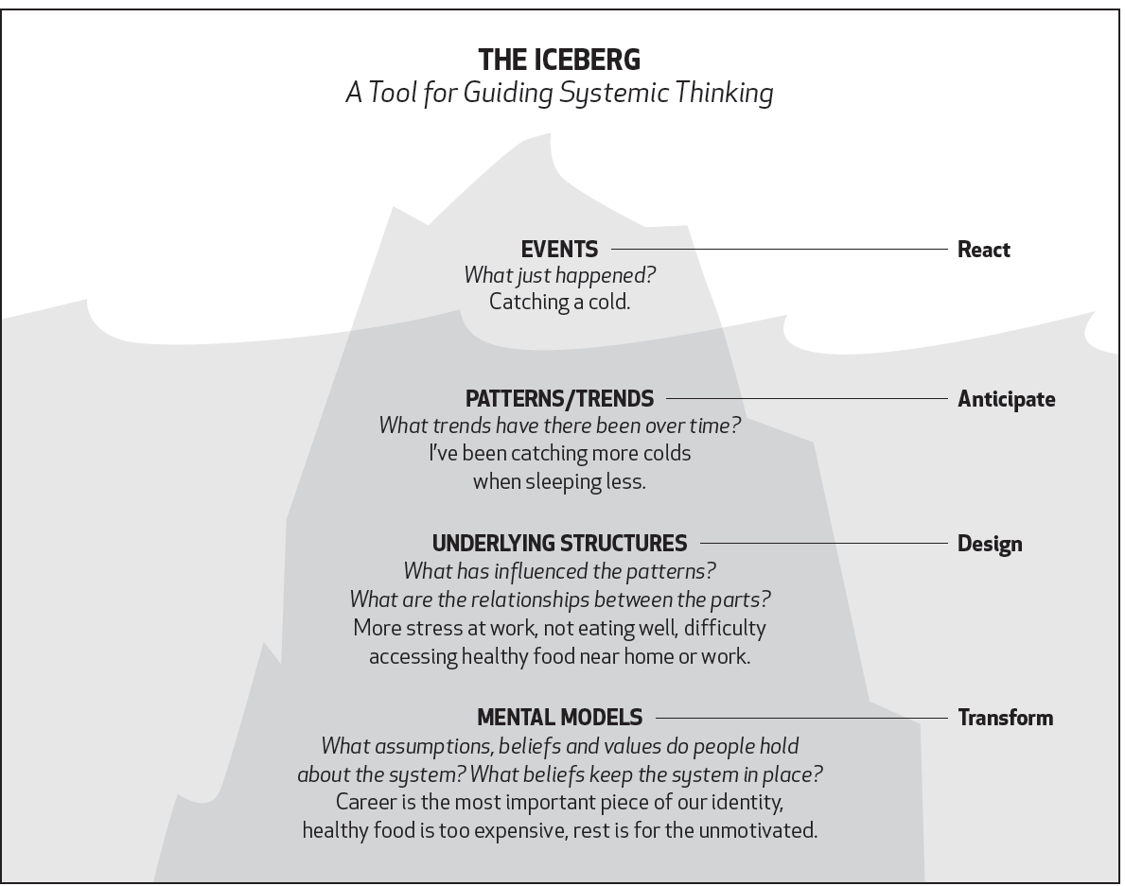

Slide 6
Eco-cycle Tool
Understanding the life cycle of coalitions

Slide 7
Session Objectives
This session will support participants to:
Consider how coalition work is more cyclical than linear
Assess how the Eco-cycle Tool helps deepen their understanding of where their Gen Wild Coalition is and what they are experiencing
Generate ideas of how to apply the tool in their interim strategic planning
Notes:
Jodi
Share objectives for the session
Ask people to take a minute to reflect on what they are most challenged by in their collaborative work, and write it on the full size sheet of paper located on the table

Slide 8
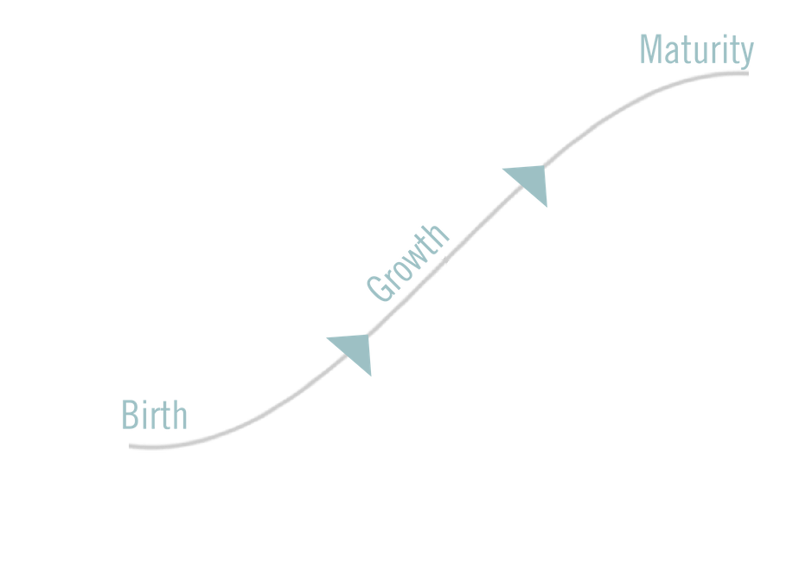
Performance Loop
Notes:
Jodi
We have a certain model in our head for how collaborative work goes
It includes these performance stages
The initial creation or ideation phase – it’s creative, it’s messy, things are certain yet there is a feeling of hope/excitement/possibility, lots of perspectives bouncing ideas, flat structure
The idea is developed and grows into something– ideas start taking shape, adaptation and flexibility is abundant, emerging practice and tolerance for risk
Things are really rocking – we know what we are doing and how we are doing it, structures routines and processes are grounded, we are seeing early returns/successes
AND…. If this is the model we have in our head, what happens when we hit a bump, a new idea or direction emerges, things stall, new perspectives join in
A sense of swirliness abounds --- who’s been part of a collaborative that is trucking along and then
What exactly are we doing?
Why or to what end?
Is this the way to organize ourselves?
?????

Slide 9
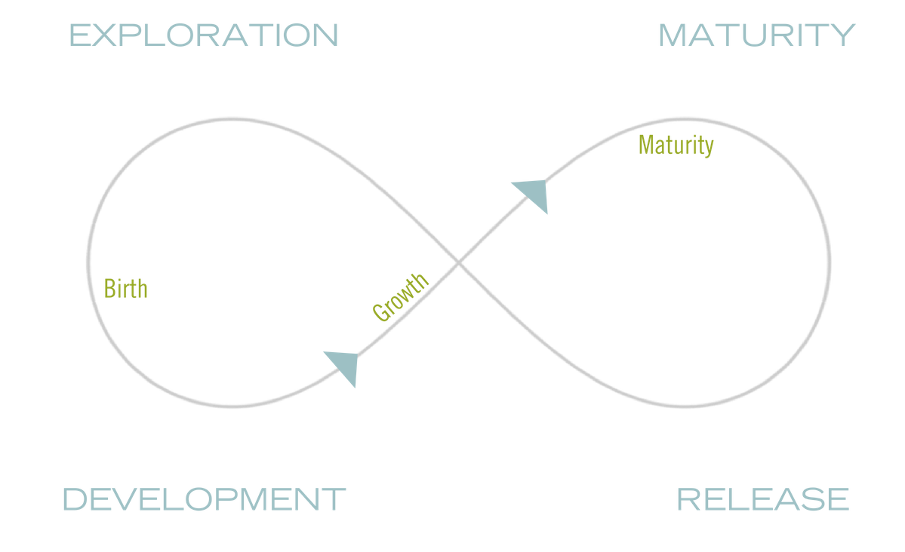
Renewal Loop
Notes:
Jodi - Let’s normalize this feeling by understanding, it’s not a linear model or frame
There is a super important renewal loop – that adds value, describes the feeling and importance of these phases, can help lessen or at least understand
feelings of pressure or frustration; identify what’s behind sense of loss, anger or blame; calls us to re-remember what is at the essence of the work – relationships, values
Creates space for new energy, sense of urgency (we aren’t done)
Which then promotes exploration – space for new or updated thinking, expanding possibilities and buy-in,
Basically re-birthing into next performance loop
Release

Slide 10
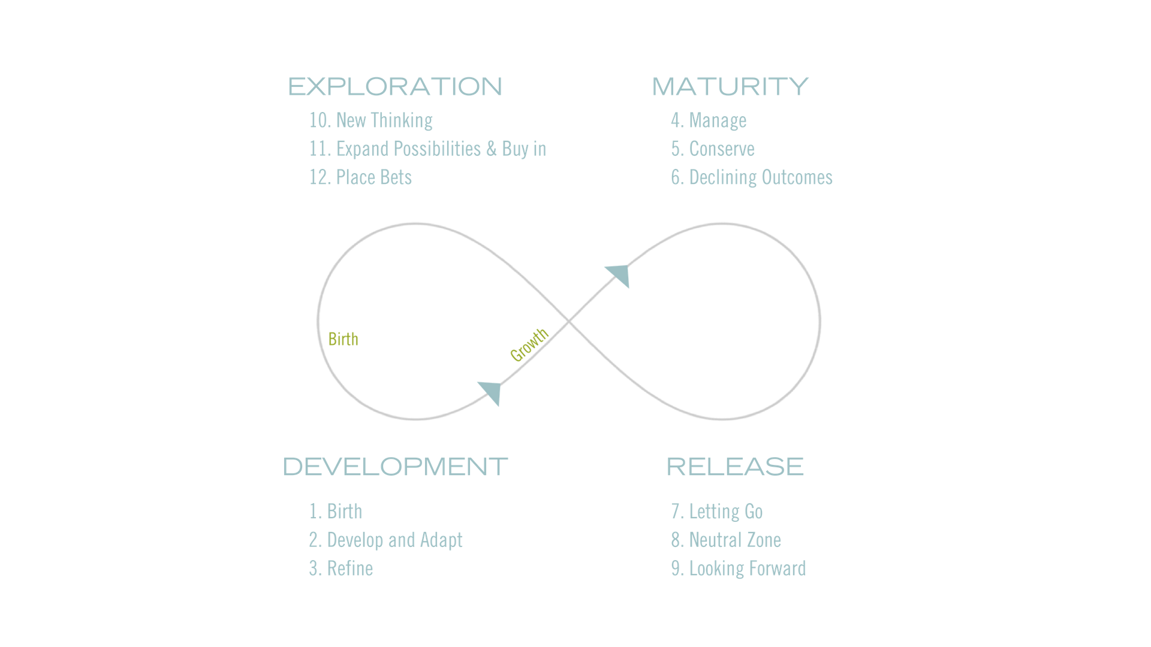
Steps within the Stages
Notes:
Jodi
Development /birth– might feel entrepreneurial, sense of possibility and opportunity; flexible and emergent; excitement
Maturity – might feel we have arrived, doing/accomplishing things; there’s clarity; feels efficient and effective
Release/creative destruction – might feel reflective, confusion and sense of loss; crisis; things are prime to change
Exploration /renewal– might feel messy, uncertain, exploratory, reorganizing

Slide 11

Where are You in the Eco-Cycle?
Why do you think you are there?
What are the signs?
What does it mean?
Notes:
Jodi
Individually consider where you think your Gen Wild Coalition is on the ecocycle
Share and talk as a group
Hear from each coalition where they think they are and what it means to them – Emily Chart

Slide 12
Deeper EcoCycle Exploration
Notes:
Emily

Slide 13
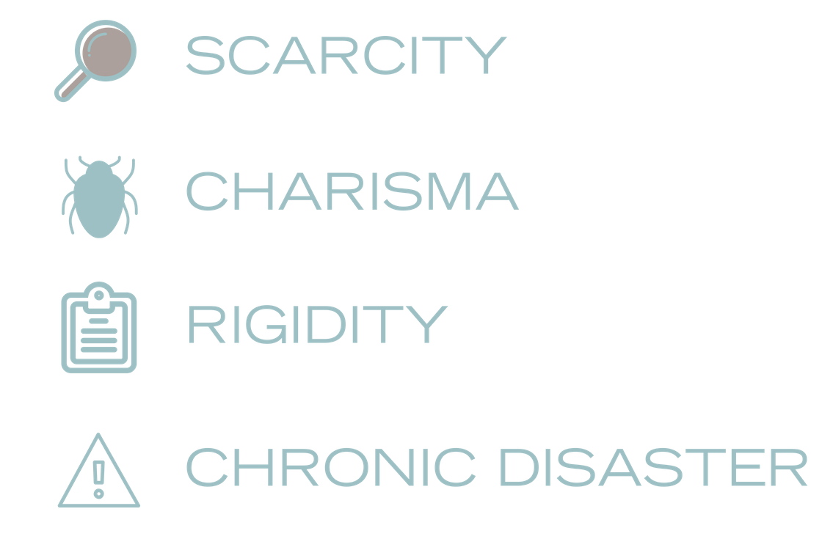
Pitfalls or Traps
Notes:
Emily
This type of coalition work is surely not without its challenges. Over the course of a project, we often see challenges of a similar variety occurring during similar phases of the coalition lifecycle.

Slide 14
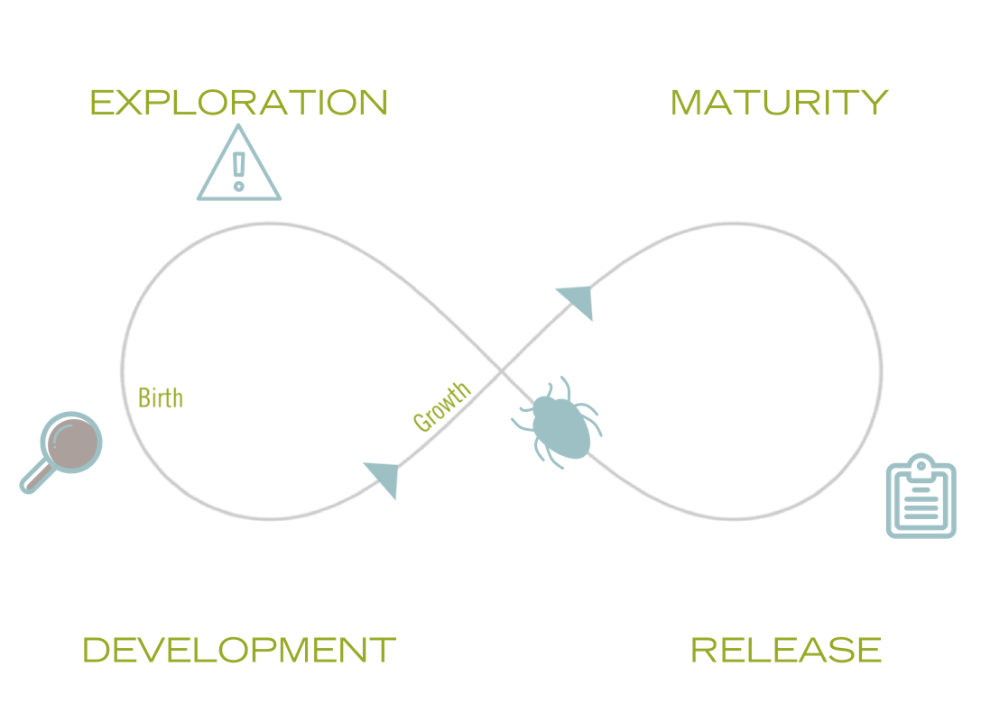
Pitfall/Trap Location
Notes:
Emily
Once we know where they are within the ecocycle, it is a bit easier to embrace and navigate the traps
Scarcity trap – sense that there aren’t enough resources to explore new ideas and/or few seem to take root; struggle to birth outcomes with broader support
Rigidity trap – people are unwilling or unable to close a chapter or end an approach that no longer fits the context, resistance to new ideas – digging in
Charisma trap – challenges sustaining or growing the work without the original founder(s) or champion(s); parasitic feeling attached to what/who gave it birth
Chronic Disaster trap – stay too long or too deep in that ‘spin cycle’ where not getting traction, so much change and messiness can leave folks feeling isolated and helpless
Evidence suggests that what matters most is strategically observing and understanding where each collaboration is on the cycle and carefully managing transitions between phases – minimize disruption between stages as much as possible.
See change as part of a natural and continuous cycle of growth and decay – not something to be earned or avoided or ignored.

Slide 15
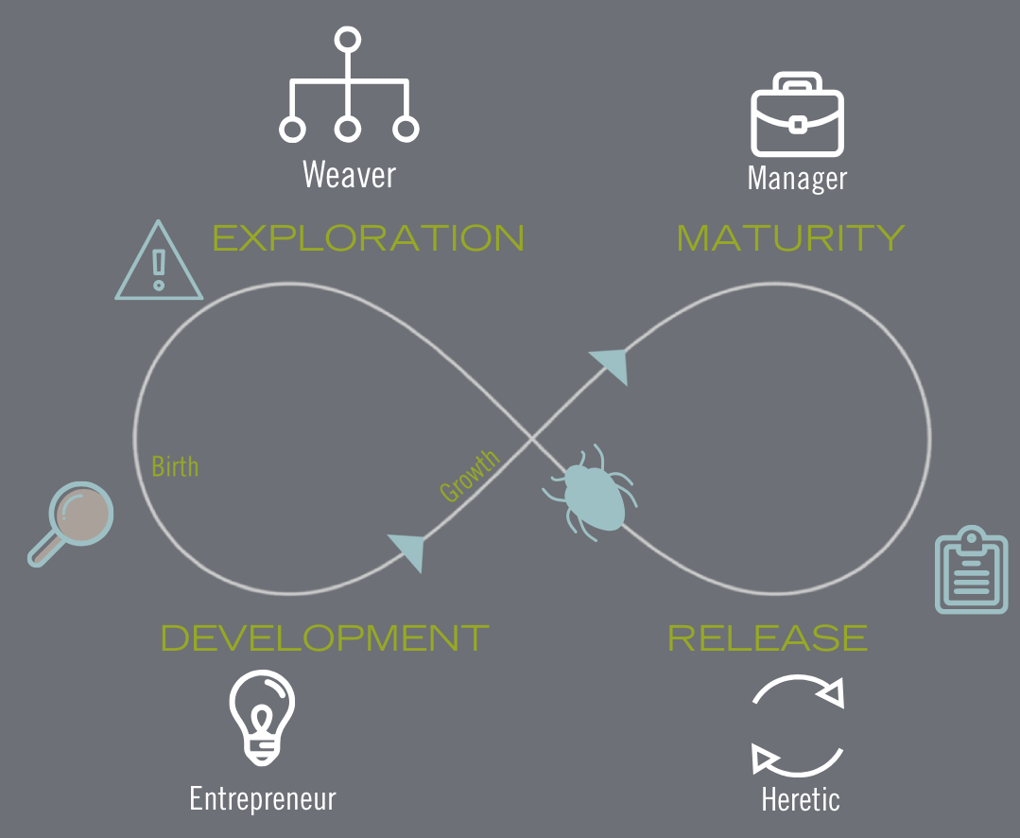
Leadership Leveraging
Notes:
Emily
Different types and ways of leadership or leadership models are helpful at different stages of ecocycle. Embrace and maximize the various personas that are helpful at different times – acknowledge variety is needed
Entrepreneur – in the development stage, leadership that supports development/start-up/new systems and processes, sees and lives innovation
Manager – supports routines, processes; accountability and structures
Heretic – promotes new thinking, questions status quo, pushes limits
Weaver – connecting, organizing, facilitating relationships

Slide 16
Navigating Traps
Trap | Description | Tips to Navigate (examples)
Scarcity Trap | Too few resources to explore new ideas; ideas don’t take root; struggle to birth outcomes with broader input | Asset mapping; relationship building; collective visioning
Rigidity Trap | Inability or unwillingness to change; resistance to new ideas; doing things the way ‘they’ve always been done’ | Re-ground group in values and guiding principles; embrace ambiguity
Charisma Trap | Challenge to sustain or grow without original founder/host; dependence on person(s) | Shared leadership models; succession planning; leadership development
Chronic Disaster Trap | Inability to get traction; so much change results in ‘spin cycle’ | Celebrate accomplishments; MVP-thinking
Notes:
Emily

Slide 17
What trap(s) is your coalition facing?
How might you navigate the trap(s)? What strategies have you found helpful?
Notes:
Emily
As a coalition, talk through the traps that align with where you are in the eco-cycle.
What are you experiencing? How might you navigate those traps? What strategies have you found helpful?
Hear from each coalition where they think they are and what it means to them

Slide 18
Debrief
How might the Eco-Cycle Tool support the interim strategic planning?
Notes:
Emily and Jodi

Slide 19
The Promise, Pitfalls and Polarities of Collaboration

Slide 20
Session Objectives
This session will support participants to:
Become familiar with 3 tools to support collaboration
  Stone Soup story
  Prisoner’s Dilemma Simulation
  Managing Polarities Model
Apply the polarity management model to examples your coalition might be facing

Slide 21
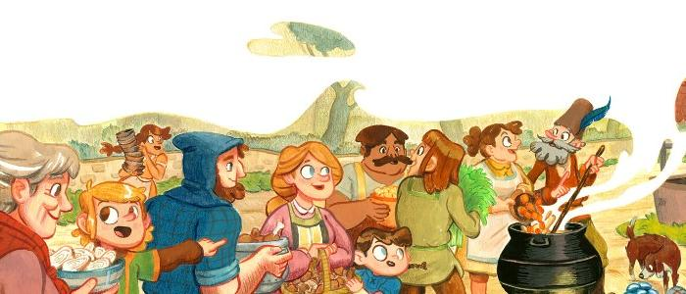
More than the sum of our parts:
Stone Soup

Slide 22
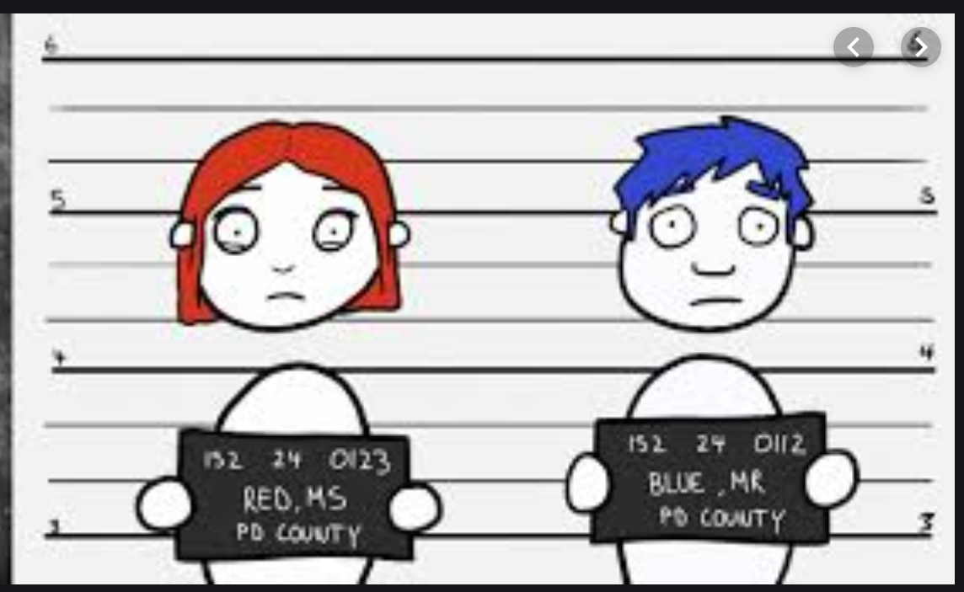
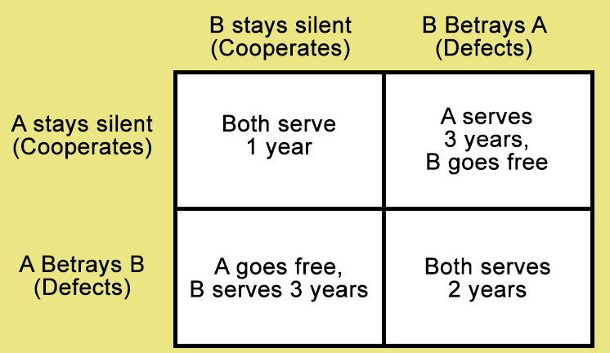
Less than the sum of our parts:
The Prisoners Dilemma
Notes:
Vanessa: One key to understanding the collaboration game is knowing what obstacles to avoid in the game. In a moment we are about to show you a video about a concept called “The Prisoner's Dilemma”.
What this is, is the concept that “the game” (or in our case, the non-profit and community world) force organizations or “prisoners” to have to choose between acting in their own self-interest or not.
When brought into the “the game”, people can only see what they are able to see, and act in their own self-interest based off the limited information they have. It is not a fault of theirs that they cannot see what is not being shown to them. So, usually, “prisoners” choose to act in their own self interest, leading to conflict and counterproductivity to the overall community’s best interest.
This video will illustrate the usual thought process that people, and organizations, have when given the choice to collaborate or not.

Slide 23

Prisoners Dilemma Video
Notes:
Vanessa:
*Watch Video*
Okay, everyone take a moment to digest what you’ve just seen and speak in your groups about what you took from this video and how this may affect you in your field of work. Are there places where you see this dilemma getting in the way of collaboration progress?
*Give a few minutes*
Something that is interesting about this concept is that it has many factors playing into it. For example, during a scientific study of this theory, when people were told the name of the game was “Wall Street” they were less likely to collaborate compared to when they were told the name of the came was “Community”. This can give us some comfort knowing that the work we do is truly community, and so we can hope that most people will put on their collaborating mindset.
This dilemma can be seen in so much of the work we do. It is a common problem we face in our coalitions and communities, causing silos and duplication. s
Video
Two experiments, one conducted with American college students and one with Israeli pilots and their instructors, explored the predictive power of reputation-based assessments versus the stated “name of the game” (Wall Street Game vs. Community Game) in determining players’ responses in an N-move Prisoner’s Dilemma. The results of these studies showed that the relevant labeling manipulations exerted far greater impact on the players’ choice to cooperate versus defect—both in the first round and overall—than anticipated by the individuals who had predicted their behavior. Reputation-based prediction, by contrast, failed to discriminate cooperators from defectors. A supplementary questionnaire study showed the generality of the relevant short-coming in naïve psychology. The implications of these findings, and the potential contribution of the present methodology to the classic pedagogical strategy of the demonstration experiment, are discussed.
From <https://journals.sagepub.com/doi/abs/10.1177/0146167204264004>

Slide 24
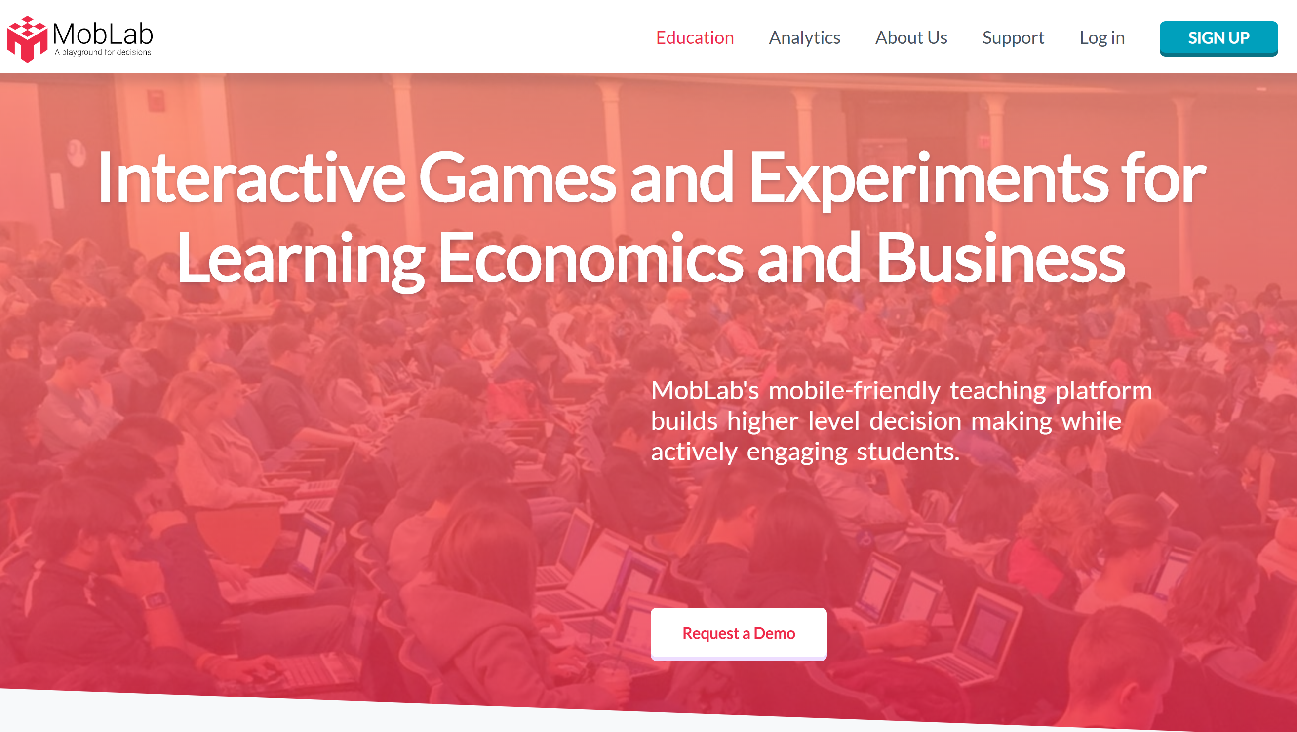
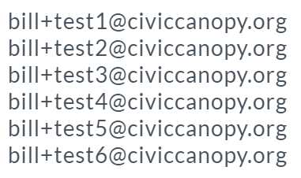
www.moblab.com
Log in as one of the Following:
Password is moblab123
Scroll over the Default Class and select “Join”

Slide 25

push and pull
overview
  matched with the same other player for a number of rounds
  each round, each simultaneously chooses either Push or Pull
  Push increases your match’s payoffs; Pull increases your payoffs
  Match choosing Push increases your payoffs; her choosing Pull increases hers
9A Playground for Decisions
9

Slide 26
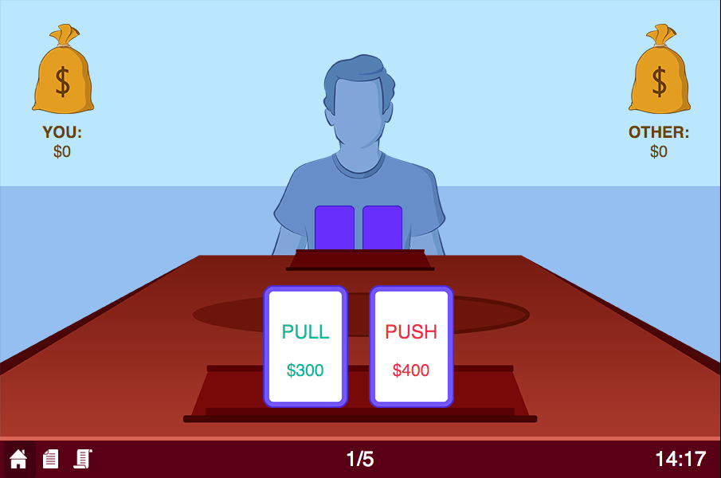

your game screen
current round/total number of rounds
9A Playground for Decisions
9

Slide 27
your game screen
actions and payoffs
9A Playground for Decisions
9

Slide 28
your game screen
click a card to choose an action
9A Playground for Decisions
9

Slide 29
your game screen
happy playing!
to see previous choices
9A Playground for Decisions
9

Slide 30
Polarity Management

Slide 31

+ / Strengths
Creativity
Honors what has proven to be effective
Provides a sense of continuity
Familiar and comfortable
Continuous improvement
Innovation
Adapt to meet new needs
Tradition
Unleashes new possibilities
Often disruptive
Creates a feeling of uncertainty
Harder to plan for
Might not be effective
Can become outdated, not able to meet current needs
Can feel stifling, rigid
Discounts current needs and prefers historical patterns
- / Weaknesses

Slide 32
Applying Polarity Management
Take a minute as a coalition team to identify any polarities that your coalition might be facing, such as:
  Stability/structure vs. flexibility/fluidity
  Distributed leadership vs. centralized decision making
  Individual interests vs. community needs
Work through a polarity map to fill in all quadrants and identify potential ways to manage the polarity

Slide 33
+ / Strengths
- / Weaknesses

Slide 34
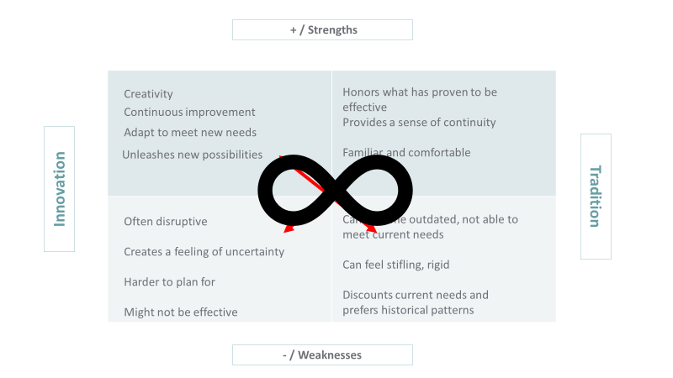
How Do We Maintain the Positive?
How Might We Both __ AND __?
How Do We Maintain the Positive?
What Are the Early Warning Signs?
What Are the Early Warning Signs?
What Do We Most Fear?

Slide 35
Guidance
Make sure it’s a true polarity, not option or priorities masquerading as a polarity
  Government as fiscal sponsor vs. nonprofit as fiscal sponsor
  More programs vs. more places
Be on the lookout for “lobbying” while doing this. Telltale signs are:
  Difficulty filling in the weaknesses of your preferred pole
  Over-eagerness to point out the weaknesses of the opposing pole
  Feeling a need to convert others to your position
  Best antidote: focus on a “4 quadrant view” instead of a debate

Slide 36
Applying Polarity Management
Take a minute as a coalition team to identify any polarities that your coalition might be facing, such as:
  Stability/structure vs. flexibility/fluidity
  Distributed leadership vs. centralized decision making
  Individual interests vs. community needs
Work through a polarity map to fill in all quadrants and identify potential ways to manage the polarity

Slide 37
Gallery Walk Share Out
One person stays as an ambassador to explain the map to visitors, others go visit other tables
Ambassador takes a few minutes to explain overall conversation
Visitors share insights and additional solutions via sticky notes
Photograph your final map to share with your team
Bonus: Upload to Civic Network

Slide 38
Assessing Collaborative Capacity

Slide 39
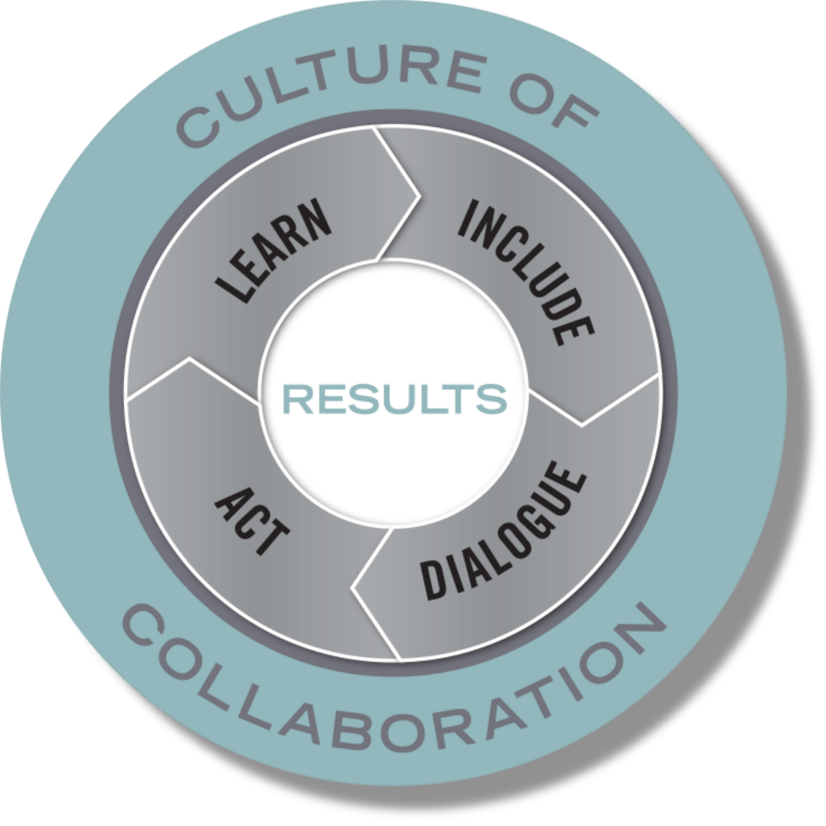
Community Learning Model
Synthesis of research on effective teams and collaboratives
Correlation between the quality of process and quality of population outcomes
Provides a way to think about the ongoing work of creating collective impact through continuous improvement
Notes:
Canopy’s Community Learning Model

Slide 40
Notes:
In a spirit similar to other collective impact models, The Civic Canopy supports groups to design and facilitate collaborative work suing a research-based Community Learning Model that focuses on results, includes relevant and diverse stakeholders in thoughtful dialogue, and develops action plans and structures for learning from results—all within a culture of trust and collaboration.
The Community Learning Model Rubric is intended for groups to assess where they are in their collaborative work and identify where they would like to focus their time and attention. The rubric is NOT intended to rate the quality of collaborative work. Instead, it is a tool designed to support collaboratives through the developmental process of building a culture of collaboration. Routine use of the rubric will also help identify what types of supports, services, and expertise The Civic Canopy can provide, tailoring support along the way. This tool is meant to be completed at the beginning and end of an efforts work with The Civic Canopy, and ideally is used throughout the group’s work to assess progress and identify areas for focus.

Slide 41
Assessing Your Coalition’s Collaboration
Assess your coalition
  1 poster per group
  2-3 coalitions per group
  Use sticky notes (one color per coalition) to mark your scores
Discussion
  Share with group members reasons why you evaluated yourself the way you did
  Provide potential strategies for improvement to group members based on your coalition experience
Rotate

Slide 42
Tips for Evaluation
Increased risk for conflict?
  Increase anonymity
Support outliers
  Make room for the empty chair
Short on time?
Feeling stuck?
  Try brainwriting to produce new ideas or strategies
Put the focus on continuous learning

Slide 43
Pulling it All Together

Slide 44
Preparing for Interim Strategic Planning
What does it look like for your coalitions to approach this interim strategic planning with a new-found sense of possibility given where you are in the eco-cycle?
What reflections and/or tools from today can support you and/or your broader coalition function better at each level?
  Theoretical level
  Strategic level
  Tactical level
  Emotional level

Slide 45
4 Layers of Complex Collaboration
Level | Description
Theoretical | Relates to underlying principles and theories that explain why we believe things happen the way they do
Strategic | Relates to intentional efforts to organize actions in a way that achieves desired results
Tactical | Relates to specific actions and concrete activities
Emotional | Relates to the personal experience of the work and the relationships involved

Slide 46
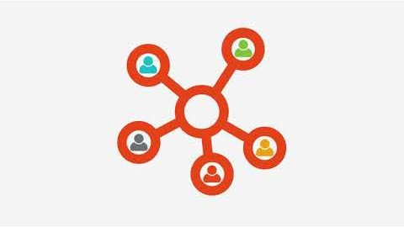
Tool to Connect, Build Collaboration

Slide 47
Go to bit.ly/gocoeval to take our survey.
We appreciate your feedback.

Slide 48


Strengthening Coalition Collaboration
THE MANY WORKING AS ONE FOR THE GOOD OF ALL
Thank You!!!!!
ageno@civiccanopy.org jodi@civiccanopy.org emily@civiccanopy.org bill@civiccanopy.org kalie@civiccanopy.org
www.civiccanopy.org

