Slide 1
Canopy Associates Training 3: Authentic Community Engagement
THE MANY WORKING AS ONE FOR THE GOOD OF ALL
August 23, 2019

Slide 2
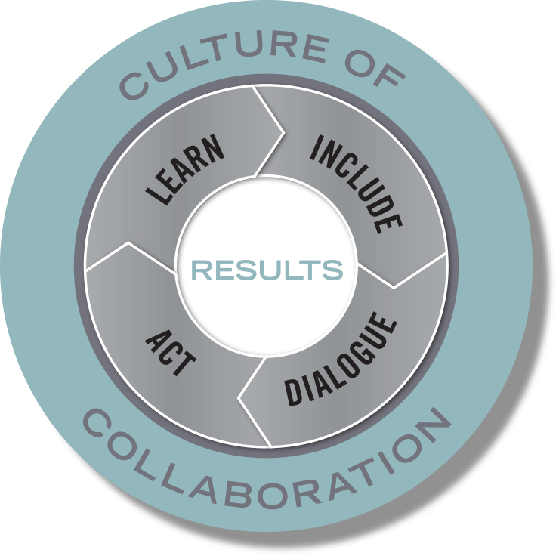
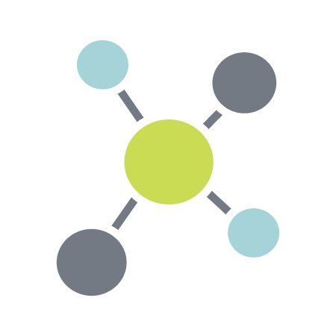
Purpose and Vision: thriving communities in which all participate, prosper, and reach their full potential
Mission: to create the conditions for the many to work as one for the good of all
Build Relationships
Develop Capacity
Catalyze Collective Action
Notes:
Jodi
he Civic Canopy transforms the way pivotal issues are solved by creating a culture of collaboration across Colorado
The Civic Canopy is a community-based nonprofit working to connect diverse groups of people seeking change in their communities
We use a research-based Community Learning Model to drive our work supporting a 3 part platform that:
Builds connections through shared technology;
Builds capacity through training and technical assistance; and
Builds a movement through engagement and advocacy

Slide 3
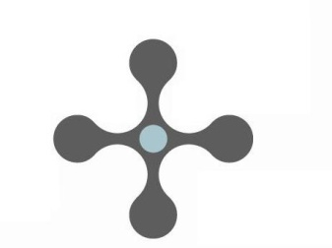
Core Beliefs
Every individual matters and contributes.
Communities are filled with assets and solutions.
The answers emerge from the collective.
Civil society is a place of caring, compassion and love.
Notes:
Jodi
he Civic Canopy transforms the way pivotal issues are solved by creating a culture of collaboration across Colorado
The Civic Canopy is a community-based nonprofit working to connect diverse groups of people seeking change in their communities
We use a research-based Community Learning Model to drive our work supporting a 3 part platform that:
Builds connections through shared technology;
Builds capacity through training and technical assistance; and
Builds a movement through engagement and advocacy

Slide 4
Intended Outcomes
Develop a shared understanding of what authentic engagement looks and feels like in collaborative processes
Understand authentic engagement within the context of power
Apply our understanding of authentic engagement to living case studies

Slide 5
Community Learning Model
Synthesis of research on effective teams and collaboratives
Correlation between the quality of process and quality of population outcomes
Provides a way to think about the ongoing work of creating collective impact through continuous improvement
Notes:
Canopy’s Community Learning Model

Slide 6
Include

Slide 7
The Power of Inclusion
Meet people where they are and not where you want them to be
Increases creativity
Increases support for solutions
Provides legitimacy for interventions
And. . .
Increases likelihood of conflict
Increases complexity of process
Notes:
The phrase “nothing

Slide 8
So What is High Quality Process?
Fairness—those affected by a decision have input into the decision
Equality—affords all stakeholders equal opportunities to contribute and influence outcomes irrespective of role or background
Goal-orientation—people’s efforts are focused on the common good, not just advancing individual interests
Authenticity—stakeholders feel they can make binding commitments without those being rescinded by agents with higher levels of authority

Slide 9
The Transfer of Commitment
High Quality Process
Commitment
Cooperation
Effectiveness

Slide 10
So. . . If inclusion is related to high quality process. . .
What steps can we take to improve our process?

Slide 11
Dialogue

Slide 12
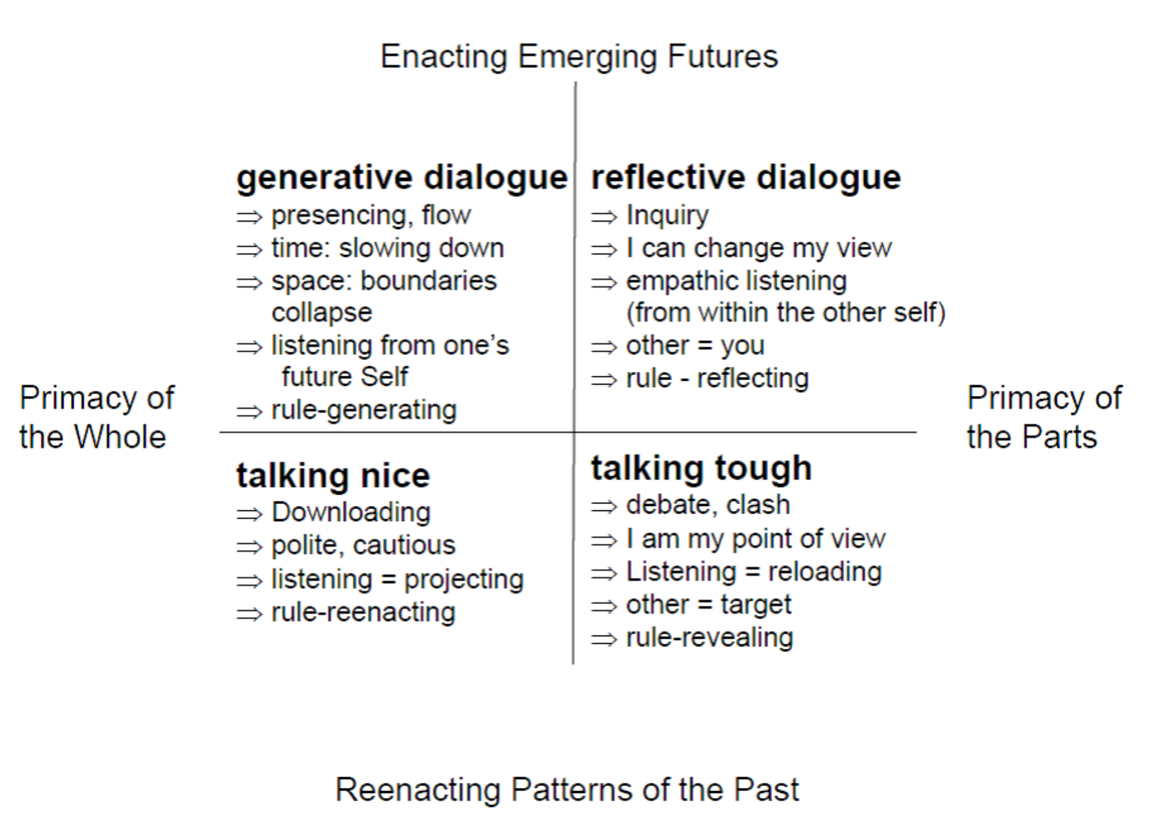
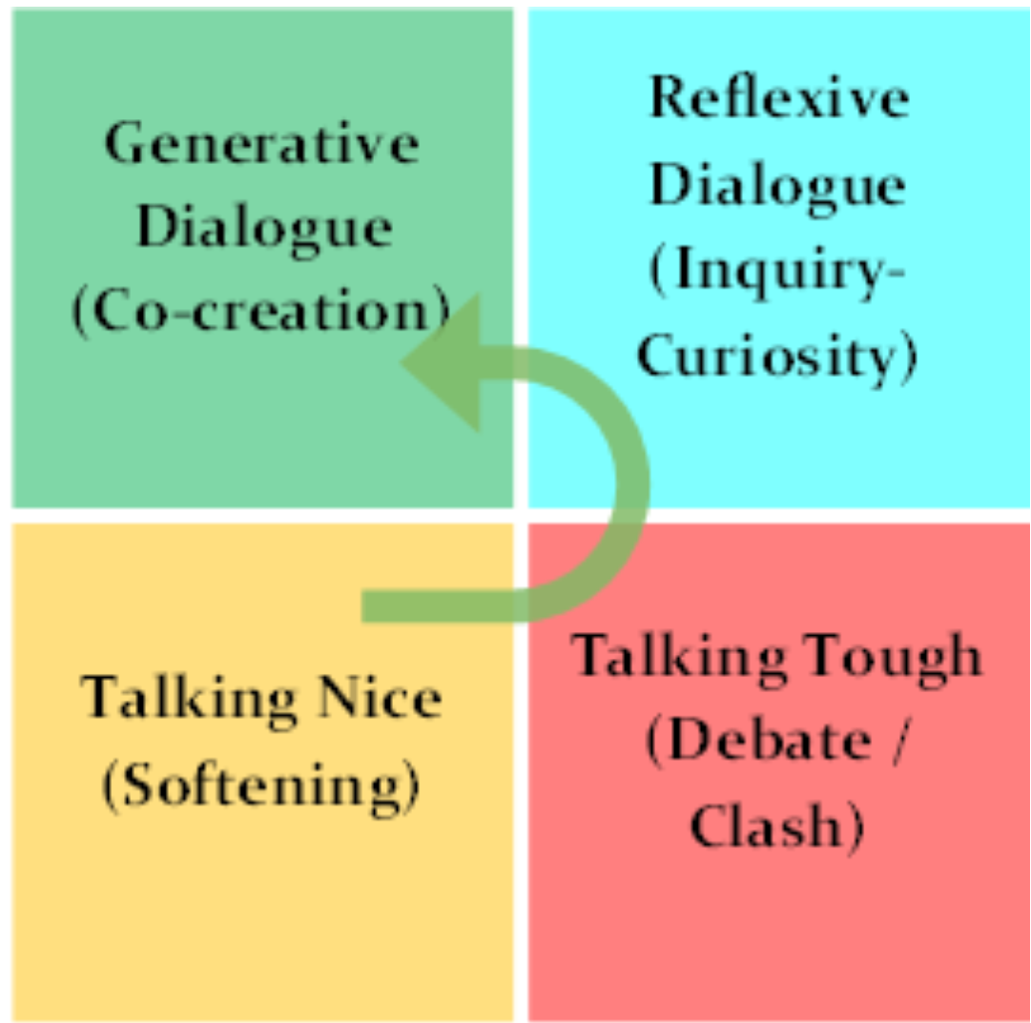
Dialogue: The Art of Thinking Together
From Otto Scharmer, Theory U
Notes:
Dialogue comes from the Greek works dia or “through” and logos or “meaning”—creating a flow of meaning between people, or learning to think togethr

Slide 13
Otto Scharmer: Theory U

Slide 14
Thinking About Power
Power is the ability to achieve a purpose. Power is neither good nor bad, but how it’s used can have positive or negative consequences for those with less power and privilege.
Dr. Martin Luther King, Jr.

Slide 15
6 Main Sources of Power (Eric Liu)
Physical violence
Wealth
State action
Social norms
Ideas
Numbers—lots of humans

Slide 16
Eric Liu: What is Power?

Slide 17
Power Over vs. Power With
Instrumental Rationality | Communicative Rationality
Reaching my objective | Reaching agreement
Getting my way | Mutual understanding
Coercion | Consensus
Power over | Power with
Dominance | Reciprocity
Voting, Aggregating Interests | Dialogue, Deliberation

Slide 18
Notes:
https://www.ted.com/talks/jeremy_heimans_what_new_power_looks_like/transcript?language=en#t-252300

Slide 19
From Command and Control to Community Aspiration
FROM TO
writing a plan building a common commitment
involving experts involving everyone who cares
planning mentality arousing and following our curiosity
a quick plan taking the time for broader engagement
How to Develop a Common Agenda for Collective Impact - Paul Born, Tamarack Institute
Notes:
Fundamental mindset shifts essential to creating a coalition’s shared vision
The field is learning and evolving into best practices that creating/refining a shared vision is
Substantially different from strategic planning thinking and methods
It’s about taking the time and creating the space needed to generate widespread commitment rather than a time constrained process that is all about a product
It’s about valuing and elevating context expertise (those who live the experience) rather than content expertise (those studied in the issue) – both/and
It’s about arousing the curiosity and energy that comes from thinking, sharing, learning together rather than centering around assumptions and givens
It’s about an engagement process rather than about a product – strive to be open, inclusive

Slide 20
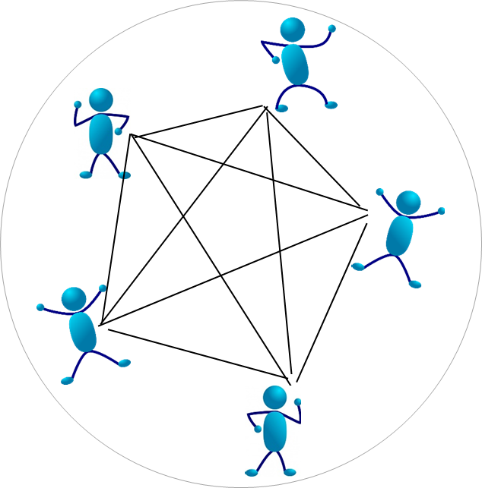
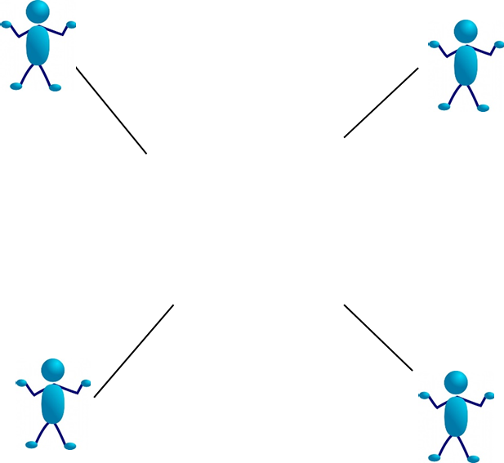
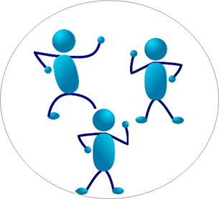
Paradigm Shifts in Engagement
Notes:
Typical paradigm—small group of core leaders, typically white, typically professional service providers, administrators or officials
Trying to engage “those who aren’t involved”—frequently people of color, lower income, and/or underserved.- those at the front line or consumers of services. Often a hierarchical model, “getting buy in” or “seeking input”
Often there is already a means to an established goal and we want to show we have “buy in”
New paradigm: Think of a more reciprocal model where each and every person has a role, voice, function. All come with/from a different perspective, background yet all treated equal and have shared role in establishing and achieving the goal
In the Canopy Community Learning Model, we strive to bring the unheard voices to the table as equal voices recognizing this takes time, energy, commitment and a spirit of learning as try, reflect and adapt

Slide 21
Levels of Involvement
Transactional Involvement | Transitional Involvement | Transformational Involvement
Communication: One-way from the collaborative to the community
Communication: Two-way, mostly collaborative to the community
Communication: Two-way equal collaborative to community and community to collaborative
Examples:
Public Report Card release
Information/Training sessions
Awareness Campaigns
Social Media
Examples:
Community Advisory Committees
Community Dialogues
Community Calls to Action
Examples:
Issue specific workgroups
Joint decision-making
Co-ownership of outcomes
More People Involved Deeper Level of Engagement
Notes:
Strive has a model that describes this evolved thinking of a continuum of engagement. It describes the differences along with the variation in depth of engagement and numbers potentially engaged
Transactional-
more about informing community and bringing about awareness of the work.
typically involves more one-way communication through disseminating information.
Has the potential to reach a broad audience although depth of engagement is limited
ex.: community information meeting to share the work underway
Transitional:
More active form of engagement
Involves community in collaborative activities
More two-way communication, however collaborative team often still determines purpose
Ex: campaign to engage community in identifying strategies to increase reading to young children and mobilizing community to do those activities
Transformational:
Deepest level and integrates community into decision-making and problem-solving process
Equal communication across stakeholders and partners
More limited number of people involved at this level
Ex: engaging community to think through and prioritize best approaches to addressing childhood obesity based on the cultural and socio-economic background of those impacted along with the approaches to continually monitor and adapt

Slide 22
Examples in Action
Transactional:
Transitional:
Transformational:
Notes:
Transactional: let's Talk Colorado is funded by a State Innovation Model grant from the Center for Medicare and Medicaid Innovation. The purpose of the funding is to improve the health of Coloradans by providing access to physical and behavioral health care.
The goal of the Let’s Talk Colorado media campaign is to reduce the stigma around mental illness so that people who need treatment are more likely to seek it.
-- seeing increased awareness and discussion about mental health; increased connection to community supports and services; uptake by communities across the state
Transitional:
Transformational: community-driven initiative focused on all children arriving at school healthy and ready to engage in learning. Advisory comprised of 51% or more community/family leaders; the rest are non-profit/service/health care/agency leaders. Equal voice in decision making. resource allocation decided by Council with commitment that all $ stay within the community. Share/rotate chairing meetings and work groups.

Slide 23
Engagement Strategies

Slide 24
Sample Tools in Toolkit
Top 100 Partners
Reciprocity Circles
Community Input Strategies for Defining Results Statements
Discuss with a partner what additional strategies you will add to the list

Slide 25
Applying What We’ve Learned

Slide 26
In Table Groups:
Ask for a volunteer who has an upcoming event, process, meeting, etc. that would benefit from more authentic community engagement.
Consider ways that you can increase inclusiveness through high quality process measures: fairness, equality, goal orientation, authenticity
Consider ways to increase dialogue in your process
Consider ways to transform the way power is shared in your process

Slide 27
Bill Fulton
THE MANY WORKING AS ONE FOR THE GOOD OF ALL
bill@civiccanopy.org
www.civiccanopy.org

