Slide 1
Canopy Associates Training 4:
Getting to Results
THE MANY WORKING AS ONE FOR THE GOOD OF ALL
August 23, 2019

Slide 2
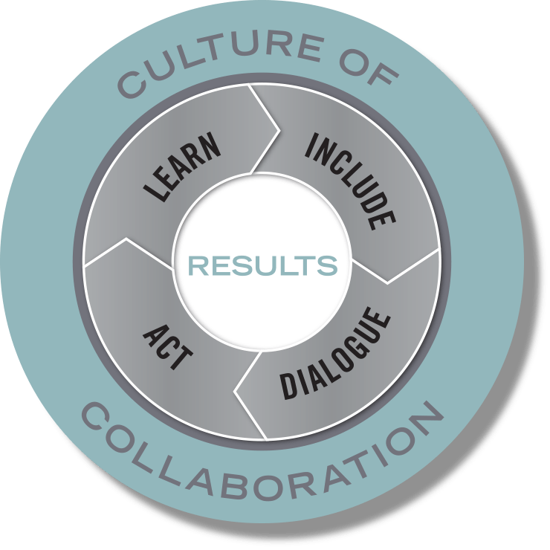



Purpose and Vision: thriving communities in which all participate, prosper, and reach their full potential
Mission: to create the conditions for the many to work as one for the good of all
Build Relationships
Develop Capacity
Catalyze Collective Action
Notes:
Jodi
he Civic Canopy transforms the way pivotal issues are solved by creating a culture of collaboration across Colorado
The Civic Canopy is a community-based nonprofit working to connect diverse groups of people seeking change in their communities
We use a research-based Community Learning Model to drive our work supporting a 3 part platform that:
Builds connections through shared technology;
Builds capacity through training and technical assistance; and
Builds a movement through engagement and advocacy

Slide 3

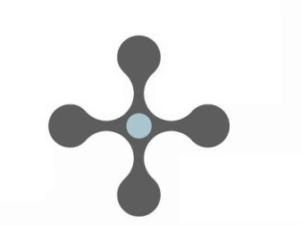

Core Beliefs
Every individual matters and contributes.
Communities are filled with assets and solutions.
The answers emerge from the collective.
Civil society is a place of caring, compassion and love.
Notes:
Jodi
he Civic Canopy transforms the way pivotal issues are solved by creating a culture of collaboration across Colorado
The Civic Canopy is a community-based nonprofit working to connect diverse groups of people seeking change in their communities
We use a research-based Community Learning Model to drive our work supporting a 3 part platform that:
Builds connections through shared technology;
Builds capacity through training and technical assistance; and
Builds a movement through engagement and advocacy

Slide 4
Training Outcomes
Understand a results-based approach including population-level results, performance indicators and strategies developed to “Turn the Curve.”
Understand the key elements in developing an Action Map.
Understand strategies and structures that help sustain Action Teams within a results-based framework.

Slide 5
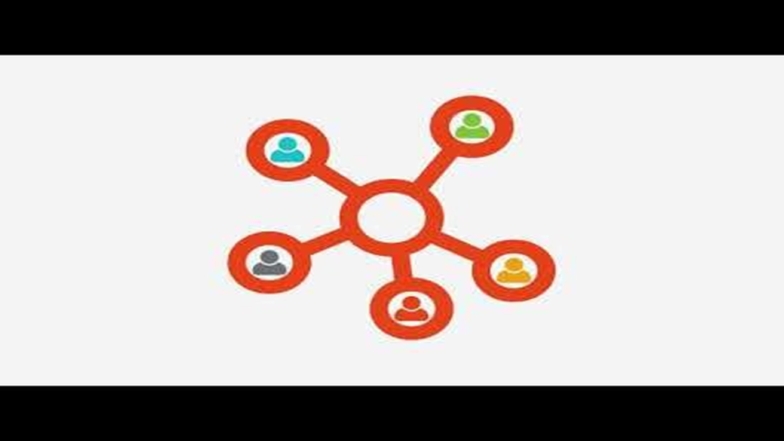
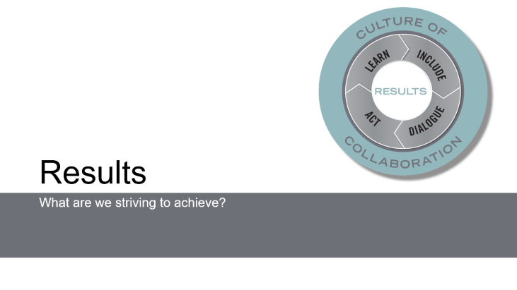
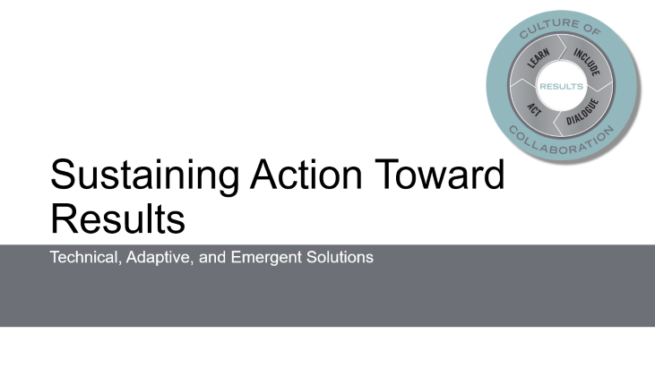
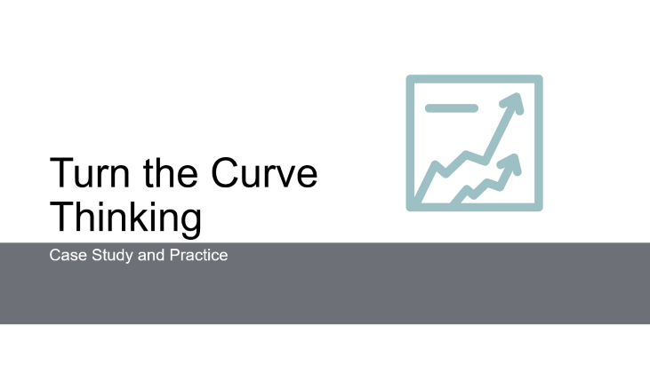
Presentation in Brief

Slide 6
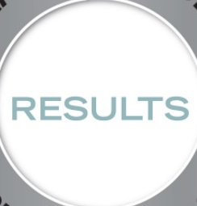
Results
What are we striving to achieve?
Notes:
At the core of all successful collaborative work is a set of identified, shared results. WHAT we are striving to achieve.

Slide 7
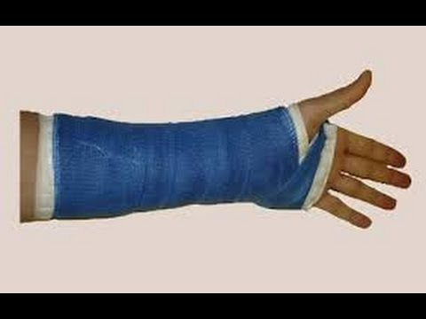


Problem Types and Solution Orientations
Definition of Problem | Definition of Solution | Kind of Challenge | Type of Solution | Examples
Clear | Clear | Simple | Technical Problem Solving
Clear | Unclear | Complicated | Adaptive Strategy
Unclear | Unclear | Complex | Emergent Solutions
Adapted from Ron Heifetz, Leadership Without Easy Answers, 1994, and Fourth Quadrant Partners, A Whole Greater Than Its Parts, 2018.

Slide 8
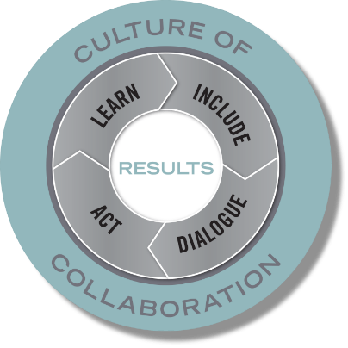
The Big Picture:
A Framework for Complex Collaboration
Key partners aligning efforts. . . |  | around strategies that make a difference. . . |  | on measures at a population level. . . |  | leading to our desired future.
Organizations and Institutions | Residents and Community Members | Strategies | Performance Measures | Results | Indicators | Shared Vision
Reinforced by a set of ongoing supports:
Continuous communication Collaborative infrastructure and routines |  |  |  | Shared data Mutual accountability Sustainable resources
Notes:
bill

Slide 9
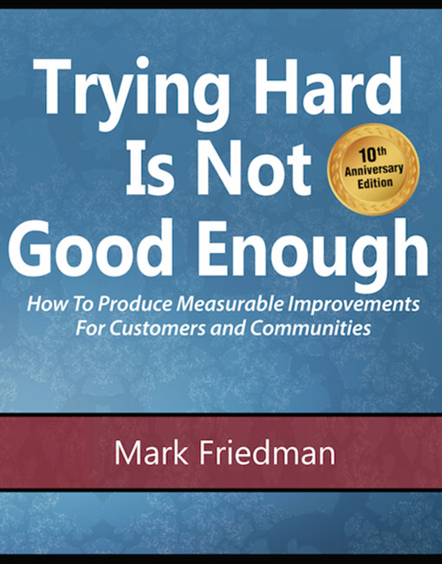



Based on the work of:

Slide 10
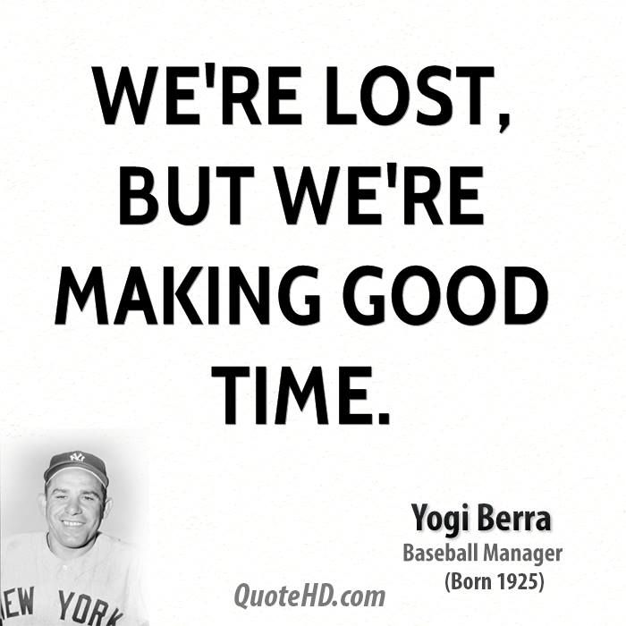
Quotehd.com
Notes:
Joke that points out the different ways we can think of measurement—do we know where we are going, and are we making good progress. We need both—often we only have one.

Slide 11
Key Definitions
Colorado has a prosperous economy.
Arvada is a safe and supportive community.
All Jeffco residents with developmental disabilities are supported
RESULT
A condition of well-being for children, adults, families or communities.
Population Accountability
Employment rates
Violent crime rates
Mental health supports available
INDICATOR
A measure which helps quantify the achievement of a result.
1. How much did we do?
2. How well did we do it?
3. Is anyone better off?
PERFORMANCE MEASURE
Performance Accountability
A measure of how well a program, agency or service system is working.
Notes:
Let’s start with some key definitions…
So breaking down these levels of accountability…
At the HIGHEST LEVEL on the population accountability level, we have RESULTS…..
On the population level, which you will remember is concerned with whole populations, we call a result a condition of well-being…
Indicators are measures which help quantify the achievement of a result. So, for example, the rate of low-birthweight babies helps quantify whether we're getting healthy births or not…
Performance Measures are measures of how well public and private programs and agencies are working. The most important performance measures tell us whether the clients or customers of the service are better off. Remember, this is only for the clients you may serve (for a council this could be complex, and we’ll talk about this later)
If you’re a hospital and one of your results is healthy babies and % of low birthweight babies in your community is your indicator, what might a good performance measure be? (i.e. your own hospital’s rate of low birthweight babies, # of parents served by prenatal classes, etc.)
The principal distinction here is between ends and means. Results and indicators are about the ends we want for children and families. And strategies and performance measures are about the means to get there.
CFF: Already have Performance Measures in place, all working on SDOH’s—working to track their impact connected to clientele, but this can help us visualize and understand how your work at the Performance Level can connect to a bigger, shared result or outcome – that is how Collective Impact can fit in.

Slide 12
Language Discussion
Always go back to the original idea:
Ideas | Group 1 | Group 2 | Group 3
1. A condition of well-being for children, adults, families and the community. | RESULT | OUTCOME | GOAL
Notes:
When there’s confusion about a particular term, always go back to what the original idea is (i.e. is this a condition of wellbeing or is it a measure, strategy? Etc.)
Brainstorm: when we say the term RESULT, what are other terms people often use to distinguish? How can they be easily misinterpreted?

Slide 13
Population & Performance Accountability
POPULATON Accountability
is about the well-being of
WHOLE Populations
For Communities – Cities – Counties – States - Nations
PERFORMANCE Accountability
is about the well-being of
CLIENT Populations
For Programs – Agencies – and Service Systems
Notes:
A core part of RBA is distinguishing between two levels of accountability….
Accountability for whole populations, like all children in Los Angeles, all elders in Chicago, all residents of North Carolina. This first kind of accountability is not the responsibility of any one agency or program.
Performance Accountability, is about the wellbeing of the client’s you serve . It’s about the programs and services we provide, and our role as managers, making sure our programs are working as well as possible.
These are two profoundly different kinds of accountability

Slide 14
Key Distinction
Results & Indicators
are about the ends you want to see.
Performance Measures
are about the means to get there.

Slide 15
Key Definitions
Colorado has a prosperous economy.
Arvada is a safe and supportive community.
All JeffCo residents with developmental disabilities are supported
RESULT
A condition of well-being for children, adults, families or communities.
Population Accountability
Employment rates
Violent crime rates
Mental health supports available
INDICATOR
A measure which helps quantify the achievement of a result.
1. How much did we do?
2. How well did we do it?
3. Is anyone better off?
PERFORMANCE MEASURE
Performance Accountability
A measure of how well a program, agency or service system is working.
Notes:
No animation on this slide

Slide 16
Checking for Understanding
% of population in poverty
Children are ready for school
Attendance rates for afterschool programs
% of students graduating high school
Residents eat healthy foods
% who rated a training “excellent”
Number of meals served at food bank
Children live in safe, stable, and supportive
families and communities
INDICATOR
RESULT
PERFORMANCE MEASURE
INDICATOR
RESULT
PERFORMANCE MEASURE
PERFORMANCE MEASURE
RESULT
Notes:
Go back to your definitions and we’ll do a quick pop quiz!

Slide 17

Turn the Curve
Thinking
Case Study and Practice

Slide 18


Turn the Curve
“Getting from
Talk to Action”

Slide 19
Results Thinking in Everyday Life: A Leaking Roof
Experience:
Not OK
Inches of Water
Measure:
? Fixed
Turning the Curve
Story behind the baseline (causes):
Partners:
What Works:
Action Plan:
Notes:
To illustrate the common sense approach of turn the curvy thinking and how we use it in everyday life we will look at a common situation of a leaking roof….
1. How can you tell if the roof is leaking? Water on the floor, down the walls etc.
2. How you measure how badly the roof is leaking- or how serious your problem is – is "by how much water is in your house...” So you might put out a bucket and measure the number of inches in the bucket after each rainstorm!
3. You can see by the 3 data points which represent the number of inches from the last three rainstorms, that the trend is going up and so we can assume that this line is going to keep heading up if you don’t do anything about it.
4.Since you’re not OK with a forecast that says you’re going to have more and more water in your home, you decide to do something to turn the curve on this data line and send it toward zero.
5. So you get up on your roof and you try to find out why your roof is leaking. this is the story behind the baseline, the causes of why this picture looks the way it does.
6. Then you think about who are some of the people who might help you fix the leak? (brother-in-law, neighbor, professional roofer) These are some of your potential partners.
7. Next you consider what works to fix a leak - Patching material, get a whole new roof, sell the house. You have some choices about types of patching material. Some will work better than others. Tar is probably better than duct tape.
8. So now that you’ve got a picture of what’s going on, the important final question is what are you going to do? This is your action plan.
9. Finally you implement your action plan. Maybe you've hired a roofer who's gotten up on the roof and patched it. Next thing you do is wait for the next rainstorm to see if it's still leaking.
If it’s still leaking you get back up on the roof and start the process over again and try something else. This is an iterative process. Hopefully you fix the roof in one pass. But the things we are working on are much more complicated than a leaking roof, and one iteration won't do it.
10. So, this is the whole results thinking process that is at the heart of RBA! It's just common sense. It's how we solve everyday problems. And communities working to improve the quality of life, or managers working to improve their program's performance can use this same process.
11. Notice that we identified the "inches per bucket" measure pretty easily. With a leaking roof, it's obvious what's important and what could be measured. But with programs, agencies and service systems, the choice of what's important and what to measure is much more complex.

Slide 20
Notes:
So now that we’ve distinguished between performance vs. population accountability and defined results, indicators, and performance measures, let’s come back to our Turn the Curve Thinking. We opened by looking at the leaky roof situation to illustrate the common sense approach to turn the curve thinking, now I want to tell a story about a group of folks in Prowers County Colorado who went through the turn the curve activity together to move from talking to action.

Slide 21
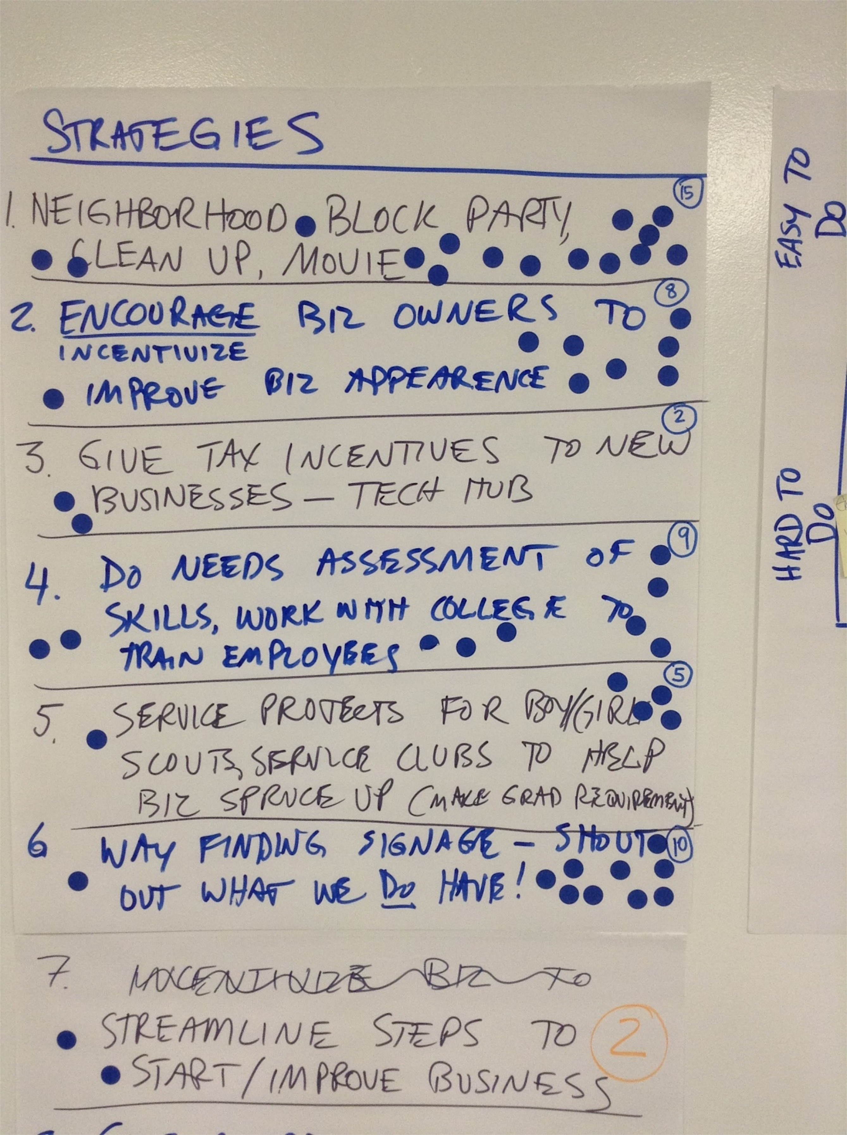
Families choose to stay, live, and invest in Prowers County.
Net Migration Rates
Challenging business environment
City leaders, elected leaders, economic development orgs, business owners, community colleges
Brainstormed list of strategies and prioritized based on strategies with highest feasibility, impact, and interest
Action teams currently working on the top 6 strategies. Each team has an action plan.
Notes:
To review the RBA process of moving from ideas to action.
The result that Prowers County is driving for is for “families to choose to stay, live, and invest in Prowers County.”
Their indicator to quantify the achievement of this result is Net Migration Rates.
They found that the trend for this data was not what they wanted and so they wanted to turn the curve on it and so they looked at the story behind the data and found that their county is a challenging business environment. They determined that some of the partners they needed to turn the curve were….
Next they brainstormed a list of strategies…
And then created action teams that are currently working on the top 6 strategies and each have their own action plans.

Slide 22

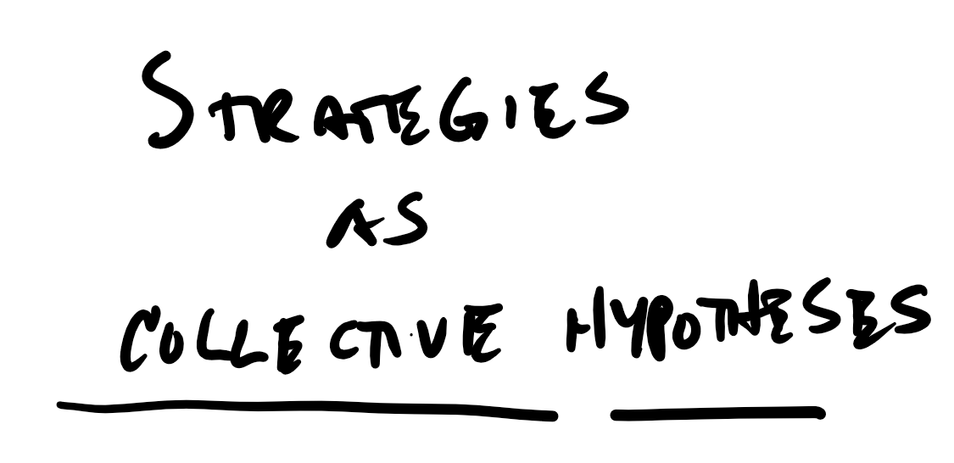
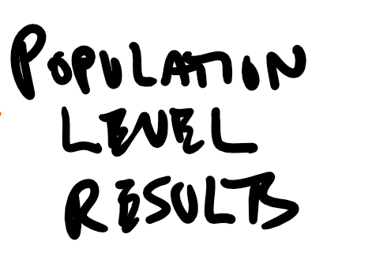


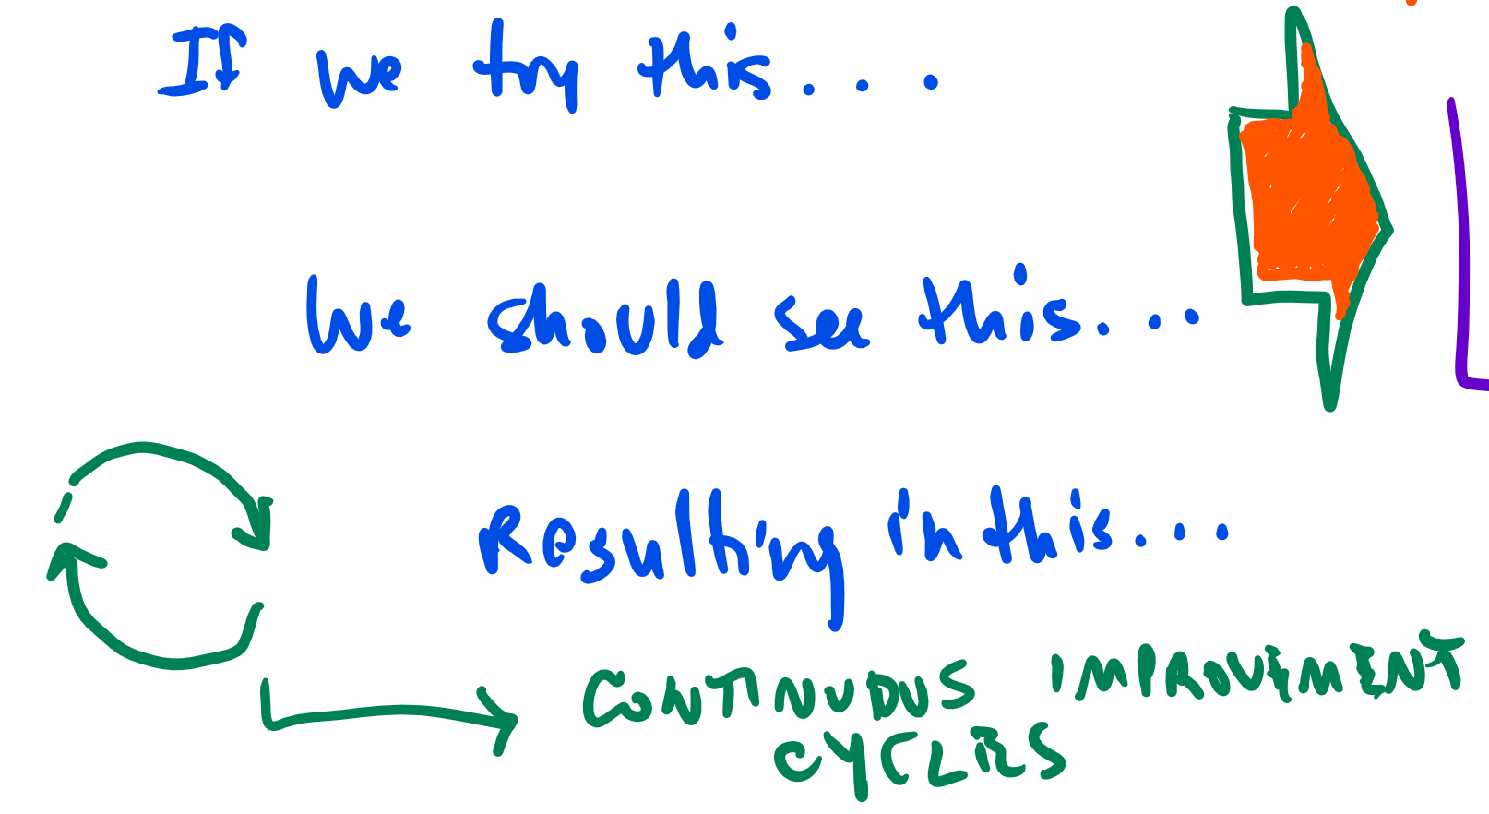
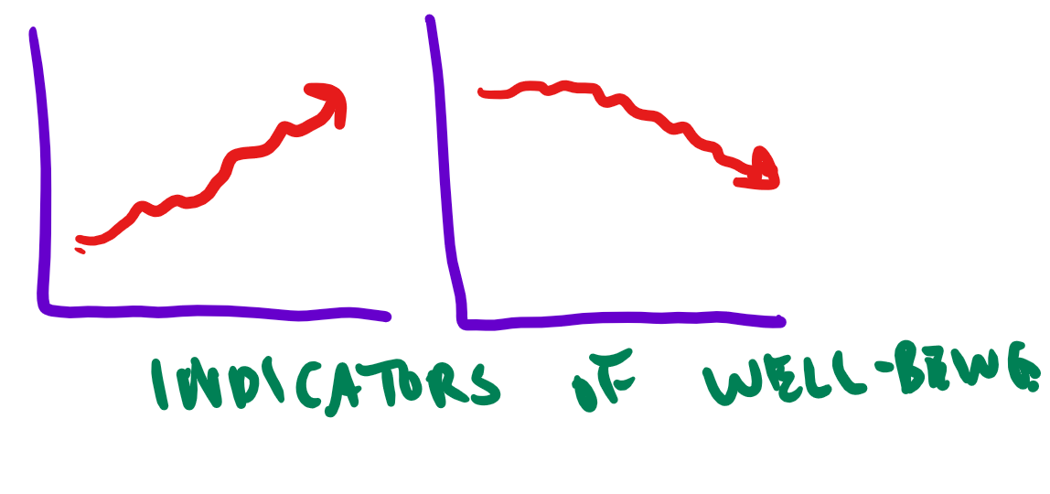

Slide 23
Strategy as Hypothesis Testing
Strategy
Performance
Measure
An organized set of tactics designed to achieve a result
The intended outcome of a strategy
Answers the questions “How much? How well? And is anyone better off?”
Presumes some hypothesis of what should work to get results that can be verified

Slide 24
Establishing Performance Measures
Strategy | Performance Measure | Result/Indicator
Provide afterschool tutoring for lowest performing readers
Recruit 50 Tutors
Improved scores on monthly tests
School Success: All 3rd Graders are proficient in reading
Incentivize local entrepreneurs to create technology jobs
10 SLV residents to enrolled in a Tech Star course
Thriving economy that provides living wages to all

Slide 25
A Framework for Complex Collaboration
Key partners aligning efforts. . . |  | around strategies that make a difference. . . |  | on measures at a population level. . . |  | leading to our desired future.
Organizations and Institutions | Residents and Community Members | Strategies | Performance Measures | Results | Indicators | Shared Vision
Reinforced by a set of ongoing supports:
Continuous communication Collaborative infrastructure and routines |  |  |  | Shared data Mutual accountability Sustainable resources
Notes:
bill

Slide 26
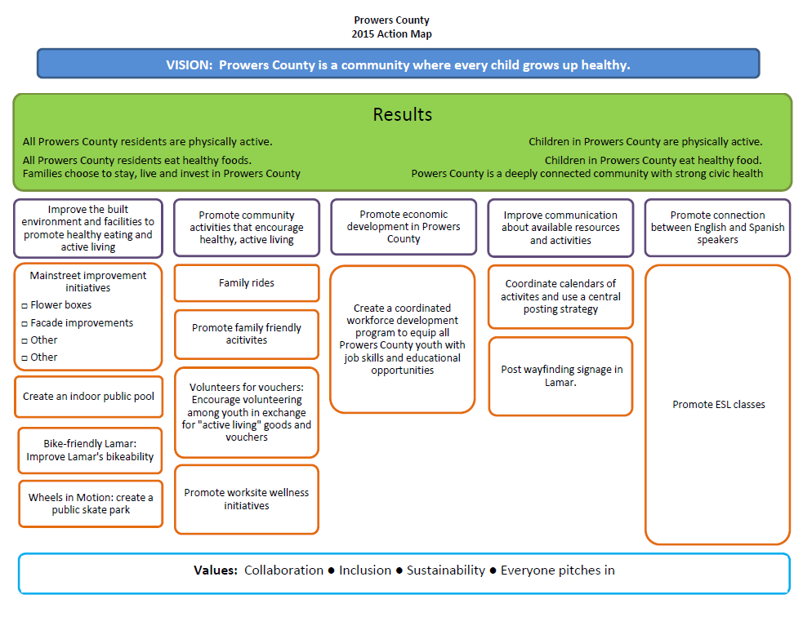

Slide 27
Pulling It All Together
Developing an Action Map

Slide 28
Building and Action Map
With a partner, sort your packet of cards into the basic categories of the Framework for Collaboration (25 min)
  Vision
  Results Indicators
  Strategies Performance Measures
  Key partners who can help turn the curve
  Baseline measures
  Story behind the data
Use the blank cards to add items to each category that you think would help complete the Action Map
Write up a simplified Action Map on a flip chart and report out to the group (2 minutes each per pair)

Slide 29
Sustaining Action Toward Results
Technical, Adaptive, and Emergent Solutions

Slide 30
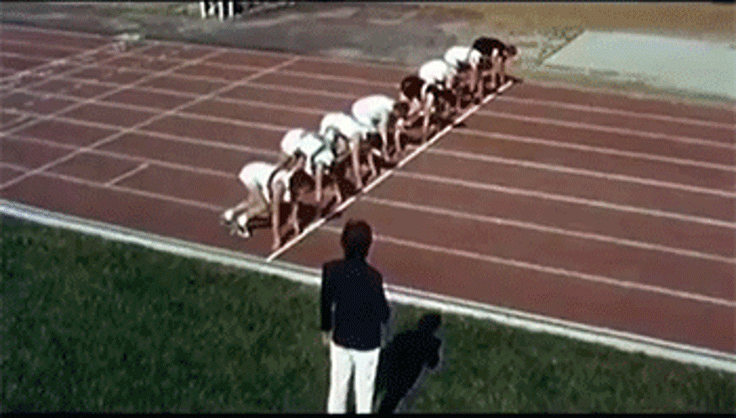
Ready for Action, But. . .

Slide 31
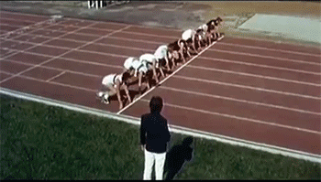
Ready for Action, But. . .

Slide 32
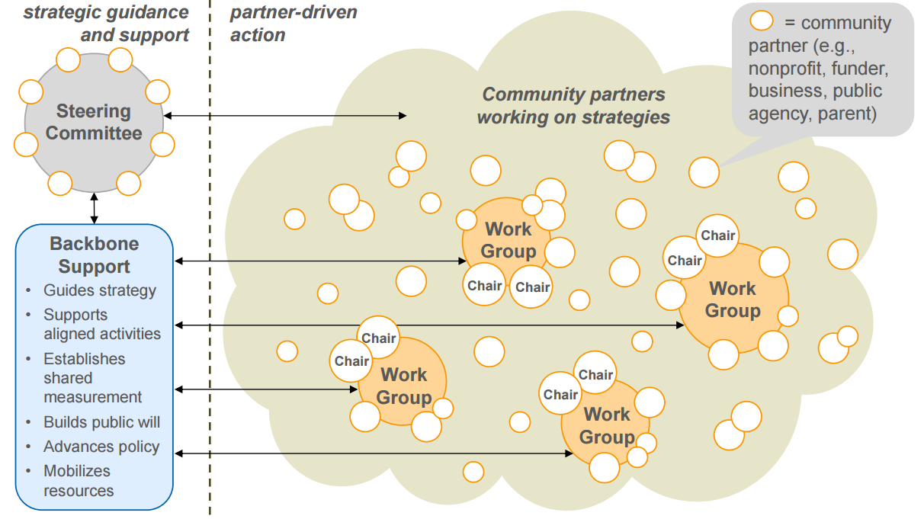
Governance Structure
Notes:
bill

Slide 33

Slime Mold as Emergent Solution

Slide 34
Emergent Solutions
Fourth Quadrant Partners
Line of sight—focus on shared results, and link actions to those results
Freedom to experiment—allow actors to choose their own strategies as hypotheses on how best to achieve results, and track data to test hypotheses
Return learning to the system—structured learning processes for all actors to share their results and learn from each other
Download report
Notes:
Hanna
-Some additional reflections on how the results-based mindset has impacted our work

Slide 35
Comparing Adaptive and Emergent
Adaptive Strategies
Emergent Solutions
Chess: Each actor controls and adapts strategy based on opponent’s response
World War II: Generals develop battle plans, troops execute, Generals adapt global response based on enemy response
Marching Band: Precise movements choreographed and practiced in advance
Sports Teams: Coach sets game plan, but each player is part of creating overall team response
Afghanistan: Generals develop strategy, troops encounter enemy response and must invent local solutions
Jazz Band: Interaction of players creates new songs each time

Slide 36
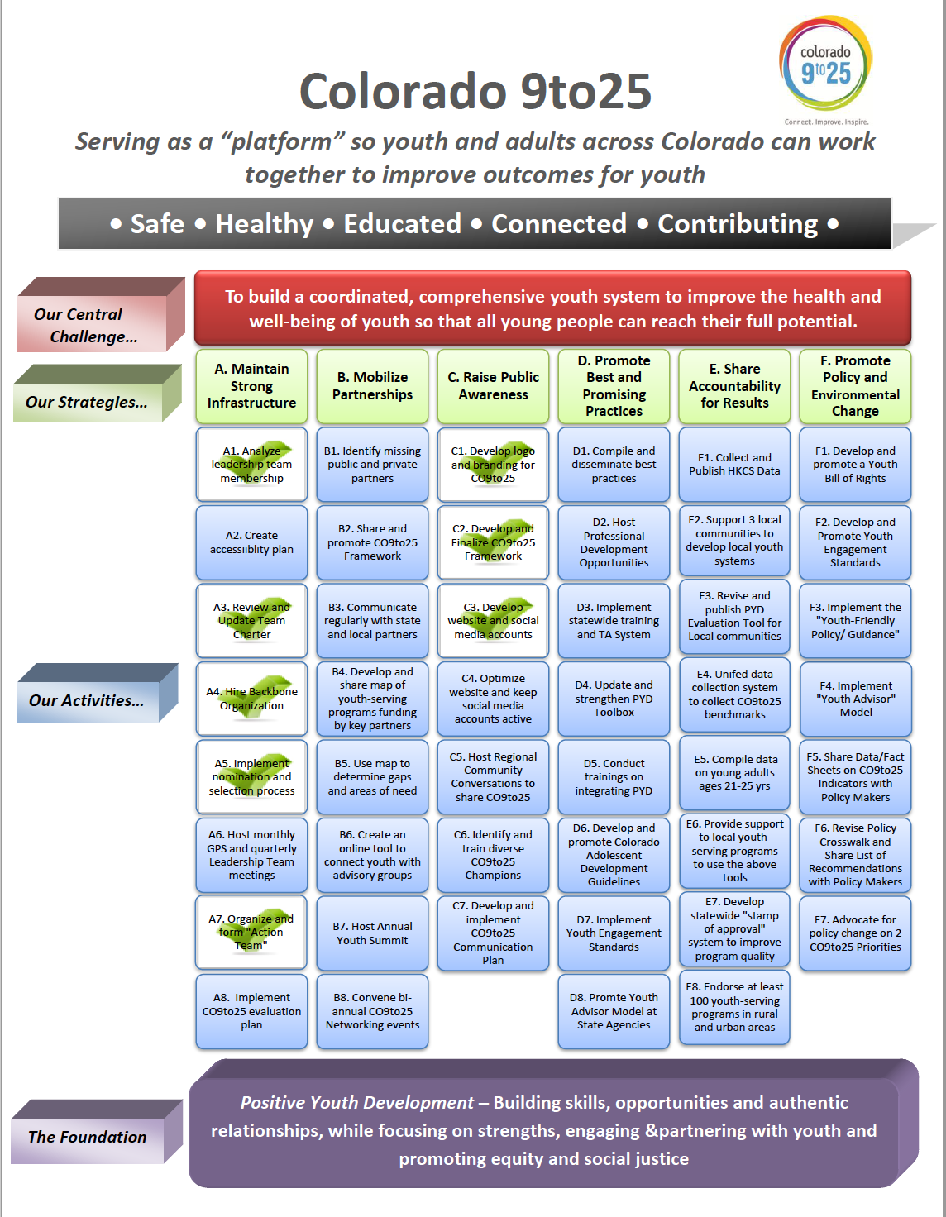
Action Map Characteristics
Allows actors to choose how they want to participate
Builds in accountability to shared results—each action team is “testing a hypothesis” as part of the larger experimental effort
Network sets population results and indicators, action teams set strategies and monitor performance measures

Slide 37
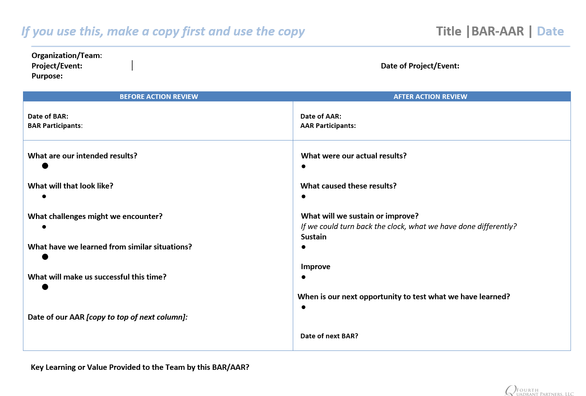
Before and After Action Reviews

Slide 38
Action Team Routines
Check in regularly for short periods of time to ensure the work is moving forward
  Get all contact info for group on sheet
  Establish a Lead or Co-Leads (designate on sheet)
  Set a regular time to connect
  Set a regular number to call or a place to meet
Keep it simple:
  What did we say we would do
  What happened
  What do we do next
Make it easy
  Set a regular schedule for action team meetings
  20 minute conference calls are often helpful as quick check ins in between monthly meetings

Slide 39
Suggestions for Sustaining Momentum
Action teams continue to work and track progress
Core Team continues to meet monthly to coordinate among groups
  Expand to include reps from all action teams and other voices in the community
Ongoing communication about progress across the work groups
Work toward an annual community gathering when the time is right to update baseline data and review progress

Slide 40
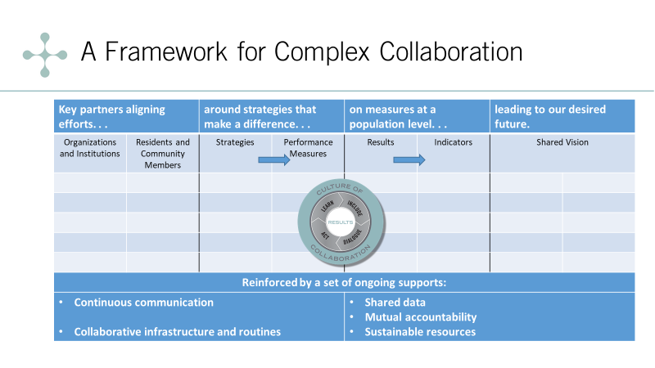
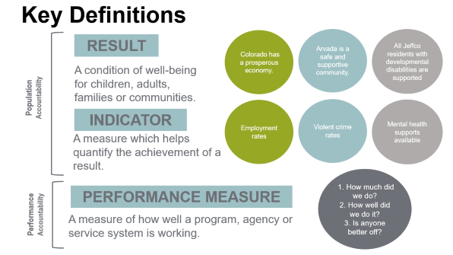
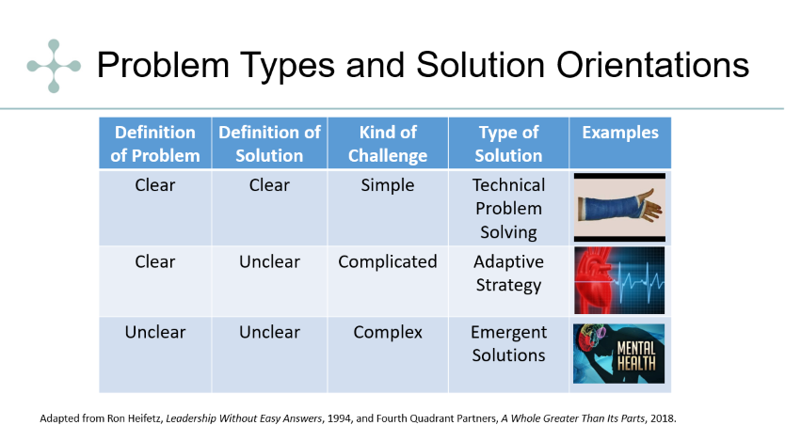
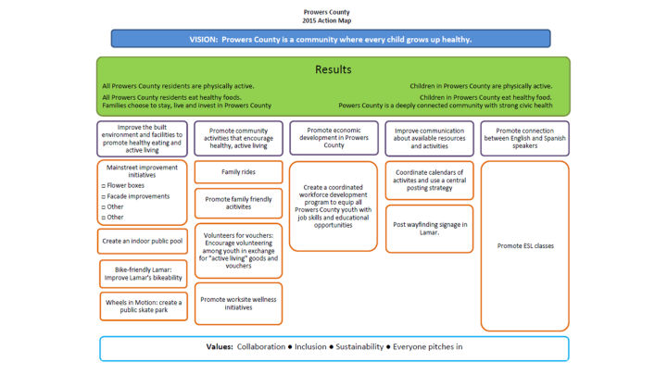
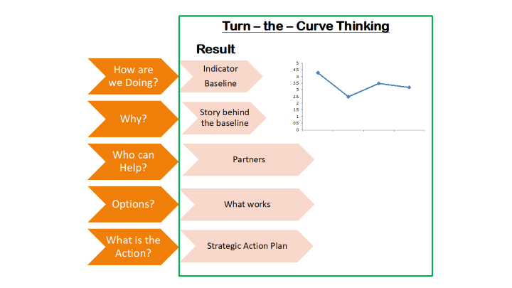
Let’s Review. . .

Slide 41

Civic Network – www.civicnetwork.io
Notes:
bill

Slide 42
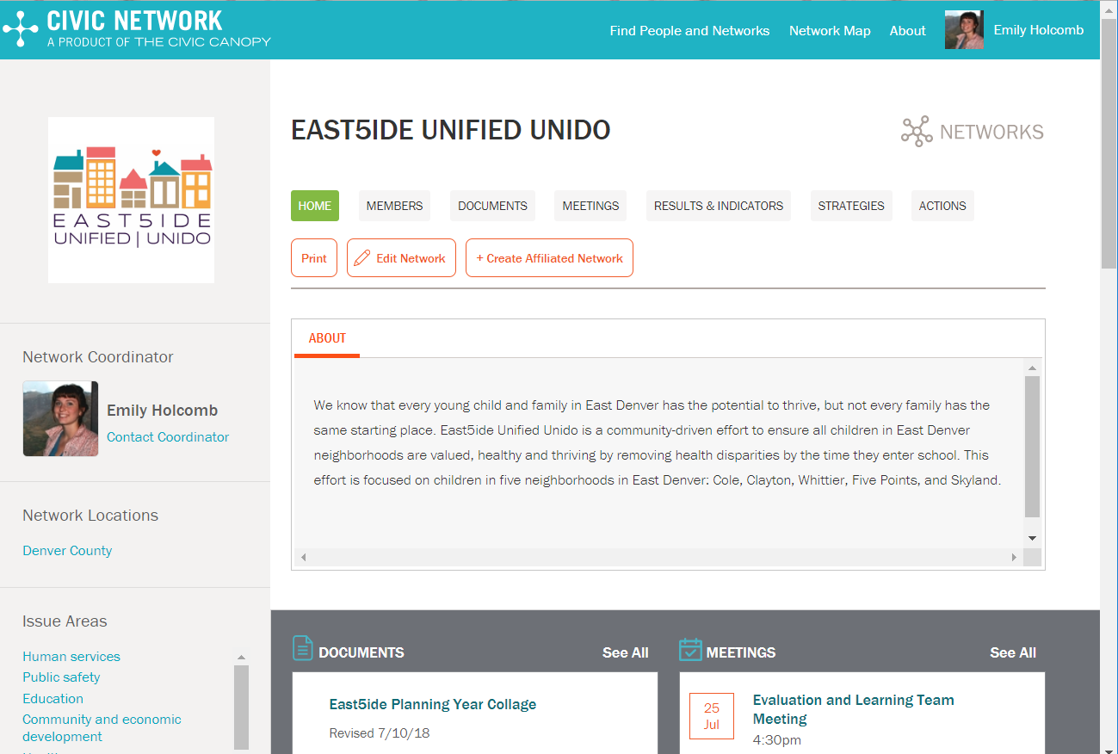
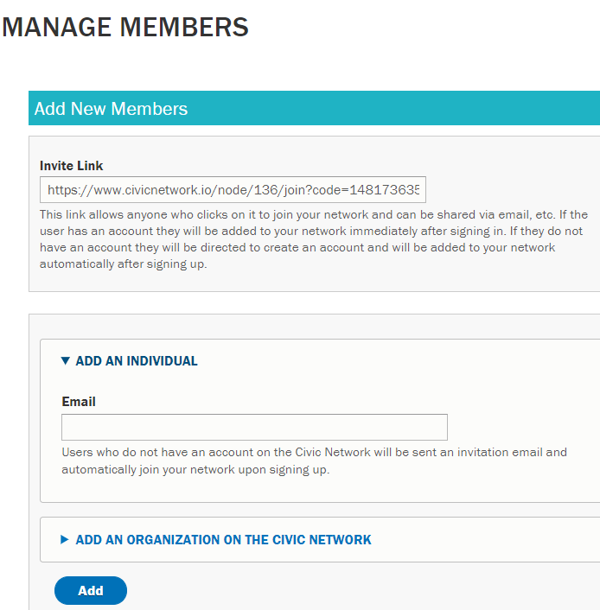
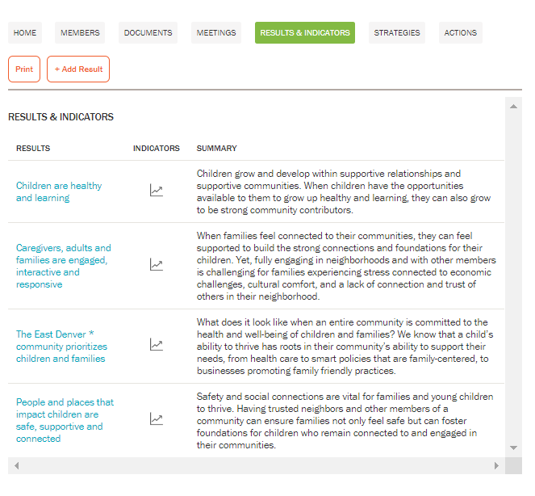
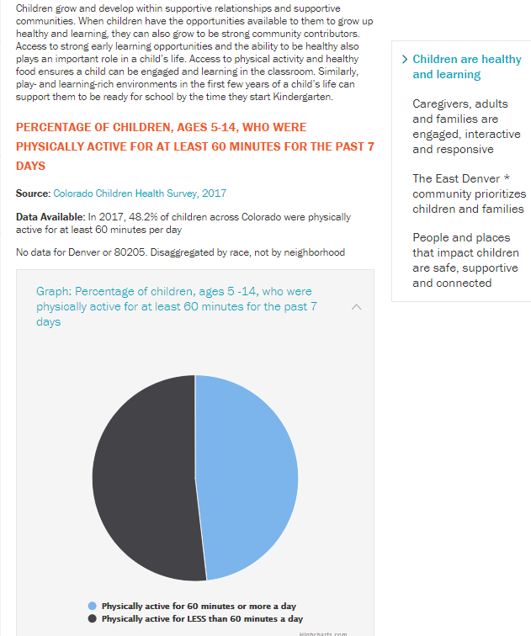
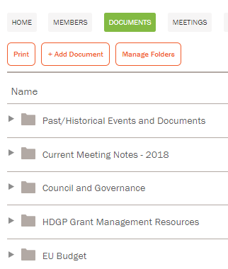
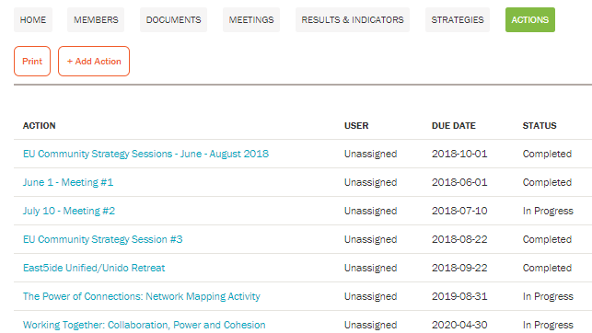
Visit: civicnetwork.io to explore!
Notes:
Civicnetwork.io Main overview
1.Manage members
2. Documents
3. Actions
4. Results and indicators
5. 1 result

