Slide 1
Community Meeting 1
THE MANY WORKING AS ONE FOR THE GOOD OF ALL
Bill Fulton and Kelli Pfaff

Slide 2
Introductions
Round 1: What brings you here today, and what do you hope to contribute?
Round 2: What do you hope to gain from being part of this effort?
Round 3: What does success look like in Durango? What is your vision for this work?
Notes:
Make adjustments based on attendees as needed

Slide 3
Initiative Partners

Slide 4
The Big Idea
This initiative will support three Colorado communities to engage stakeholders to examine a public education challenge, explore its root causes, and design a locally-driven solution.
Support provided through this initiative includes facilitation, communication, and research/data support, as well as project meeting costs.

Slide 5
Project Overview: Durango
The challenge that continues to create significant barriers for our students in Durango is the lack of, and deep need for, coordinated and aligned wrap-around services connected to youth mental health and wellness.
We hope that by the end of this process, our community has the supports, resources, and interagency communications planned and/or available to help our youth population have the resources they need to become the best versions of themselves and barriers that have existed in their lives can be addressed.
Notes:
Top language from the LOI and bottom language from the project kick-off sheet.

Slide 6
Process Overview
Establishing a Foundation
January 2019
Review research on collaboration
Draft result statements
Turning the Curve
April 2019
Reviewing data on indicators
Identifying root causes
Organizing for Action May 2019
Finalize strategies
Launch Action Teams
Defining Results February 2019
Finalize Result Statements
Identify potential indicators
Build Action Map
Drafting strategies

Slide 7
Intended Outcomes: Meeting #1
Strengthen relationships among community members
Establish a collaborative framework for solving community challenges
Create and prioritize draft results statements that describe the desired future for the community
Determine next steps

Slide 8
Making Collaboration Work
The Hard Science of Soft Skills

Slide 9
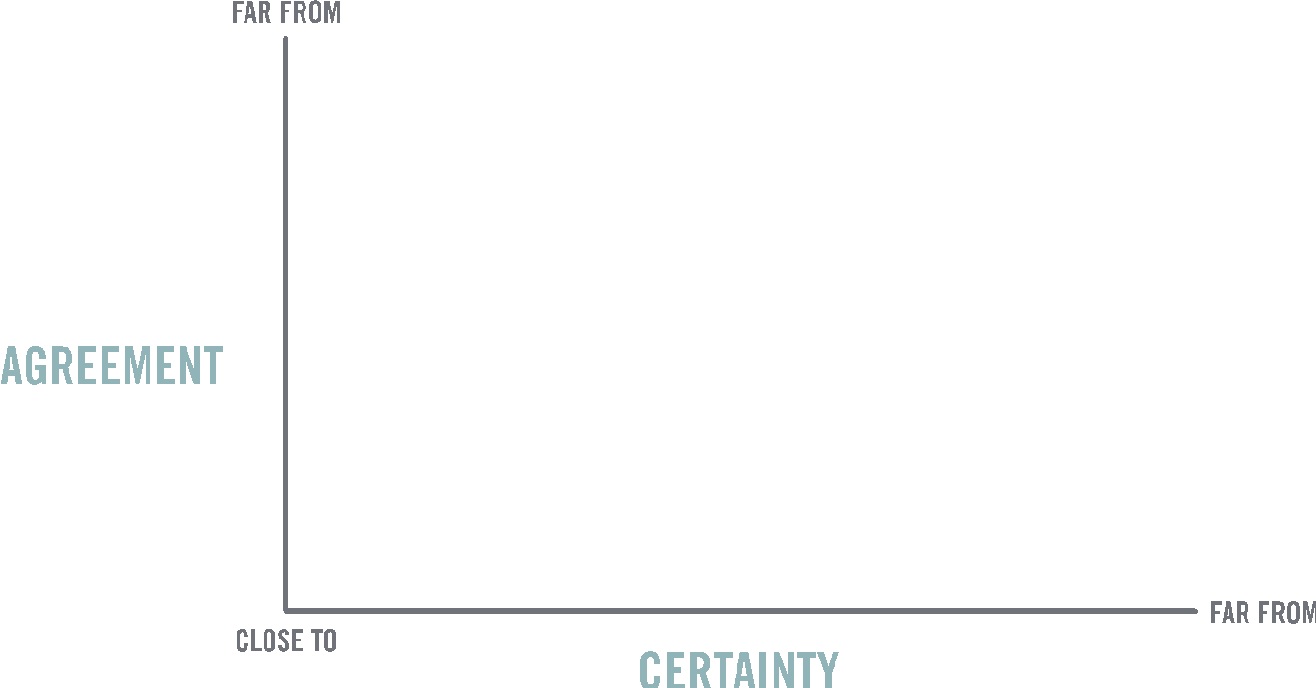
Notes:
Before we dive into the nature of collaboration and collective impact, let’s be clear—this is a method of last resort. Not all problems require this kind of extra layer of work. Ralph Stacey, organizational theorist (https://en.wikipedia.org/wiki/Ralph_D._Stacey)

Slide 10
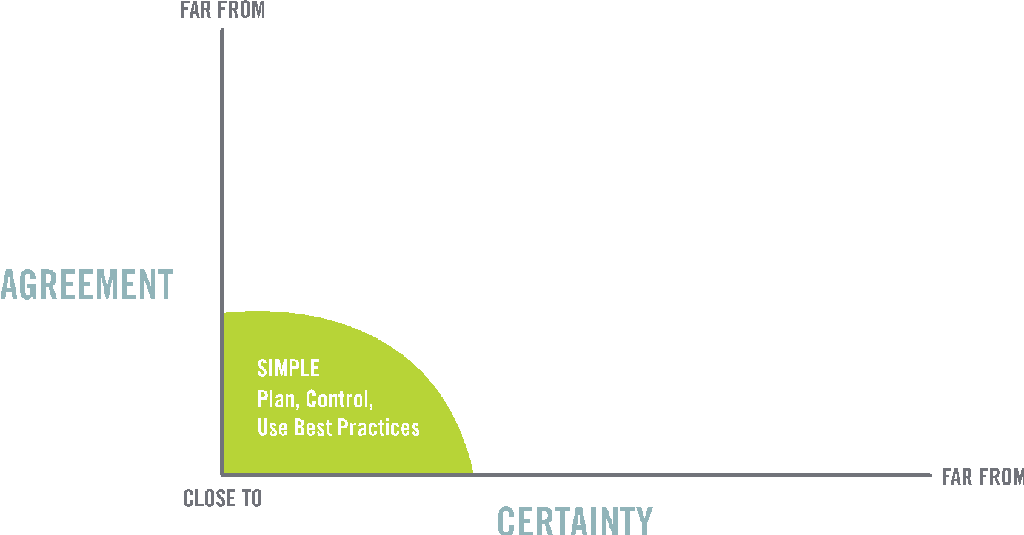
Notes:
He likes this photo but if you have a better idea or something more branded? I told him I would show you and go from there.

Slide 11
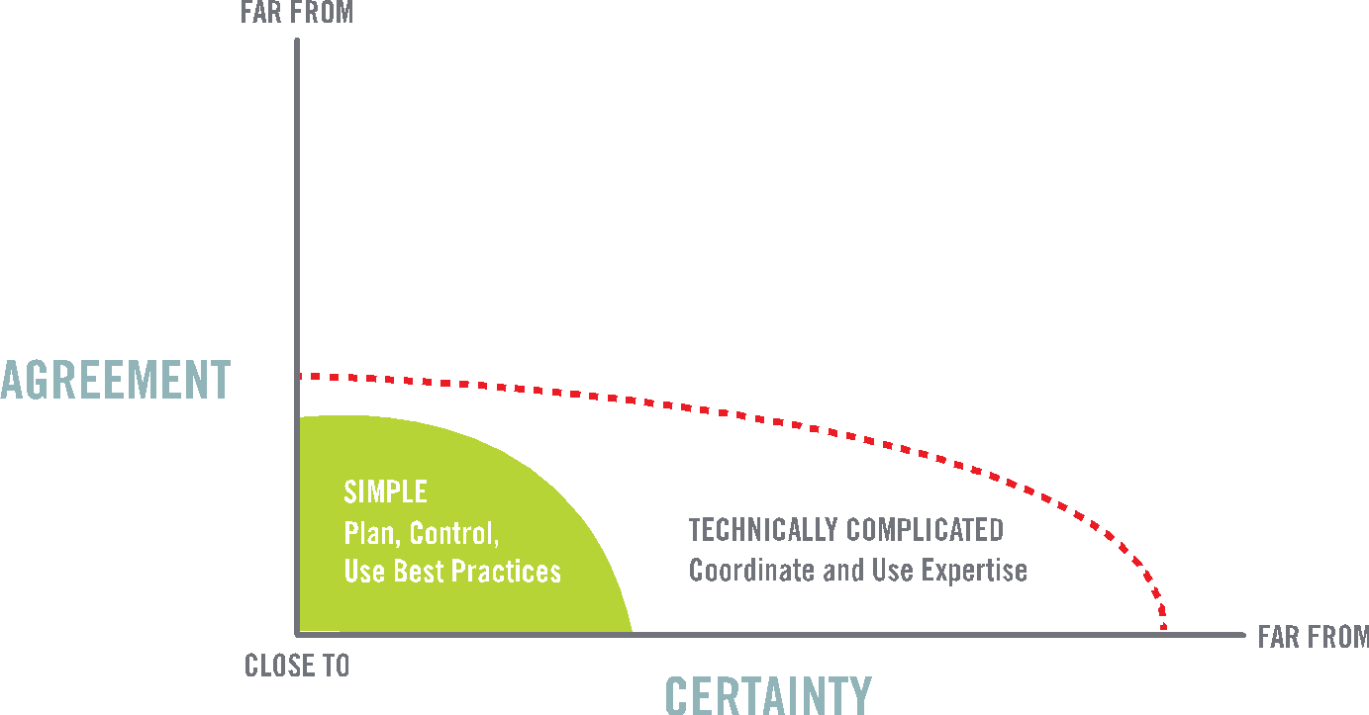
Notes:
He likes this photo but if you have a better idea or something more branded? I told him I would show you and go from there.

Slide 12
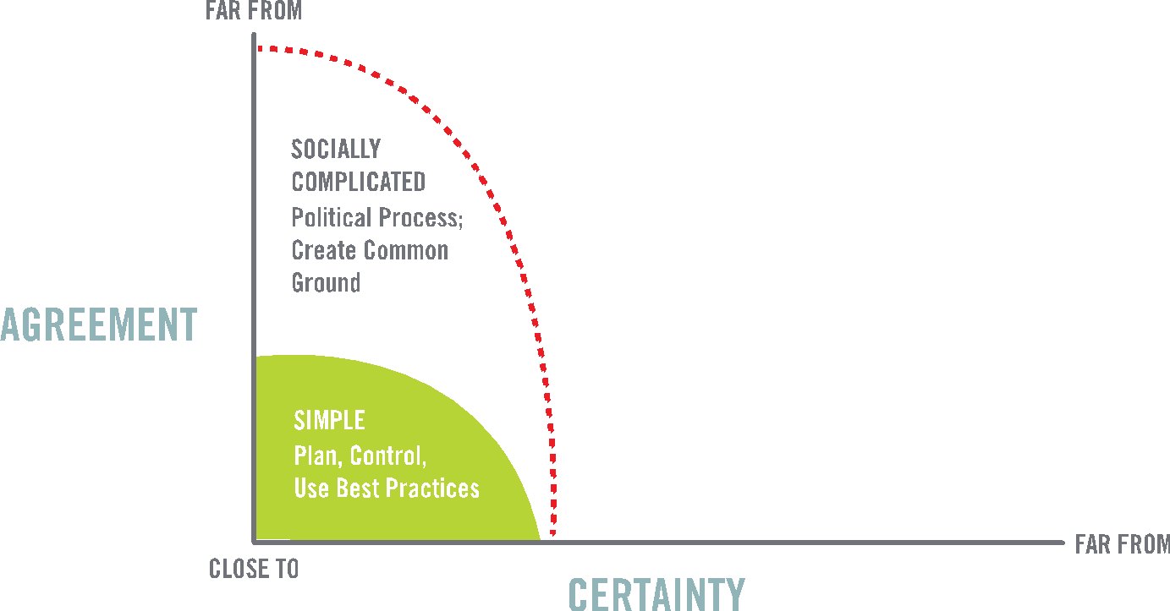
Notes:
He likes this photo but if you have a better idea or something more branded? I told him I would show you and go from there.

Slide 13
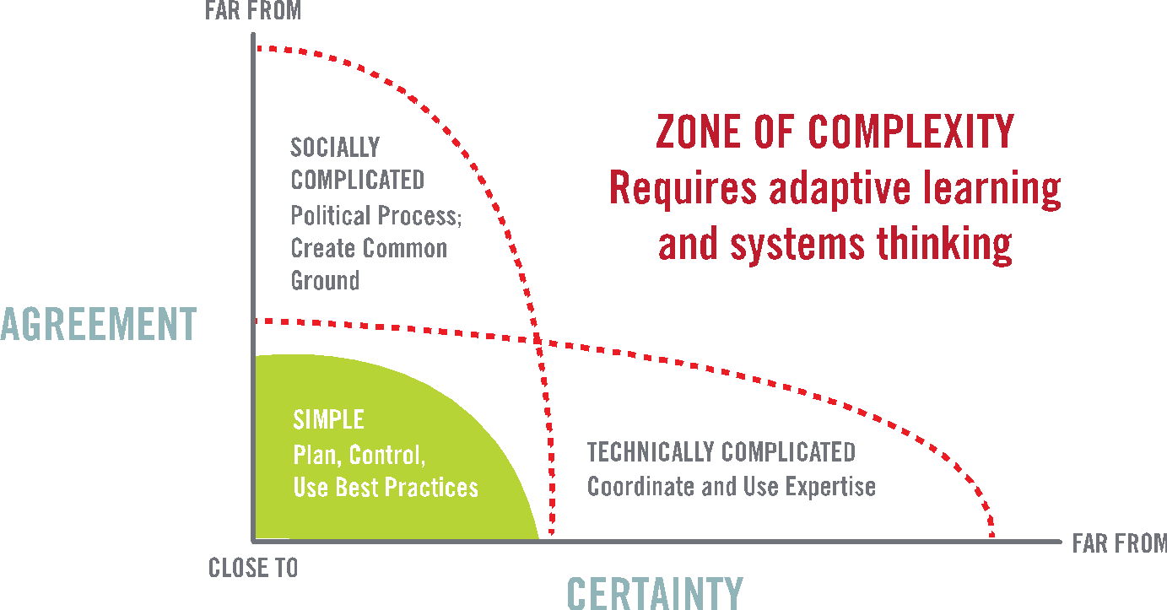
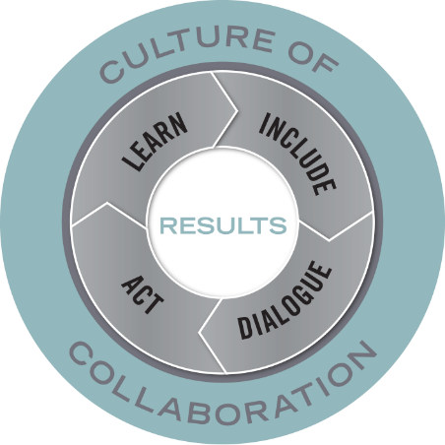
Notes:
Ronald Heifetz presented a new theory aimed at clarifying important distinctions: between technical and "adaptive" problems, and the leadership/approach needed.
According to Heifetz, society is confronted with three types of problems:
-A simple problem is well defined with a clear solution – often includes following a specific set of steps to solve the problem. For example, cooking a meal. We know the outcome and follow predetermined steps to get there. (Or fixing a broken arm.)
-A complicated problem is clearly defined, yet there is not a clear solution. It involves more steps and perhaps even the need for working together. Building a community garden is complicated because we need someone to provide the dirt, seeds, someone to organize plots, someone who knows planting and watering schedules etc. BUT the end outcome is still very clear and doable. (or addressing cardiac disease – understand risk and protective factors, have medical and surgical interventions that are determined by certain signs and symptoms)
-Complex problems lack both clear definition and clear solutions. They require an adaptive approach because the process and outcomes are much more complicated, there is no clear cause-and-effect, they often include values and beliefs and need to evolve based on what works/doesn’t work. The answer isn’t known, and even if it was, couldn’t be addressed by one individual, group, or sector alone--- nor by one strategy alone. For example, addressing obesity in a community, or addressing childhood poverty.
Understanding the difference between complex and complicated systems is becoming important for many aspects of management and policy. With complicated problems or issues one can define the problem and strategically develop actions, time-frames and milestones along a path to success. In contrast, cause and effect are difficult to predict in complex adaptive systems.

Slide 14
Collaborative Action/Collective Impact
A group working towards the same outcome
Using shared population and performance measures
To continuously improve practices over time
Coordinated Action
A group working on the same issue,
Sharing program information/design,
Align efforts around a similar issue or population
Individual Action
Individual practioners working on specific issues,
Collecting qualitative and quantitative data for their individual programs,
Demonstrate impact with individual programs
Adapted from the Strive Together Partnership
Notes:
Useful way to visualize the difference between collective impact and our typical and current practice of isolated impact is to think of each arrow as an organization’s or group contribution. Frequently they all feel like they are working against each other, heading in separate directions. With intention and commitment, groups can move to align their efforts toward shared goals. If they take the next big leap, often involving a more explicit shared agenda and more rigorous strategic learning and accountability, they reach even deeper, collective impact.

Slide 15
Community Learning Model
Synthesis of research on effective teams and collaboratives
Link between the quality of process and quality of outcomes
Holds true in wide range of environments and conditions

Slide 16
The Transfer of Commitment
High Quality Process
Commitment
Cooperation
Effectiveness
From Hicks, Larson et al, The Influence of Collaboration on Program Outcomes, 2008
Notes:
Commitment is a reflection of individual’s willingness to contribute their energy to a group
The level of commitment within a group is directly correlated with the effectiveness of the group
The quality of a group’s process—how fair people perceive it to be, how authentic, how equal its members—sets in motion people’s willingness or hesitancy to commit
The level of commitment then determines their capacity to cooperate, work effectively, etc.
Cooperation and commitment, like other patterns of authentic behavior, are contagious. Behaviors signaling both high cooperation and low cooperation are transferable despite a high turnover of members. This has been confirmed in the research on teamwork. LaFasto and Larson (2001) have reported research with 6,000 team members on the importance of creating and sustaining mental, physical, and emotional energies in teams that are unusually successful. These energies often spread through teams to produce outcomes that go beyond the performance expectations one would have of individual team members.

Slide 17
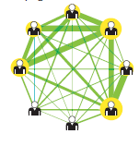
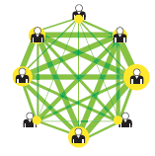
High Quality Process = Effective Flow of Energy in Group
“Team Within a Team”
Team of Equals
Alex “Sandy” Pentland. The New Science of Building Great Teams. Harvard Business Review, April 2012
Notes:
“Productive teams have certain data signatures, and they’re so consistent that we can predict a team’s success simply by looking at the data—without ever meeting its members. We’ve been able to foretell, for example, which teams will win a business plan contest, solely on the basis of data collected from team members wearing badges at a cocktail reception. We’ve predicted the financial results that teams making investments would achieve, just on the basis of data collected during their negotiations.”

Slide 18
So What is High Quality Process?
Fairness—those affected by a decision have input into the decision
Equality—affords all stakeholders equal opportunities to contribute and influence outcomes irrespective of role or background
Goal-orientation—people’s efforts are focused on the common good, not just advancing individual interests
Authenticity—stakeholders feel they can make binding commitments without those being rescinded by agents with higher levels of authority
Notes:
Reference the Working Together Survey

Slide 19
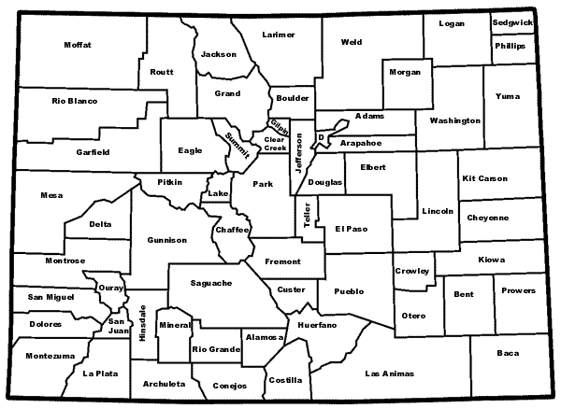
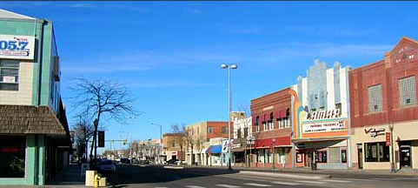
Prowers County, CO
A Case Study in Collaboration

Slide 20
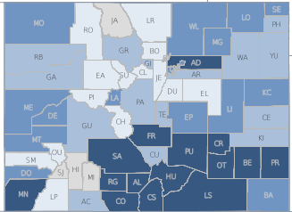
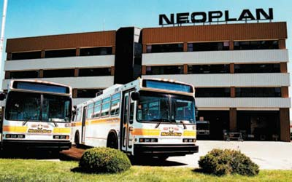
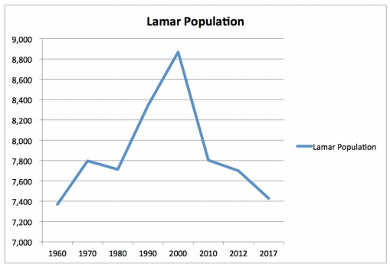

Slide 21
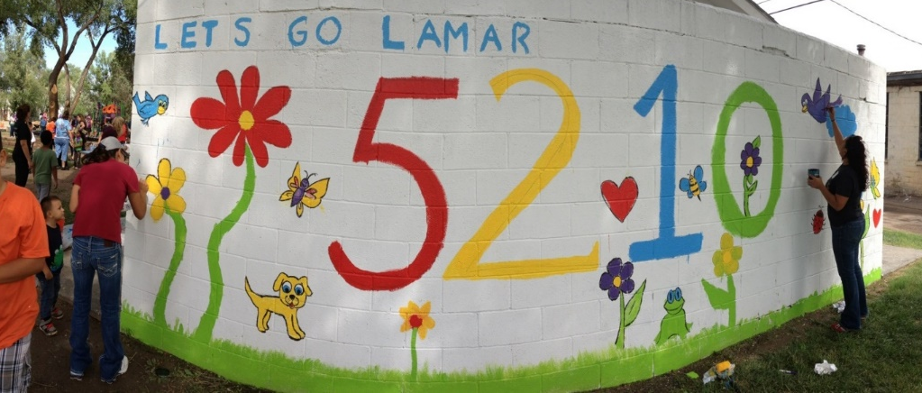
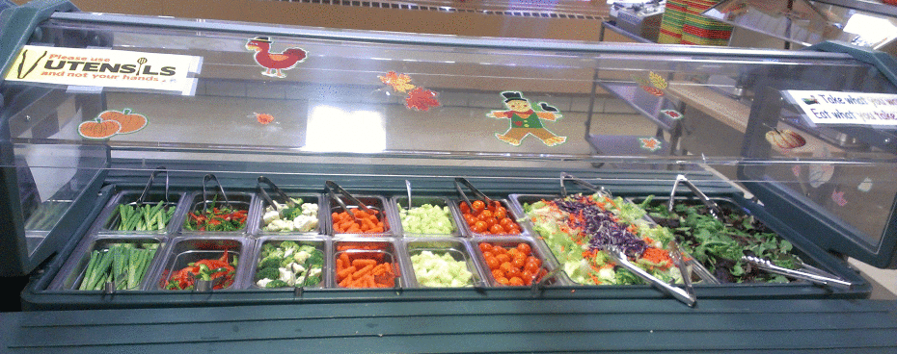
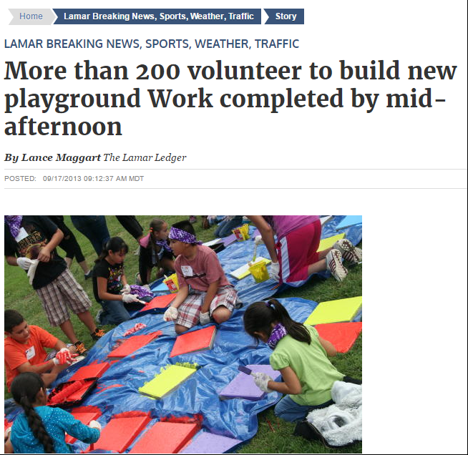
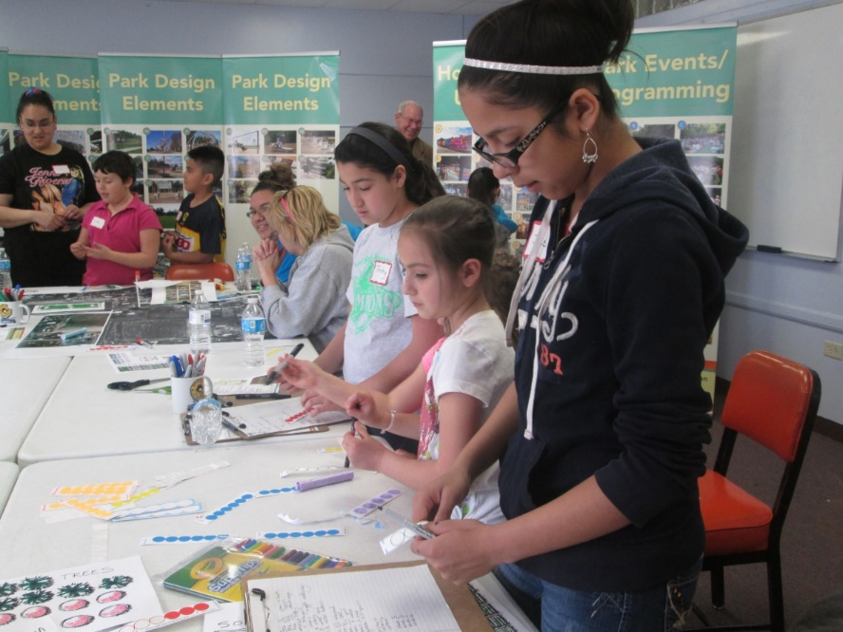

Slide 22
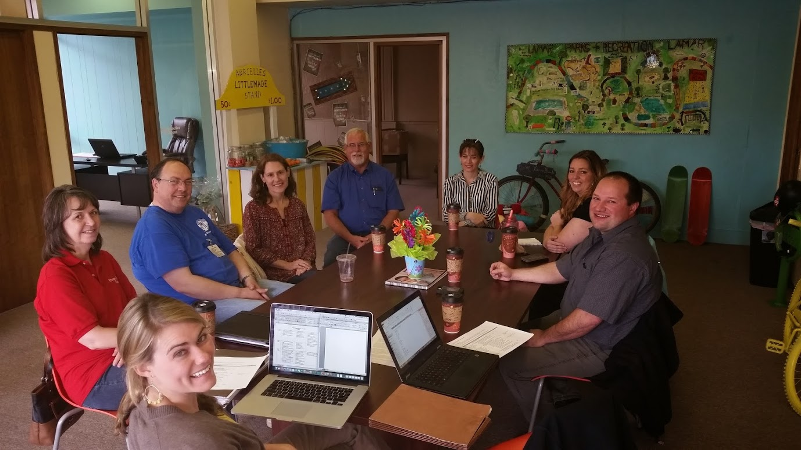

Slide 23
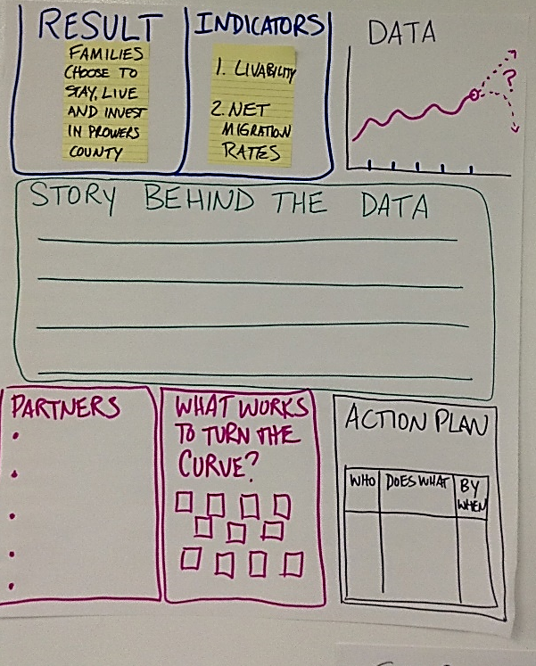
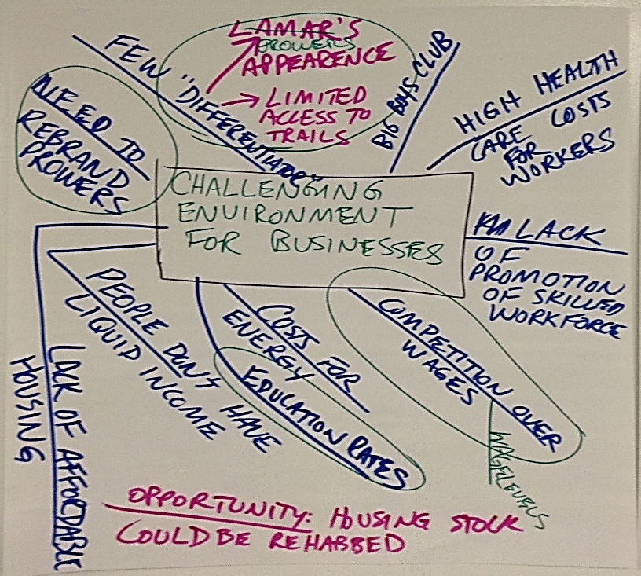
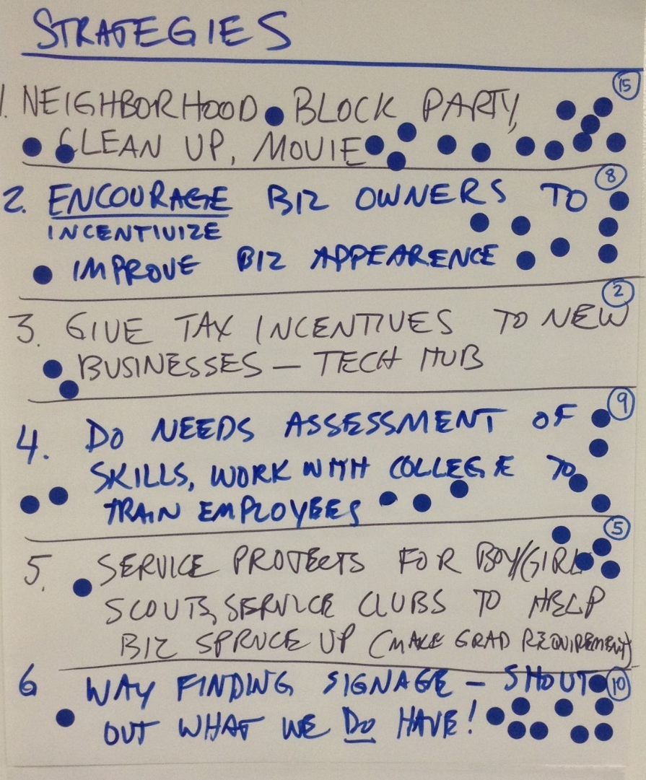
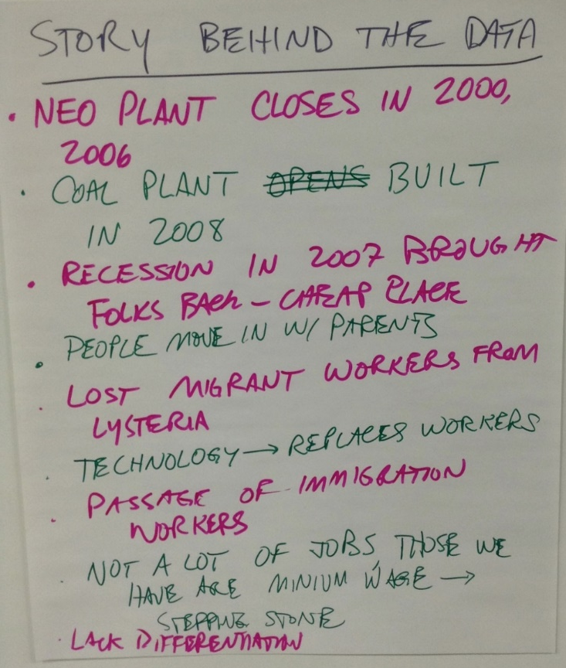

Slide 24
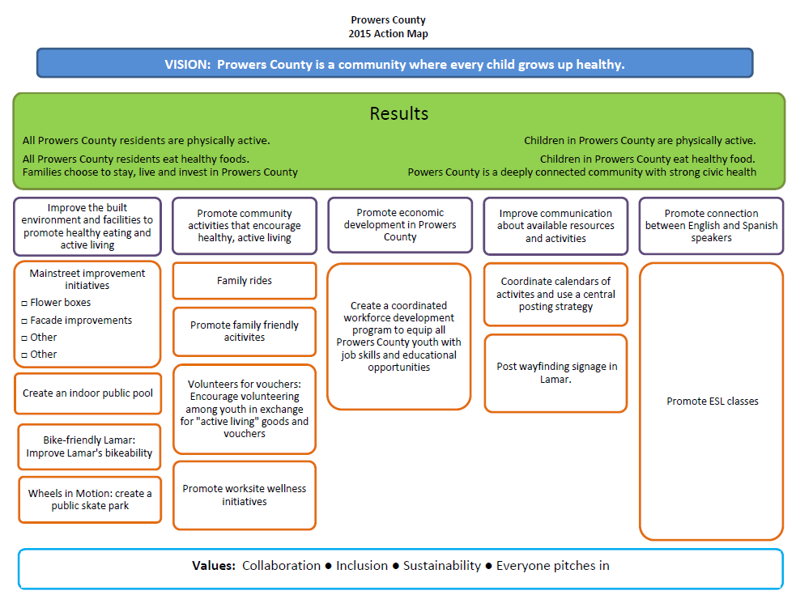

Slide 25
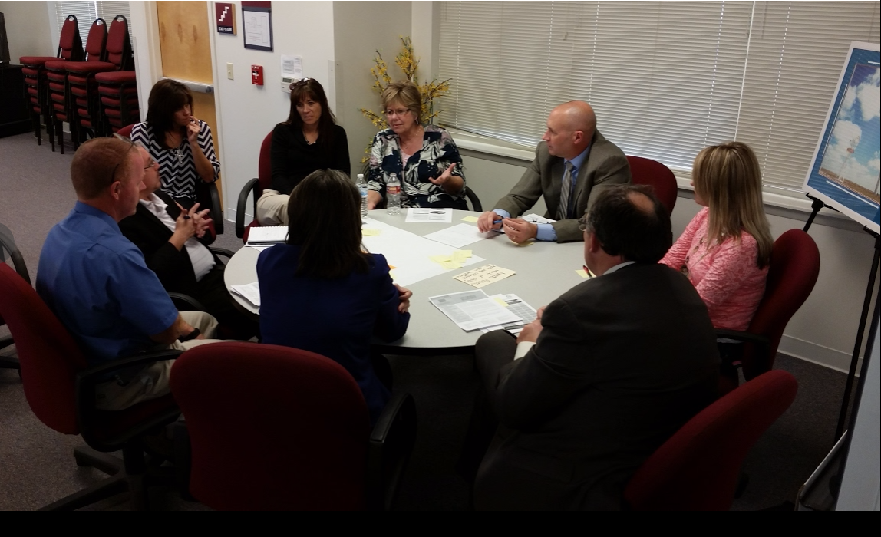

Slide 26
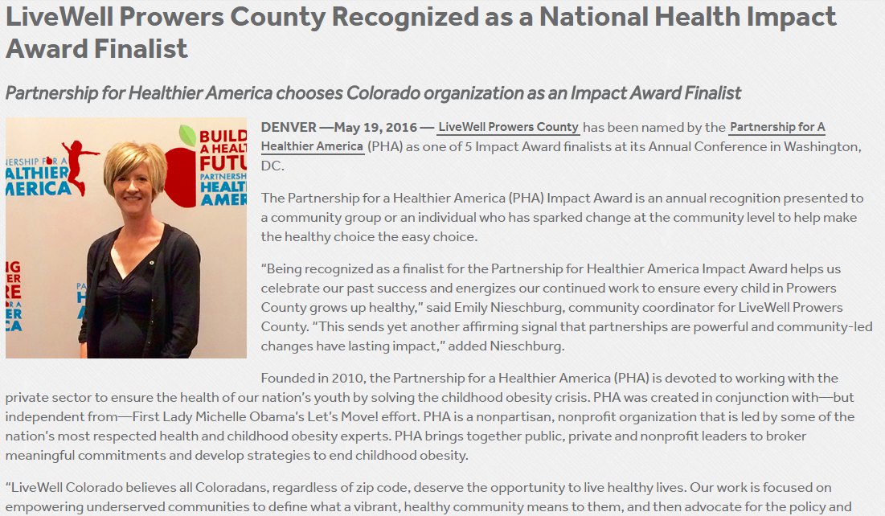

Slide 27
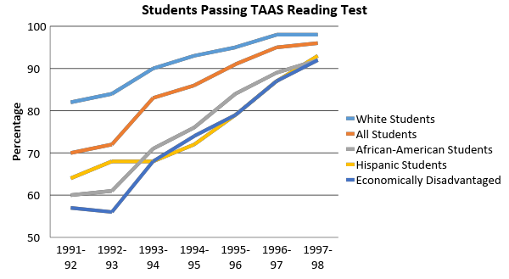
Brazosport Independent School District: Closing the Achievement Gap
From The Results Fieldbook by Mike Schmoker, 2001, ASCD Publications
Notes:
(Should be a transition on the square over the image)

Slide 28
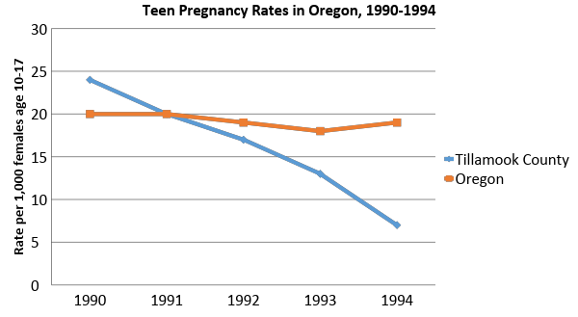
An RBA Case Study: Tillamook County, Oregon and Reducing Teen Pregnancy

Slide 29
So, what are we really talking about?
Get clear on the results we want
Get the right folks in the room
Have the honest, tough, and transformational conversations we need to have
Try stuff
Track what works, change what doesn’t
Stay at it, and build a culture of collaboration in Chaffee County that truly changes the game

Slide 30
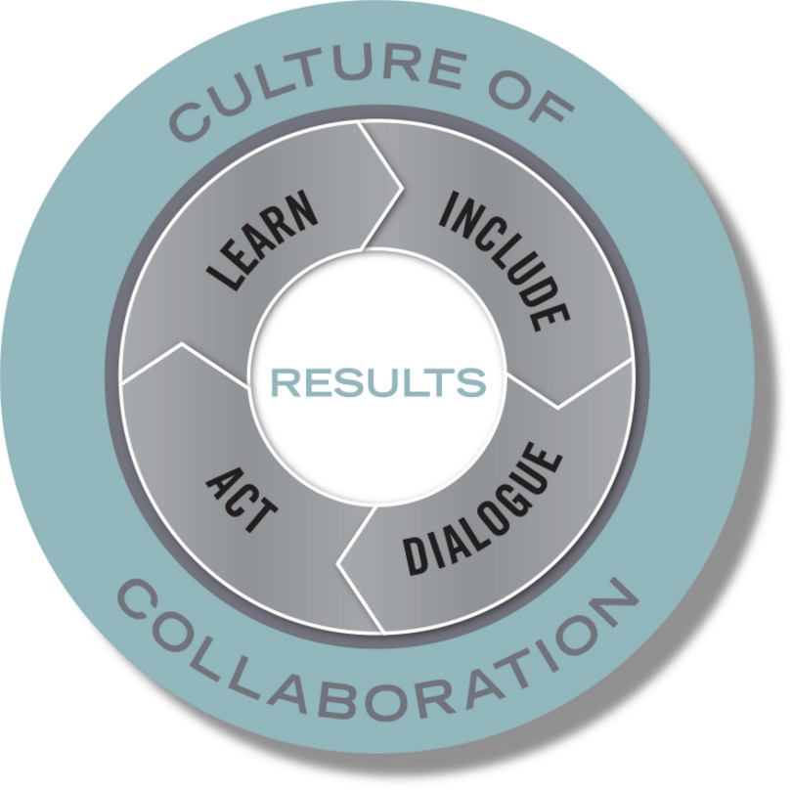
Results
Strategic Learning and Shared Measurement

Slide 31
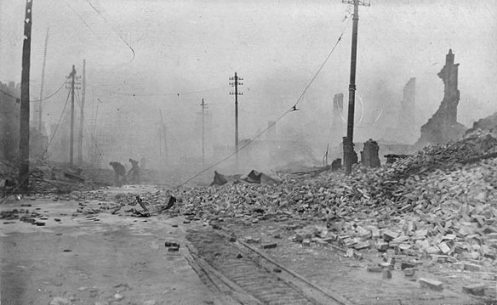
Notes:
Before we dive any deeper, I want to make a point about language here—
Great fire of Baltimore, 1904
At this point, cities in the northeast were close enough together that they had built connections, so when this fire broke out in Baltimore, fire engines (horse drawn carriages) from New York, Philadelphia, D.C., and other cities all showed up to help fight the fire. But they didn’t take into account one thing…
The hose hookups from the cities outside Baltimore were all different and didn’t fit the hydrant connections in Baltimore
Good thing is that this helped the US develop a standard hose/hydrant hookup, but point is that even with seemingly open lines of communication that had been developed, there wasn’t clear translation here. And this often happens in work around population well-being.
We use Mark Friedman’s language, but really all that’s important here is that you are using a language that is consistent and brings a common understanding to everyone in your organization or network.
Most important is that the language you use works for you and your context and helps people distinguish between these different levels of accountability and how you are measuring them.

Slide 32
Key Definitions
Colorado has a prosperous economy.
Arvada is a safe and supportive community.
All Jeffco residents with developmental disabilities are supported
RESULT
A condition of well-being for children, adults, families or communities.
Population Accountability
Employment rates
Violent crime rates
Mental health supports available
INDICATOR
A measure which helps quantify the achievement of a result.
1. How much did we do? 2. How well did we do it? 3. Is anyone better off?
PERFORMANCE MEASURE
Performance Accountability
A measure of how well a program, agency or service system is working.
Notes:
Let’s start with some key definitions…
So breaking down these levels of accountability…
At the HIGHEST LEVEL on the population accountability level, we have RESULTS…..
On the population level, which you will remember is concerned with whole populations, we call a result a condition of well-being…
Indicators are measures which help quantify the achievement of a result. So, for example, the rate of low-birthweight babies helps quantify whether we're getting healthy births or not…
Performance Measures are measures of how well public and private programs and agencies are working. The most important performance measures tell us whether the clients or customers of the service are better off. Remember, this is only for the clients you may serve (for a council this could be complex, and we’ll talk about this later)
If you’re a hospital and one of your results is healthy babies and % of low birthweight babies in your community is your indicator, what might a good performance measure be? (i.e. your own hospital’s rate of low birthweight babies, # of parents served by prenatal classes, etc.)
The principal distinction here is between ends and means. Results and indicators are about the ends we want for children and families. And strategies and performance measures are about the means to get there.
CFF: Already have Performance Measures in place, all working on SDOH’s—working to track their impact connected to clientele, but this can help us visualize and understand how your work at the Performance Level can connect to a bigger, shared result or outcome – that is how Collective Impact can fit in.

Slide 33
Language Discussion
Always go back to the original idea:
Ideas | Group 1 | Group 2 | Group 3
1. A condition of well-being for children, adults, families and the community. | RESULT | OUTCOME | GOAL
Notes:
When there’s confusion about a particular term, always go back to what the original idea is (i.e. is this a condition of wellbeing or is it a measure, strategy? Etc.)
Brainstorm: when we say the term RESULT, what are other terms people often use to distinguish? How can they be easily misinterpreted?

Slide 34
Language
Language Discussion
What’s important is going back to the idea and having the same language to talk about that idea.
What do you call these ideas in your organization?
What’s the idea? | What do you call it?
A statement about the condition of well-being that you are seeking. | Result?
A measure which helps to quantify the achievement of a result. | Indicator?
A quantifiable measure of how well a strategy/agency/system is working. | Performance Measure?
Notes:
Group discussion: talk in groups for just a few minutes about the language you use for each of these ideas at your organization. You can fill things in on your worksheet
When there’s confusion about a particular term, always go back to what the original idea is (i.e. is this a condition of wellbeing or is it a measure, strategy? Etc.)
This has really helped us when it comes to supporting groups to do things like create a logic model or develop a plan of activities. Ensuring everyone is on the same page with what you’re talking about is key.
For our purposes today, we’ll use RBA language.

Slide 35
Population Level Accountability

Slide 36
Population & Performance Accountability
POPULATON Accountability
is about the well-being of
WHOLE Populations
For Communities – Cities – Counties – States - Nations
PERFORMANCE Accountability
is about the well-being of
CLIENT Populations
For Programs – Agencies – and Service Systems
Notes:
A core part of RBA is distinguishing between two levels of accountability….
Accountability for whole populations, like all children in Los Angeles, all elders in Chicago, all residents of North Carolina. This first kind of accountability is not the responsibility of any one agency or program.
Performance Accountability, is about the wellbeing of the client’s you serve . It’s about the programs and services we provide, and our role as managers, making sure our programs are working as well as possible.
These are two profoundly different kinds of accountability

Slide 37
Key Definitions
Colorado has a prosperous economy.
Arvada is a safe and supportive community.
All Jeffco residents with developmental disabilities are supported
RESULT
A condition of well-being for children, adults, families or communities.
Population Accountability
Employment rates
Violent crime rates
Mental health supports available
INDICATOR
A measure which helps quantify the achievement of a result.
1. How much did we do? 2. How well did we do it? 3. Is anyone better off?
PERFORMANCE MEASURE
Performance Accountability
A measure of how well a program, agency or service system is working.
Notes:
We’ll come back to this slide multiple times today to just show where we are in the grand scheme.

Slide 38
Key Distinction
Results & Indicators
are about the ends you want to see.
Performance Measures
are about the means to get there.

Slide 39
Population Level Accountability
Establishing Population Level Accountability
RESULT
The first question to ask is
“what is the end result you seek?”
The second question to ask is
“how would you know if you got there?”
INDICATOR
Notes:
Before jumping into figuring out what you are going to do, what programs and services you’ll provide. First, determine what the “ends” looks like - what are you trying to achieve. To what end are you doing this work for?? Establishing results and indicators will help you to get clear on this and to keep it top of mind. There are two questions that are
To determine results ask yourself ”what does success look like for the population”. This is how we started this collaborative collective impact-based initiative in Prowers County. We asked the community, what would it take, what would it look like for every child to grow up healthy?
If the first question we ask ourselves is “what does success look like” for children and families in Southwest and from our answer we create our results. Then the second question we ask ourselves is “how will we know when we are successful?” “How can we quantifiable assess and continually track our progress toward achieving our results? The answer to that questions helps us determine our indicators.

Slide 40
Population Accountability
Results | Indicators
Families choose to stay, live and invest in Prowers County | Net migration rate (the rate of people moving into a county subtracted by the number of people moving out of the county )
Children reach their developmental potential and are ready to succeed in school and in life | % of children, Kindergarten – 3rd grade who have significant reading deficiency
Colorado youth are connected to their community | % of 9th-12th grade students who report participating in any extracurricular activities in school

Slide 41
Getting to RESULTS
Is a complete outcome statement.
Example: “All ______ (population) in ______ (geographic area) are __________ (statement of well-being)”
Uses simple and plain language.
Environments impacting Colorado children are safe, stable, and supportive.
Avoids referencing data or improvement needs.
Example to avoid: More families can access affordable housing in Jeffco.
Avoids referencing services (services are a means to your end).
Example to avoid: Elder care centers in Lakewood serve clients effectively.
Notes:
How could we alter the last two to be stronger?
Consider highlighting how Results statements make look very different based on your needs and the population you serve

Slide 42
Population Level Accountability
Examples of Results
Early Childhood Colorado Partnership | Larimer County Early Childhood Council | Big Timbers Community Alliance
Young children reach their developmental potential and are ready to succeed in school and in life Adults are knowledgeable, responsible, and interact effectively on behalf of young children Environments that impact children are safe, stable, and supportive Localities and the state attain economic and social benefits by prioritizing children and families | All children are valued, healthy and thriving | All Prowers County residents are physically active All Prowers County residents eat healthy foods Families choose to stay, live and invest in Prowers County
Notes:
Can look a little different depending on your approach
For example, Larimer has just one population-level result whereas the ECCP (a statewide network) has 4
You can see in Prowers they have ones that apply specifically to their population
Potential 15 minute activity: think individually about what a Result statement might look like for your organization.
Share criteria of what a good Result statement is
Think-pair-share activity
Consider how results statements might connect/align with others?

Slide 43
Small Group Conversations on Results
3 Rounds of Discussion
Round 1: (15 minutes) Complete the worksheet independently at your table. Develop 3-5 results statements and be ready to share at your table in round 2.
Round 2: (15 minutes) Discussion: Review themes and develop a group list of 5-7 that reflect common desired outcomes. At the end of the round, one person stays at the table to share results with next group, remainder go to different tables.
Round 3: (15 minutes) Narrow to top 1-3. Write 1 result statement on a piece of paper provided
Notes:
will give out handout here

Slide 44
Next Steps

Slide 45
Process Overview
Establishing a Foundation
January 2019
Review research on collaboration
Draft result statements
Turning the Curve
April 2019
Reviewing data on indicators
Identifying root causes
Organizing for Action May 2019
Finalize strategies
Launch Action Teams
Defining Results February 2019
Finalize Result Statements
Identify potential indicators
Build Action Map
Drafting strategies

Slide 46
Logistics
Creating a Civic Network profile: Civicnetwork.io
Civic Network is an open source platform created as a way to help communities achieve their goals. It provides a user-friendly place to connect, collaborate, and coordinate across efforts by sharing documents, tracking actions, and managing projects.

Slide 50
Final Steps
Who else needs to be involved for this to be successful?
Please list the specific people and/or organizations you are willing to contact before the next meeting to explain this effort and invite them to join the team
Fill out a Working Together survey so we can get an assessment of your baseline level of collaboration, and a meeting evaluation form to give us feedback on what worked, what needs improvement, and what to consider going forward
Thank you for coming!!!

Slide 51
Bill Fulton and Kelli Pfaff
THE MANY WORKING AS ONE FOR THE GOOD OF ALL
Bill@civiccanopy.org; Kelli@civiccanopy.org
www.civiccanopy.org

