Slide 1
SWFI Childcare Learning Community Meeting
September 10, 2018

Slide 2
Meeting Outcomes
Review baseline data related to the demand for high quality child care in the areas served by CCD and CCA
Review progress to date from each action team
Understand the connection between each action team and larger systems change
Plan next steps for action teams and the overall Learning Community

Slide 3
Result: Colorado families are valued,
healthy, and thriving across generations.
Toxic Stress
Lack of supportive services
“Healthy” Trajectory
Poverty
“At Risk” Trajectory
Strategies
Valued, Healthy and Thriving
Strategies
Strategies
Strategies
Strategies
Birth
Adulthood
Access to HQ Reading on Grade Post Secondary Sustainable
Childcare Level Attainment Wage
Indicator
Milestones
Early Preschool

Slide 4
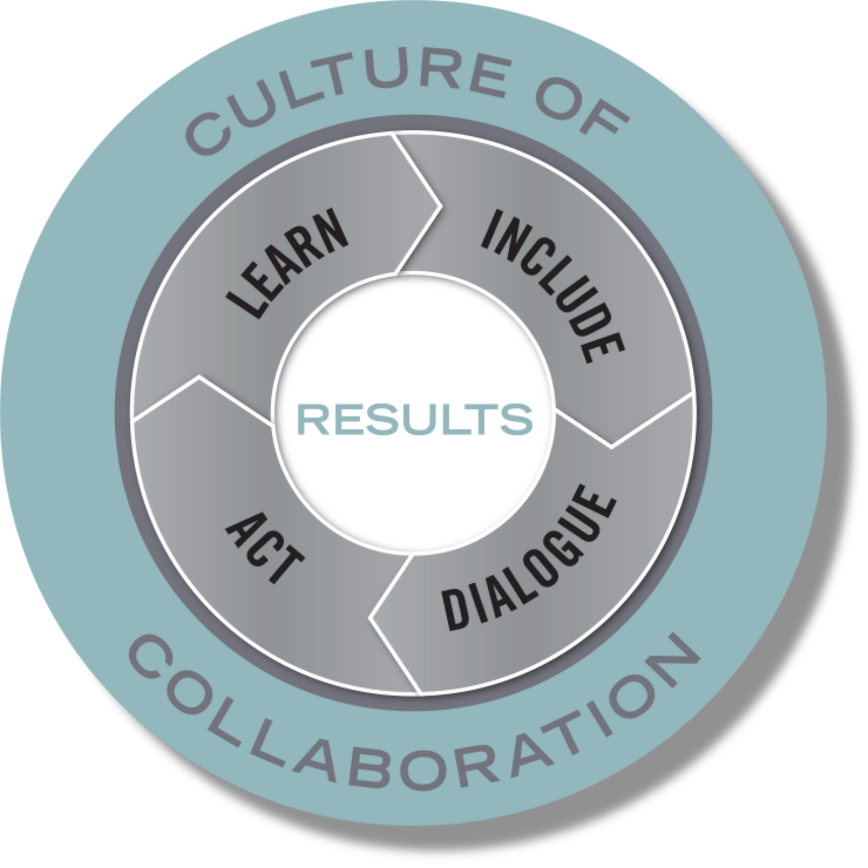
Action Map
2017 - 2020
USDOL Strengthening Working Families Initiative
Access to Success: Expanding Access to Education + Child Care = Economic Success
RESULT
Colorado families are valued, healthy, and thriving across generations.
INDICATORS
Post-secondary
credential attainment
% of children in
high quality child care settings
% of families earning a sustainable wage
4th grade reading achievement levels
STRATEGIES
Increase the affordability and financial viability of child care
Create policy solutions that expand access to quality child care
Expand availability of quality child care
Increase awareness of quality child care options
Increase available child care spots in our focus area by 2150 spots in Phase 1 and by 1995 additional spots in Phase 2.
PERFORMANCE
MEASURES

Slide 5
Guiding Principles
Solutions are sustainable
Solutions are scalable
Solutions improve systems
Solutions address root causes and barriers
Solutions respond to students’ lived experiences and goals
Solutions considers a variety of care models to honor student choice
Solutions promotes partnership and collaboration

Slide 6
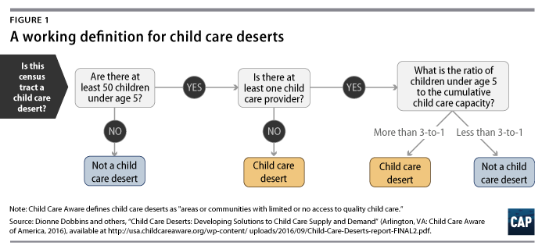
Expand Access to Quality Child Care
Center for American Progress (CAP) – Childcare Desert

Slide 7
Expand Access to Quality Child Care
Childcare Slots in SWFI Recruitment Area
Borders
  56th Avenue on the North
  Federal Boulevard on the West
  Mississippi Avenue on the South
  Tower Road on the East
Childcare deserts
  120 Census Tracts in SWFI recruitment area
  CAP Identified 32 tracts within the area as childcare deserts
  We dropped six tracts with median family income of $90K+
  26 census tracts identified as childcare deserts
Total childcare slots needed to get to a 3 to 1 ratio = 2,150
Total childcare slots needed to get to a 2 to 1 ratio = 4,145 (1,995+)

Slide 8
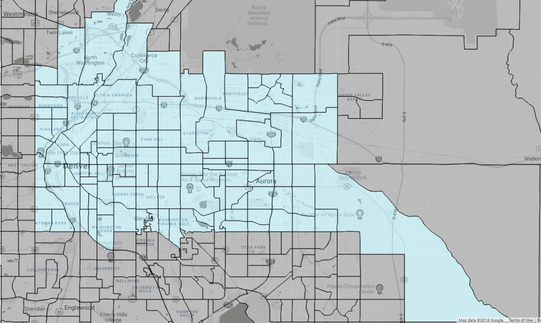
Expand Access to Quality Child Care

Slide 9
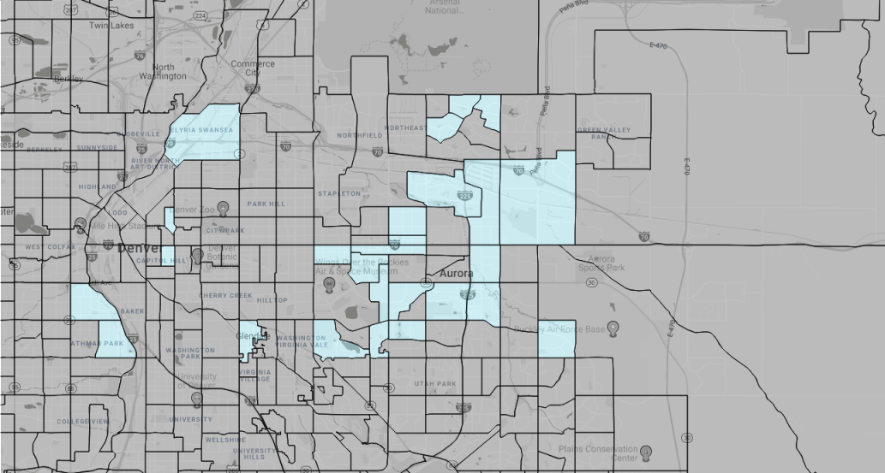
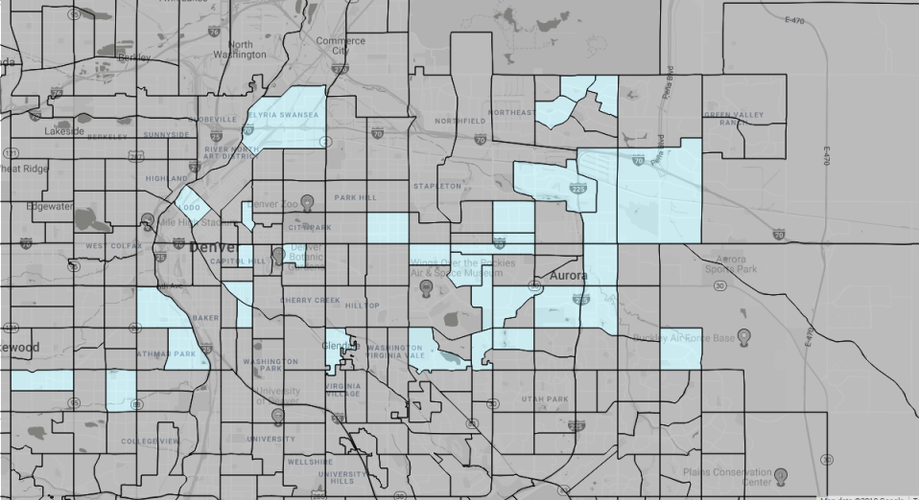
Expand Access to Quality Child Care

Slide 10
Action team share out
Child Care Economics Action Team
Expanding Availability of Quality Care Options
Awareness of Quality Care Options
Public Policy

Slide 11
Child Care Economics Action Team
Team Members
Janel Highfill – Community College of Aurora
Michelle Ewing – Arapahoe County Early Childhood Council
Gloria Shapiro – Executives Partnering to Invest in Child Care
Victor Vialpando-Nunez – Community College of Aurora
Kate Ridings – WorkLife Partnership
Matt Cornett – Arapahoe Douglas Works!
Lisa Jansen Thompson – Early Childhood Partnership of Adams County

Slide 12
Child Care Economics Action Team
Goals
Identify specific, actionable solutions to increase the affordability of quality care for parents
Ensure the financial viability of center, home-based and informal care providers
For providers: explore how to extend the benefits of tax breaks, expand access to public and private subsidies, new business models to create more sustainable child care businesses with high quality care and livable wages
For parents: explore expansion/prioritization of CCAP funds to address areas of most acute need, expand savings plan options, employer subsidies

Slide 13
Child Care Economics Action Team
What We’re Up To
Exploring creation of Shared Services Alliance in northwest Aurora/ northeast Denver: community-based partnership/entity that centralizes key functions to save money, strengthen management capacity, improve early learning, ensure sustainable, high-quality programs
Why This?
Build on existing successful models across the U.S.
Enable providers/directors to focus time/energy on ECE expertise rather than administrative tasks
Support child care business stability and expansion through marketing, enrollment, licensing, accounting/fiscal reporting services
Increase revenue potential through reduced administrative burden, leveraging of additional funding sources and cost offsets, business expansion

Slide 14
Child Care Economics Action Team
Key Components
Business structure: 501(c)3; possibly member-owned co-op
Core services: accounting, HR, central recruiting, group insurance, marketing, gov’t program administration, grant writing/management, tax credit administration, employer slot subscriptions, bulk purchasing
Revenue streams: member fees or fee for service, employer payments, parent fees, CCCAP, CACFP, private and government grants
Target providers: private/family-owned centers, licensed family home providers, unlicensed informal providers

Slide 15
Child Care Economics Action Team
Community Impact
Increase available child care slots, including evening, weekend, drop-in, emergency care
Ensure high quality care through training, networking, infrastructure resources
Increase revenue flow to providers
Increase employer investment and engagement with broader array of providers

Slide 16
Child Care Economics Action Team
Next Steps
Flesh out business plan and develop financial model with scenarios to determine min/max scale, fee structure, etc.
Conduct provider outreach to:
  Test interest in and viability of shared service alliance,
  Get input on fee structure
  Prioritize services for core offerings, phased start-up

Slide 17
Questions

Slide 18

Evaluation of the SWFI Learning Community

Slide 19
aBOUT THE EVALUATION
Random selection of Learning Community participants
Initial interviews conducted in fall 2017, previously shared
Six additional interviews conducted in Spring-Summer 2018
Hard copy survey distributed to full Learning Community in June 2018
Same survey sent electronically
Derived survey analysis from “Working Together: A Profile of Collaboration”

Slide 20
SURVEY CATEGORIES
The Context of Collaboration
The Structure of the Collaboration
Collaboration Members
The Collaboration Process
The Results of the Collaboration
Notes:
40 questions total
4 = true
3 = more true than false
2 = more false than true
1 = false

Slide 21
SURVEY RESPONSES
4 = True
3 = More true than false
2 = more false than true
1 = False
Notes:
Higher number corresponds with a positive response to the question. So people responded positively to the full survey over all; most positively about context and structure and less positively on results and just a bit on process.

Slide 22
Interviews - Context
What’s working now
For some, they or their organizations have been focusing on serving families with a 2Gen frame for some time
Ideas for improvement
For others, 2Gen framing and SWFI is a new, “eye-opening” way to look at systems, programs and policies.

Slide 23
Interviews - Context
“It’s shifted my mindset and every time we meet I feel like I’m learning from the wonderful minds in the room.”
“If people aren’t ‘in this’ work, they don’t know it’s going on – we think the whole community knows about Two-Gen but it doesn’t.”
“A lot of what we do is put a band aid on stuff. But this is trying to get deeper into what’s going on…how to change the public’s perception and how to get it to be viable.”

Slide 24
Interviews - Structure
What’s working now
Facilitation team
Time commitment required
Online tool
Connections and perspectives through the LC
Team leader for subcommittees
Workgroup approach
Ideas for improvement
More email communication
Clarity re expectations, roles
Show people the “why,” from parent case studies, parent storytelling, hearing from providers
Facilitation support for subcommittees
Integrate parents into subcommittees
Remote participation option

Slide 25
Interviews - Structure
“The facilitators are doing an incredible job of incorporating all perspectives, making people feel heard and summarizing learning community actions.”
“I like that it’s at the community college because (now) I get comfort in referring families there.”

Slide 26
Interviews - Membership
What’s working now
Voice of advocates, policy experts, community college reps, state
Learning from each other
Hearing about problem solving
Ideas for improvement
Participation, first-person perspective of parents and FFN providers
Engagement with community leaders, business community, service providers, licensure staff
Integrate parents into subcommittees
Balance engagement with not overwhelming people
Regular communication via email, platforms for those who don’t verbalize thoughts

Slide 27
Interviews - Membership
“While it’s the same people I see regularly, it excites me to be there for a different purpose to affect a larger system. And then we can think about how to do that on the ground. We learn from what works on the ground to inform systems work. We should leverage that more.”
“We talk a lot about businesses and their buy-in…yet I don’t think they ‘get’ what’s going on, and why they have a hard time getting employees, why child care, housing and other issues are problems affecting the workforce.”
“If we highlight the providers and make them feel good, they’ll want to open up care to those that need it.”

Slide 28
Interviews - Process
What’s working now
Facilitators keeping the group on track
Moving in the right direction
Can dig-in on issues
Focused on the right things, esp. at subcommittee level
Have the information needed
Fluid movement between topics
Ideas for improvement
Ensure alignment with ongoing, similar issues to avoid duplication
Don’t be too granular
Get more perspective on “nitty gritty”
Learning from more information

Slide 29
Interviews - Process
“I’m clear about our overall goals but am not always sure about how it’s achieved through the meetings, behind the scenes and in the overall SWFI leadership.”
“We shouldn’t get stuck on funding challenges – our biggest pitfall is our own thinking.”
“Our two-gen work may have progressed with our without SWFI. But in terms of the Learning Community it’s been great to understand other perspectives, especially the state’s. To have time to really hear from them about why things are happening the way they are has changed the way we think and given us more understanding. I would love to see that the state is seeing the same benefit and would want to continue that way in the future.”

Slide 30
Interviews - Results
What’s working now
Learning community goals compliment own/organization’s goals
Changing or enhancing how people think about, discuss, or perceive work
Having state department partners in the room
Ideas for improvement
More clarity around long-term, policy goals
Stay actionable, realistic
Take feedback seriously
Don’t be too myopic
Don’t be too “big-picture”

Slide 31
Interviews - Results
“Will the learning community be action-oriented?”
“I think I’ve always thought that way (with a 2Gen frame) but I didn’t realize it…and (now) I can tell parents what that looks like for them, to get them thinking that way.”
“What excites me the most is just…I feel like it’s so close. The goals are lofty, and people might say that it’s difficult but it’s so rewarding to one day maybe allow us to see that early childhood is part of public education. That would be a complete shift in how the system treats early childhood.”

Slide 32
Next steps
Ongoing evaluation by Bell Policy Center
Join Civic Network by creating a profile and joining the SWFI Network (www.civicnetwork.io)
Meet with your Action Team between now and the January 14th Learning Community Meeting to move the work forward
Share minutes and updates from Action Teams on Civic Network to continue the communication between groups
Notes:
Quick evaluation of the meeting using plus/delta on flip chart – whole group conversation

