Slide 1
Bringing Towns and Counties Together to Plan for their Future – THE Steamboat springs and routt county Colorado case study
Chad Phillips, A.I.C.P.
Director, Routt County Planning Department,
Steamboat Springs, Colorado

Slide 2
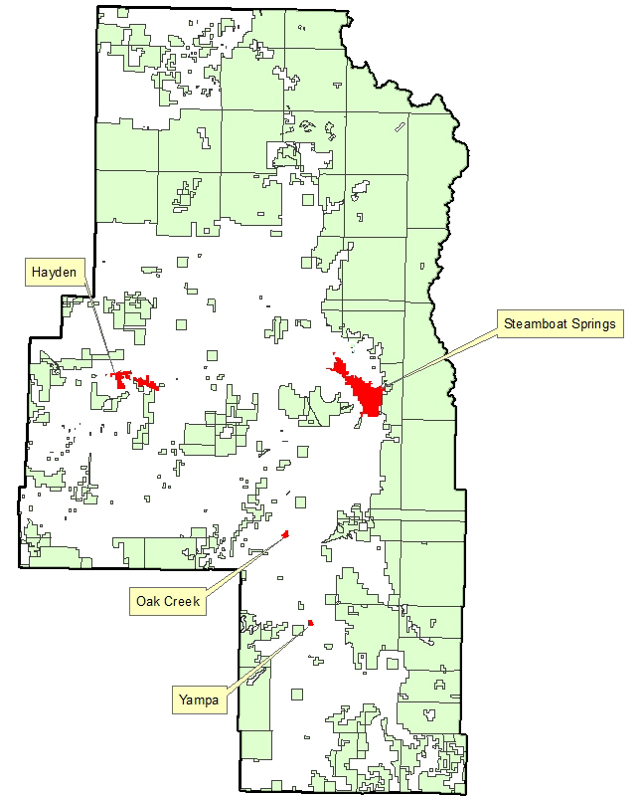
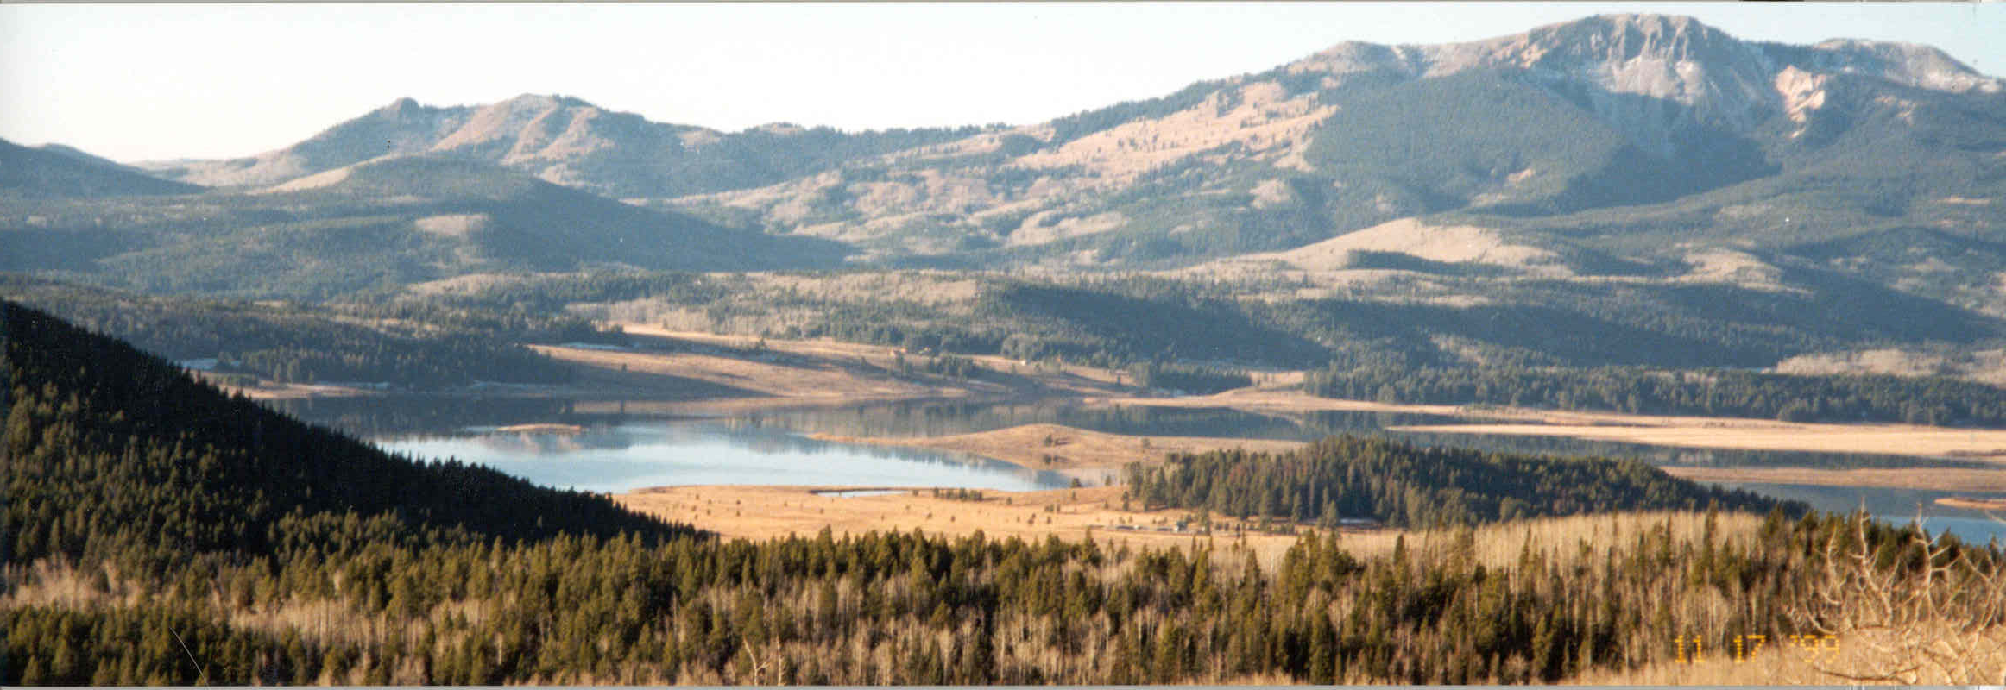
Routt County, Colorado
2,368 square miles
24,000 total population
About half public lands
4 municipalities
35-acre statutory subdivisions

Slide 3
The routt county master plan
Original adoption in 1980 (major amendment in 2003, PC confirmed active status in 2016)
The plan’s overall goal is to maintain the western rural character of the County
Included policy that directed all new residential, commercial, and industrial development into Growth Centers (municipalities)
Did not include a Future Land Use Map, maintain Ag/Forestry zoning.

Slide 4
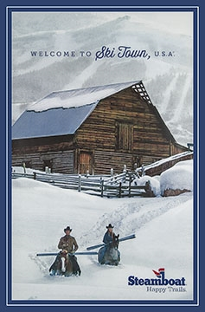
Development pressures in the early 1990’s
Popularity of the Steamboat Ski Area
Proliferation of 35+ acre parcels (SPRAWL)
Buildout of 1970’s subdivisions
YVRA runway and US40 Rabbit Ears Pass improvements
Catamount Ski Area approval
Plan for 2nd base area at Steamboat Ski Area
Increase in tourism and second homes
Population increased from 6,500 in 1970 to 14,000 in 1990
Failure of the Stagecoach and Steamboat Lake projects

Slide 5
Coming together
Widespread community concern from City and County citizens
Early 1990’s, forward-thinking, motivated BCC and CC members
Steamboat CC and County BCC decided to have regular joint meetings
City and County provided funding for Vision 2020, a community-initiated and community-lead visioning process
City and County decided to begin the process of re-writing the SSACP as a joint project
Voters approved a sales tax for a Purchase of Development Rights program for agricultural land preservation

Slide 7
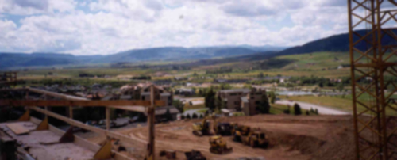
The Understanding behind the joint adoption of comp plans
What’s in it for the city and towns?
Assurance that the County will not approve developments within growth areas or plan study areas
When appropriate, all new businesses will take place in incorporated areas resulting in implementation of city design standards and increased tax base
IGA for development referrals in growth area and plan study area
Tourists!
Happy community!

Slide 8
The Understanding behind the joint adoption of comp plans
What’s in it for the County?
The towns and city help enforce the County’s Master Plan by accepting development and annexations, thus preserving the western rural landscape
IGA for development application referrals at City limits
No Parks and Recreation or Public Works Departments (urban services)
Preservation of historic ranching and agricultural lands and operations
Protection of critical wildlife habitat
Protection of scenic views
Happy community!

Slide 9
The ssacp and wssap

Slide 10
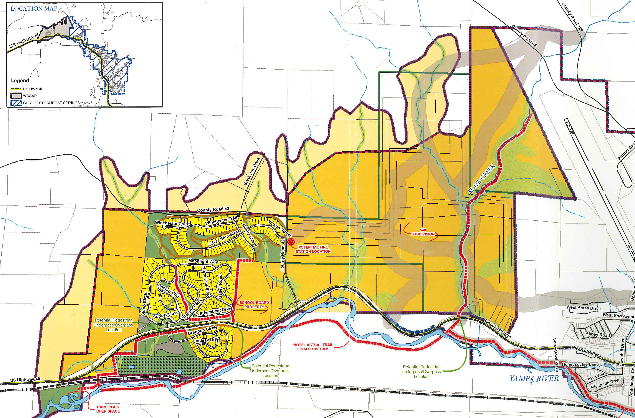

Slide 11
Cooperation…
Regional/County Building Department
Environmental Health Department
Steamboat Springs and Routt County offices 3 blocks apart
Joint Steamboat/Routt Police and Sheriff facility (design phase)
Fiber optics project
Watershed Management Plan
Regional Airport Commission
Quarterly (as-needed) joint BCC/CC meetings

Slide 12
Cooperation…
All four municipalities have jointly adopted land use/comprehensive plans
Municipalities recommend to the BCC a County Planning Commissioner
Joint Planning Commission meetings
TAC/ART
Events/gatherings – softball, fantasy football, happy hour, book club, staff lunch, director’s lunch (happy hour)

Slide 13
How’s it been working?
Since mid 1990’s, all plans and amendments still in place
County has not approved any subdivisions in the four Comp Plan’s study areas
Master Plan update re-affirm that maintaining western rural character still a community goal
SSACP subject of public hearings in 2012, validity upheld
Presently Steamboat and Routt County updating Joint Planning Agreement IGA
Unfortunately, no new annexations approved in Steamboat in 20+ years

Slide 14
Plans, regulations, and other tools since the 1990’s efforts
Joint adoption of the Steamboat Springs Area Community Plan, Oak Creek, Hayden, and Yampa Comp Plans
Steamboat Springs and Routt County Land Use IGA
Land Preservation Subdivision Exemption
Open Lands Plan
Three Sub-area plans (unincorporated areas)
Purchase of Development Rights Program
Vision 2020 (amended)
Zoning and Subdivision regulations updates

Slide 15
The future?
Amendments of the County Master Plan, SSACP, WSSAP
Public education
Check in with community to affirm goals of preservation of rural character, managed development, and that city/county cooperation is a high priority and “good government”
WSSAP failure? Revisit UGB and possibly allowing limited residential development in the County near Steamboat
Continue to look for opportunities for local government cooperation and teamwork

Slide 16
Thank you!

