Slide 1
Collaborating for Equity Workshop D Nita Mosby Tyler, Ph.D. Chief Catalyst – The Equity Project, LLC

Slide 2
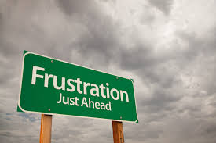
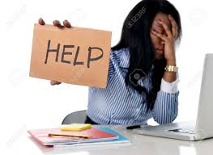
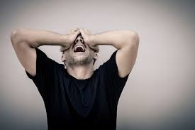
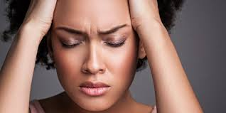
Collaboration Fatigue is A Real Thing

Slide 3
Tackling Fear Understanding Fear Increases Collective Impact
State of Fear: What you feel when you encounter something you didn’t expect or is potentially harmful. Feel fear, avoid action Experience danger, feel fear
Trait of Fear: An enduring attitude of fear. Is not connected with any present danger; it is about an imagined danger. Feel fear, avoid action altogether

Slide 4
Impact with Basic Needs in Mind
In order to understand what it takes to be inclusive and increase collaboration in your “community,” there should be a general understanding of where people (including yourself!) are in the hierarchy.
Based on where people are in the hierarchy (1) informs you about your “community,”(2) can provide indicators of exclusion sources and (3) determines how (or if) people can even hear your messages

Slide 5
Understanding Social Factors How to increase systems of inclusion
Conditions for early childhood development
Education
Employment
Income and job security
Food security
Health services
Access to services
Housing
Social exclusion
Stigma

Slide 6
Continue to Monitor the Equity Continuum
Diversity
Inclusion
Equality
Equity

Slide 7
Talking and Reflecting as a Learning Team
Give examples of how you have seen collaboration fatigue show up in your work.
Share examples of when you have seen State of Fear. How about Trait of Fear?
Discuss scenarios where you have tackled social exclusion to create systems of inclusion and equity.
How can you use the Equity Continuum to monitor your work?

Slide 8
Sealing the Deal How to Be The Change You Want to See Nita Mosby Tyler, Ph.D. Chief Catalyst – The Equity Project, LLC

Slide 9
I Believe…
“If we don’t tackle social exclusion in the communities we are a part of, we decrease the power of our collective social impact.”
-The World according to Dr. Nita Mosby Tyler

Slide 10
What can I do?

Slide 11
Fill the Funnel
Problems & Barriers
Resources
Collective Gifts & Talents
CHANGE

Slide 12
What can WE do?

Slide 13
What can WE ALL do?
Continue to explore our understanding of equity
Shift to “embracive” versus “inclusive” culture work
Webinars, podcasts, learning opportunities that help sharpen our tools on this issue
Leverage the power of the Canopy Summit Page to communicate, share and build capacity
Upload stories
Weigh in
Learning Community Dialogue
Talk to your small group to generate ideas you would find helpful in supporting your efforts.

