Slide 1
for the good of all
November 29, 2017

Slide 2
Opening Reflections
Summit Learning Journal:
Page 1, capture your hopes for the next 2 days
What are your expectations, and desires for the Summit experience?

Slide 3
Learning Table Introductions
Share...
Who you are
An organization or community you’re connected with
Something you’re hoping to learn and/or contribute

Slide 4
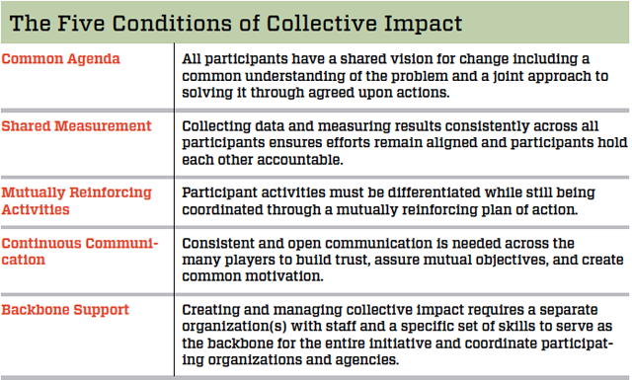
Kania and Kramer, 2011
Notes:
Reading the instruction manual for how we’re supposed to organize ourselves, gave language to our efforts

Slide 5
Parts and Wholes All the Way Down
Organism
Cell
Molecule
Atom

Slide 6
Parts and Wholes All the Way Down
Human Race
Society
Community
Individual

Slide 7
Notes:
Late on the afternoon of July 4, 1776, the Continental Congress appointed Benjamin Franklin, Thomas Jefferson, and John Adams to "to bring in a device for a seal for the United States of America."
Like other nations, America needed an official symbol of sovereignty to seal and authenticate her international treaties and transactions. The new nation needed a symbolic signature others would recognize and honor.
Many people today know what a challenge it can be to come up with a good logo and slogan for their team, business, or organization. Imagine having to design a symbol that would represent an entire nation to the whole world – and to future generations.
This is what America's founders had to do back in 1776. Using only a few images and words, they had to illustrate the principles that inspired them to revolutionize their world and create a new nation.
During the next six years of the Revolution, three different committees submitted ideas for this graphic image of America, but none were acceptable. In June 1782, Congress turned the task over to Charles Thomson who created the final design.
In September 1782, the first Great Seal die was cut and used to begin sealing the peace with England. (That die was the obverse, eagle side. A die for the reverse, pyramid side has never been created.)
For 233 years now, the Great Seal of the United States has ratified international agreements of peace, cooperation, and trade. Representing the people of America, it seals their promise to other nations.
The designs suggested by the three committees are wonderful windows into the revolutionary minds of the founders. They reflect America's struggle for Independence and help us better understand the thinking that went into the Great Seal of the United States.
http://www.greatseal.com/committees/

Slide 8
E Pluribus Unum: One From Many
Global Society
State
Community
Individual
Citizen
Country

Slide 9
3 Unproductive Frames
Individualism
Assumes that success or failure in life is individually constructed
Tribalism
Assumes that the needs of one’s own identity group take priority over the needs of other groups
Fatalism
Assumes nothing can be done to change the structures we live and work within—”the system is rigged.”

Slide 10
A New Frame: For the Good of All
From
To
Individualism: You deserve your station in life
Tribalism: Our differences define us, and we must rectify the unfair ways my group is treated
Fatalism: The game is rigged and there’s nothing we can do about it
Everyone deserves the opportunity to thrive, but opportunities are not yet equal
We are interdependent, and diversity is an asset for our shared success
If we work together, we can change the game so we all succeed

Slide 11
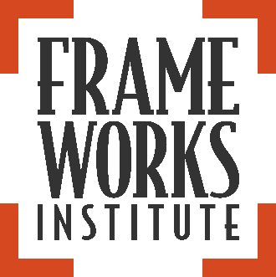
The Major Takeaway:
“Advocates for racial justice are likely to be more effective if they lead the public ‘to’ race, rather than leading ‘with’ race. Making this distinction need not mean that a call for racial justice be diluted or unduly deferred. It just means that the opening lines of a communication should be devoted to orienting Americans to the common good and to systems thinking.”
Framing Race in Education:
The Evidence We Have on How to Be Effective Advocates for Racial Justice

Slide 12
How Did We Get Here? Nita Mosby Tyler, Ph.D. Chief Catalyst – The Equity Project, LLC

Slide 13
Becoming… Evolutionary Change-makers

Slide 14
Honoring… The Power in the Pause

Slide 15
Operating… In Humble Expertise

Slide 16
Deconstructing Equity
Diversity
Inclusion
Equality
Equity

Slide 17
Talking and Reflecting as a Learning Team
What is your “Miss Ann” story? Who inspired you to become what you are today?
Discuss moments where you have experienced the Power in the Pause in your work.
Describe scenarios where you have had to use humble expertise in the process of deconstructing equity.

Slide 18
Where Do We Go From Here? Mark Cabaj Here to There Consulting Inc. & The Tamarack Institute

Slide 19
Notes:
Few challenges facing Canada are as gnarly, complex, and multi-faceted as energy.
The Energy Futures Lab emerged in response to the highly polarized environment that dominated public discourse and hung over all policy deliberations on this topic - and still do. If you only read the headlines or listened to the sound-bites, you would think that we had to choose between jobs and environmental protection, etc. In reality, though, many – dare I say most – people and organizations do not identify with the extreme ends of those polarized debates. The idea behind the EFL was to help connect and shine the light on the people and efforts already taking place in Alberta in this “radical middle” and to help create new possibilities to get us unstuck.

Slide 20
Notes:
And the way the EFL was designed was, itself an innovation.
Typically social innovation labs focus on what’s in the orange box – the generation of new ideas and breakthroughs. The partners of the EFL recognized that that would not be enough in this case. The barriers to collaboration and innovation were about far more than technology or even policy matters (though these are of course highly relevant). They are also about culture and identity.

Slide 21
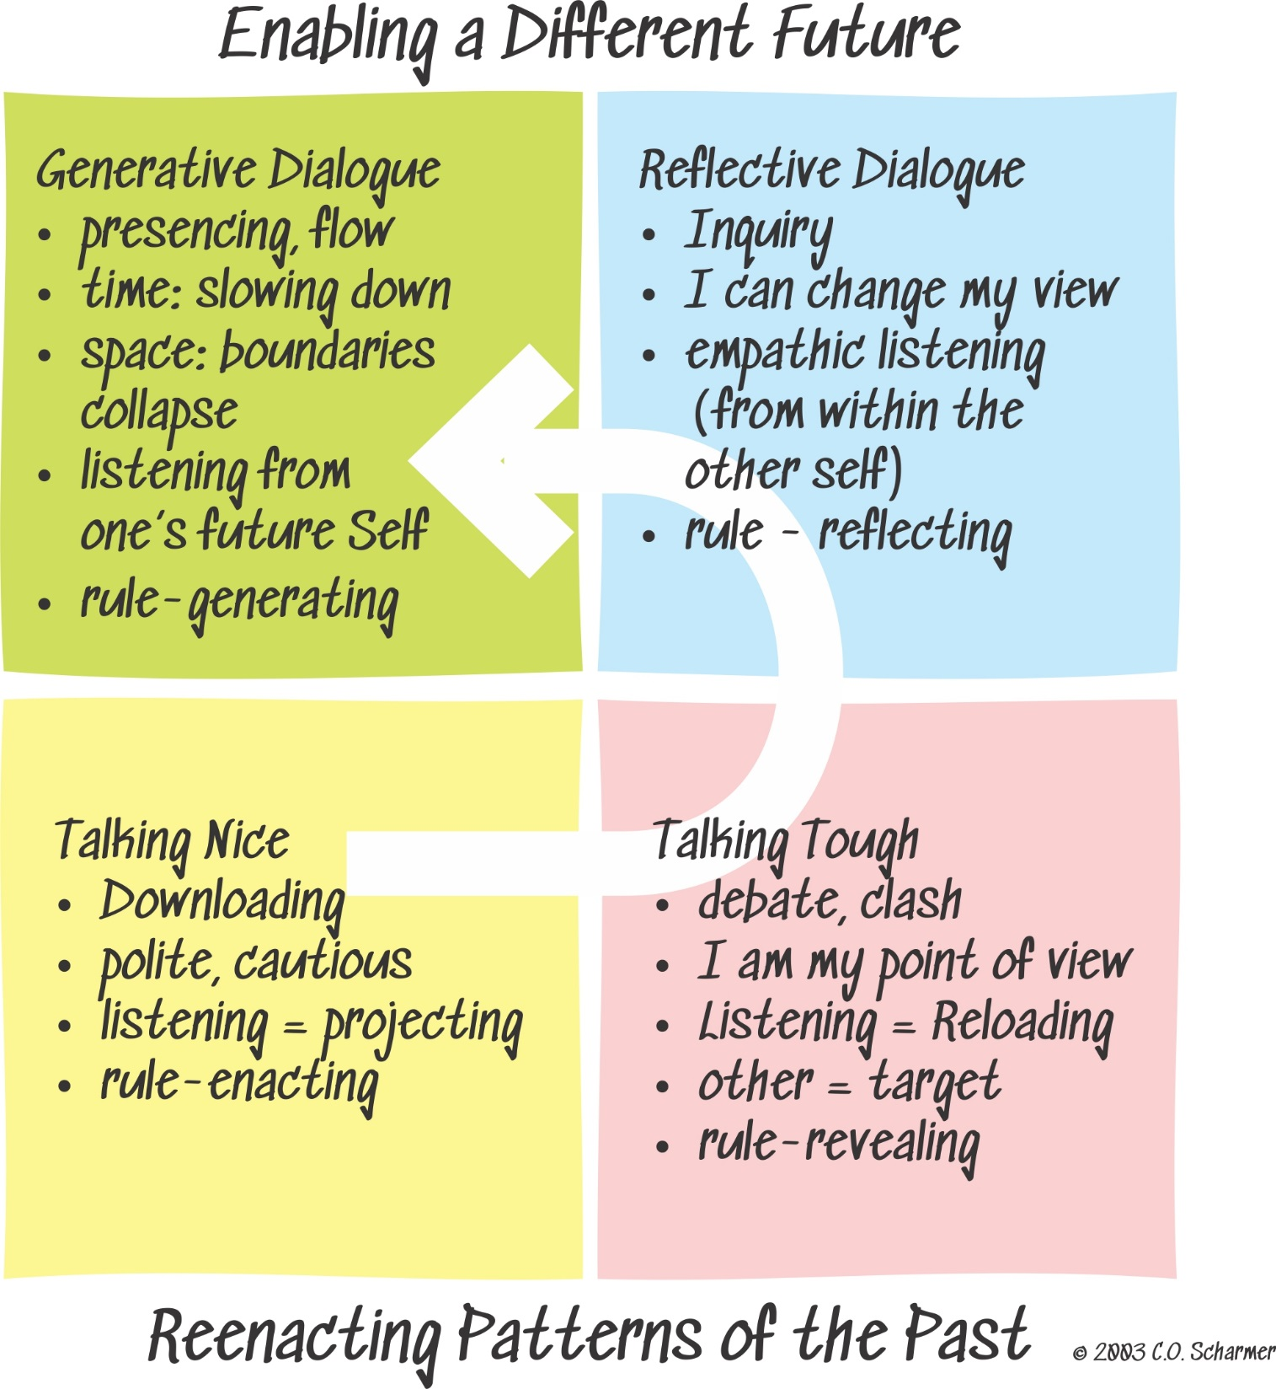
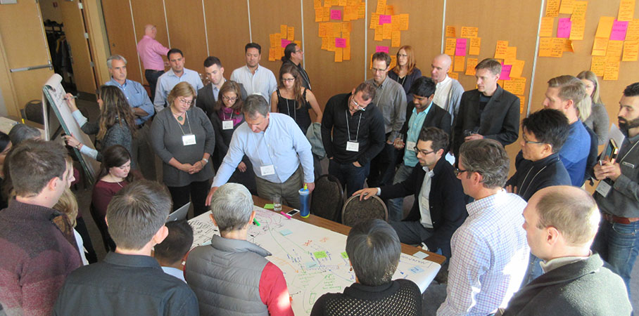
Creating a space for Albertans to move from fragmented and polarized conversations to those about shared outcomes means ‘getting good’ at deeper conversations.
.

Slide 22
Community Learning Model = Way the Many Work as One for the Good of All
Results: Tangible definition of health and well being
Include: Radical forms of inclusion to ensure all voices are at the table
Dialogue: True listening, generative exchanges
Act: Trying things, experimental approaches
Learn: Using data to guide progress
Culture: Change “the way we do things around here”

Slide 23
The Many Working as One
Learning Community
Learning Cluster
Learning Team
Individual

Slide 24
Summit Learner Experience Opportunities
Summit Learner Journal – map your time and experience
Social Media – share your experience
Twitter: #CanopySummit2017, follow/mention @CivicCanopy
Facebook: find The Civic Canopy and Tamarack Institute
Technology Showcase
Civic Network
Results Scorecard
Kumu
PARTNER Tool
Join Civic Network 2017 Summit: http://bit.ly/2AFXWrO

Slide 25
Wireless Internet Connection
Network: PSAV-MEETING
Access Code: TCCconnect2017

Slide 26
Summit Schedule Overview
Tool Sessions
Workshops
Lunch Table Topics
Community Engagement
Building Effective Action Teams
Shared Measurement & Data Collection
Reception
Decision Making Through Consensus Building
Communications & Framing
Group Facilitation Tools & Techniques

Slide 27
Summit Sponsor Recognition SPONSORS

