Slide 1
for the good of all
November 30, 2017

Slide 2
Summit Sponsor Recognition SPONSORS

Slide 3
Summit Closing
Summit appreciation
Summit evaluation
Find resources on Civic Network: http://bit.ly/2AFXWrO
Remember The Civic Canopy on
Colorado Gives Day, December 5, 2017

Slide 4
The Many Working as One
Learning Community
Learning Cluster
Learning Team
Individual

Slide 5
Head, Heart, Feet Activity

Slide 6
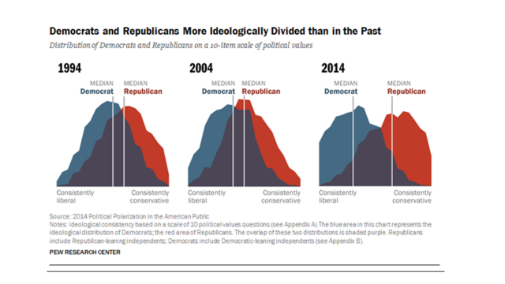
Notes:
http://www.people-press.org/2014/06/12/political-polarization-in-the-american-public/

Slide 7
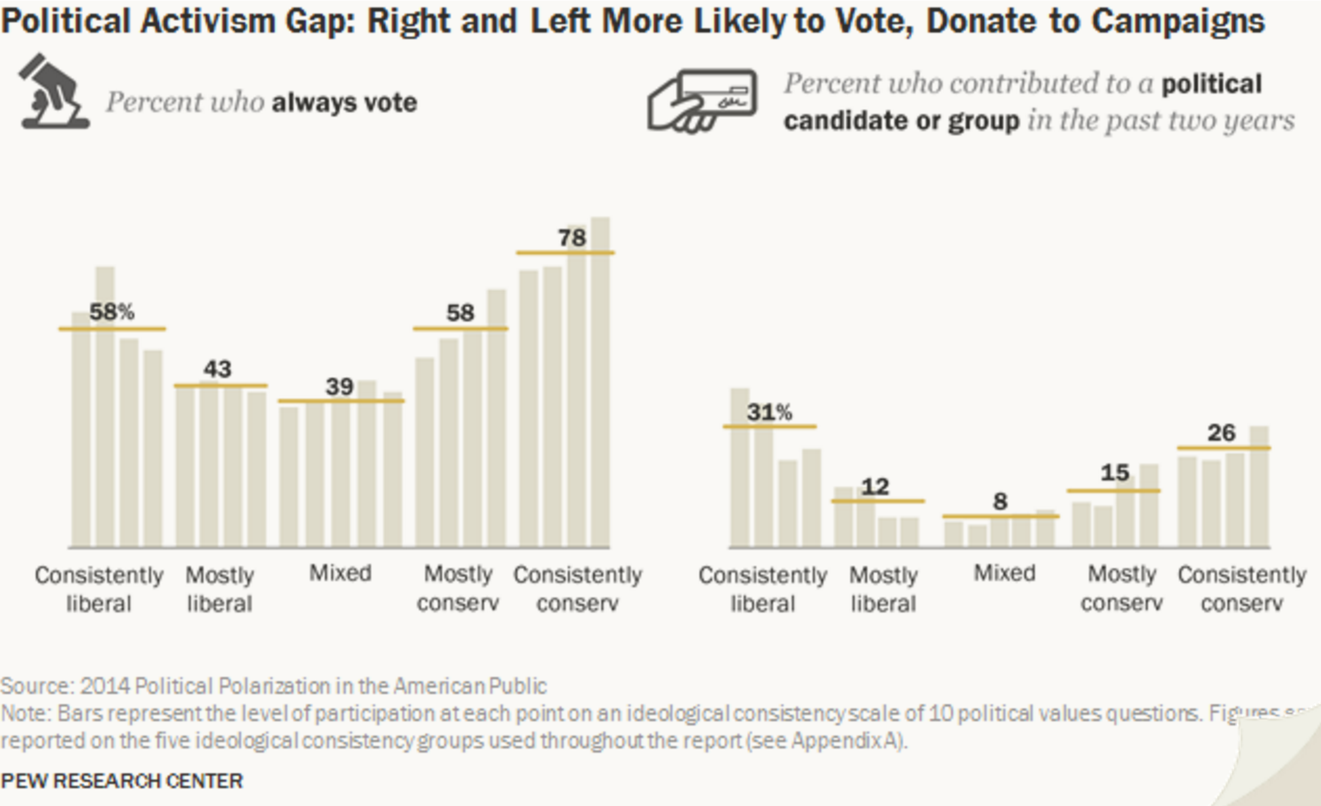

Slide 8
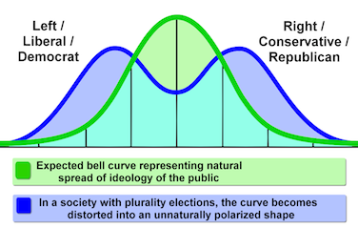
Notes:
https://www.quora.com/Centrism-3rd-Party-Prospects-in-U-S-Politics-Is-there-a-rational-middle-ground-between-Democratic-and-Republican-views-of-government

Slide 9
Imagining the Radical Middle

Slide 10
Inviting People Back to the Public Square. . . or. . . Building a Civic Cathedral
68%
95%

Slide 11
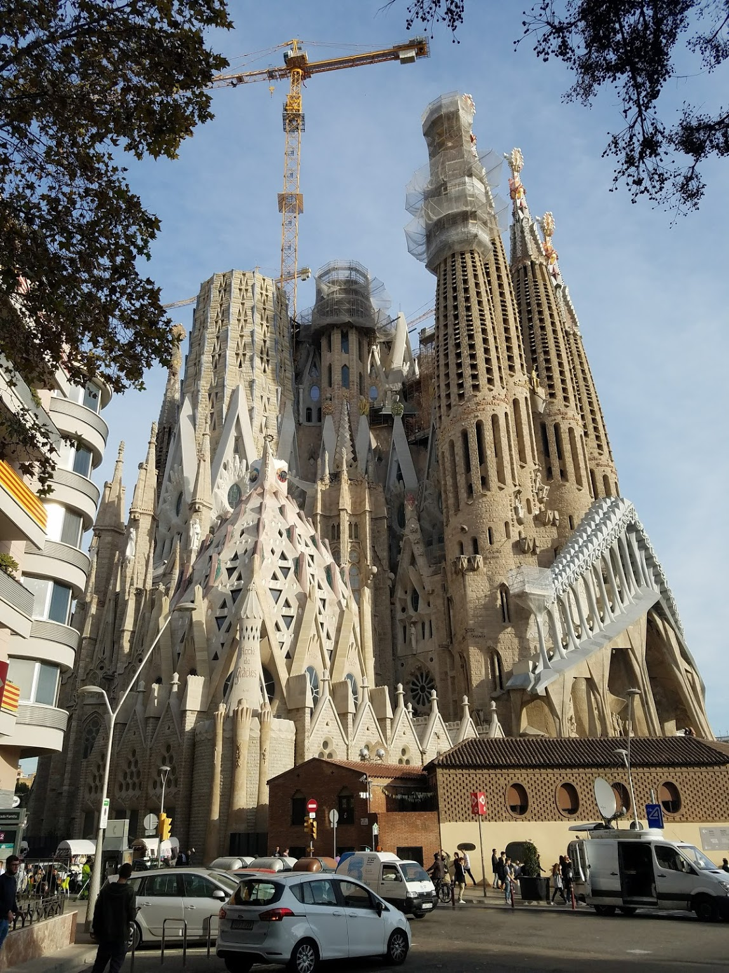
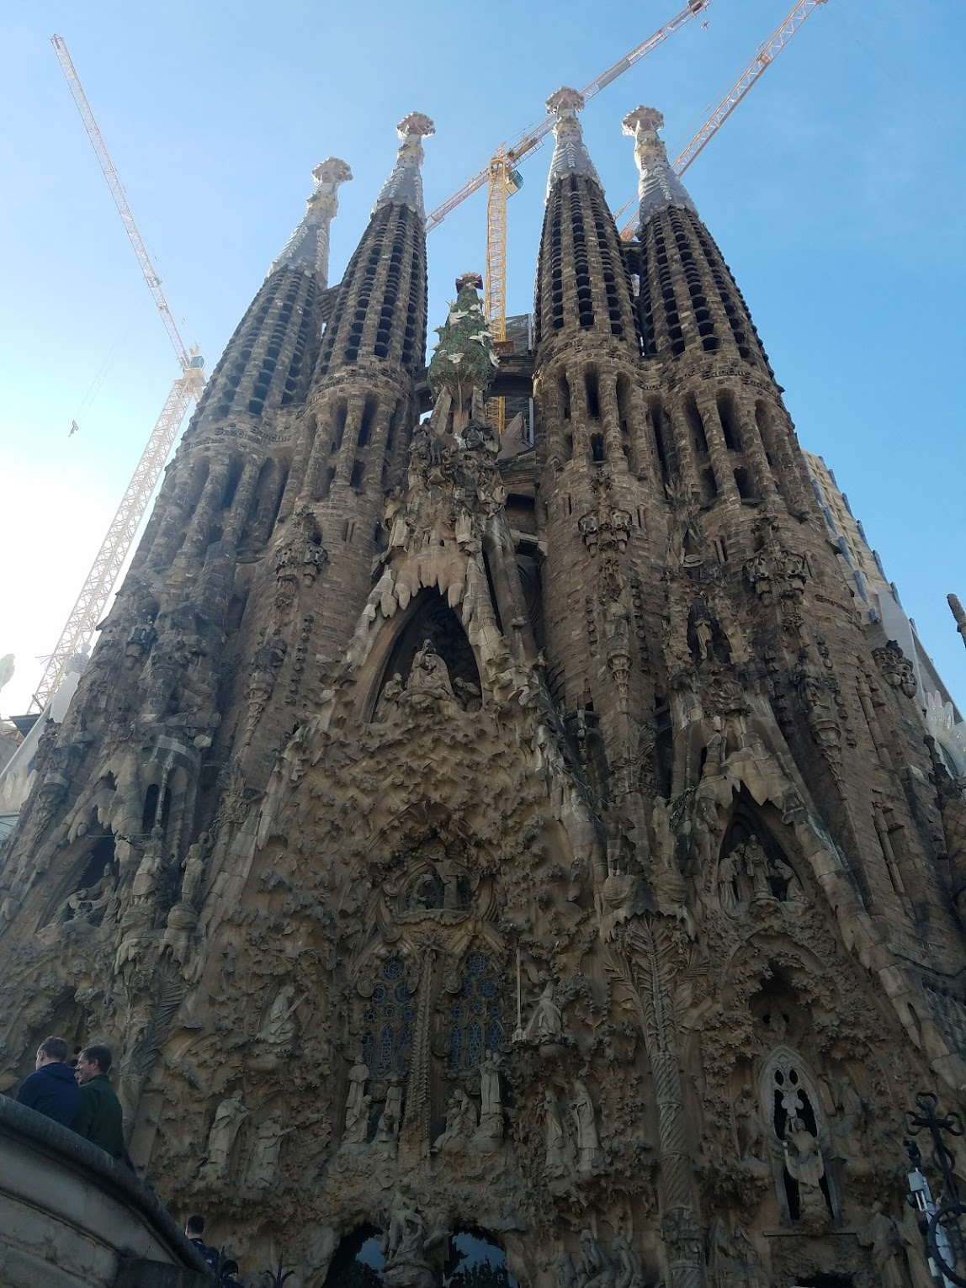

Slide 12
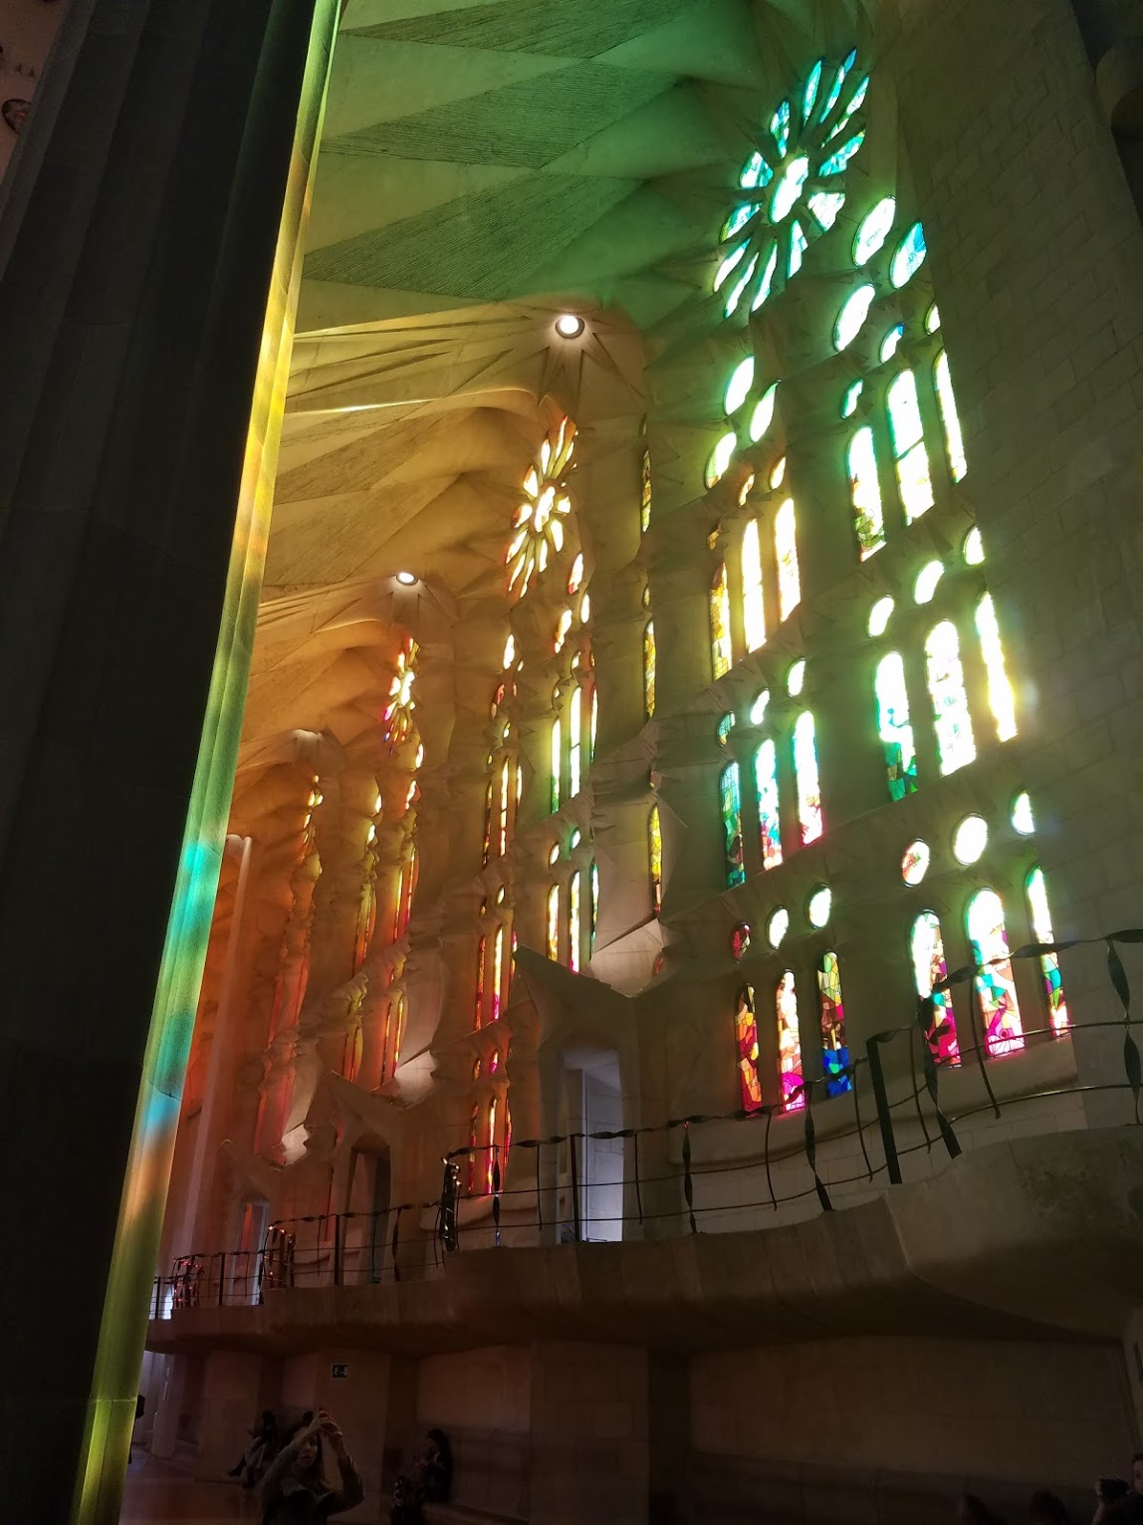
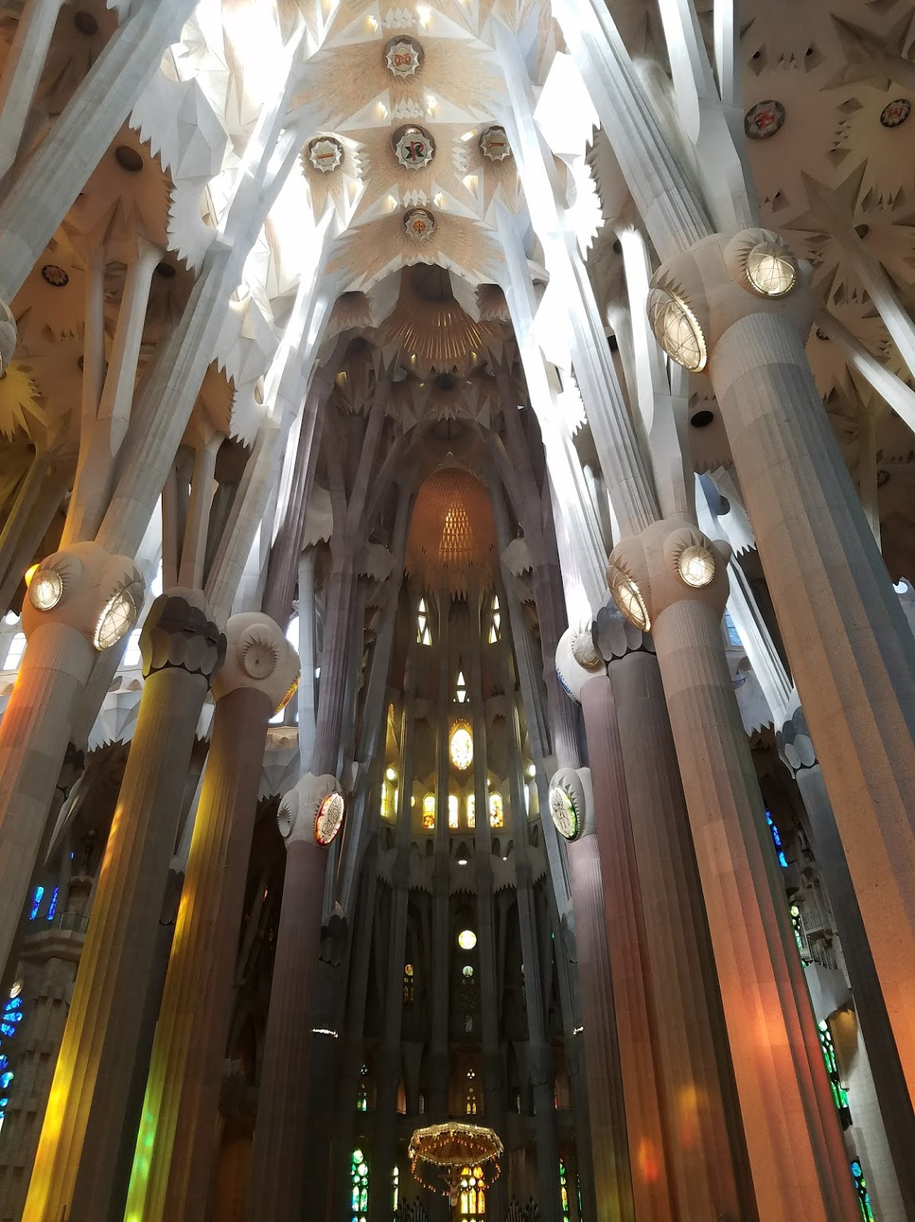

Slide 14
Sealing the Deal How to Be The Change You Want to See Nita Mosby Tyler, Ph.D. Chief Catalyst – The Equity Project, LLC

Slide 15
I Believe…
“If we don’t tackle social exclusion in the communities we are a part of, we decrease the power of our collective social impact.”
-The World according to Dr. Nita Mosby Tyler

Slide 16
What can I do?

Slide 17
Fill the Funnel
Problems & Barriers
Resources
Collective Gifts & Talents
CHANGE

Slide 18
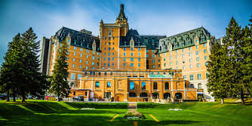
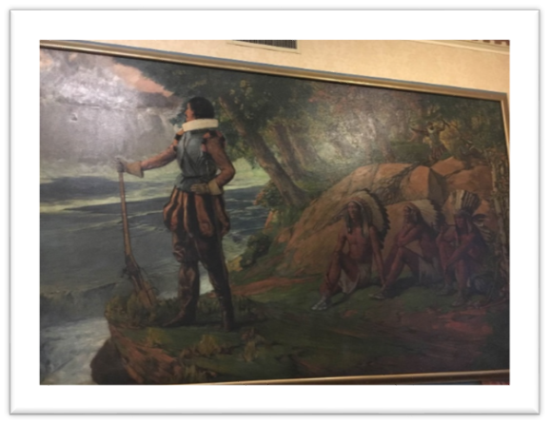
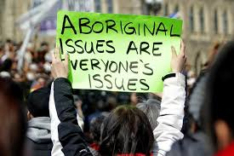
Years After Level 1, 2 and 3 Dialogue …. a symbolic moment.

Slide 19
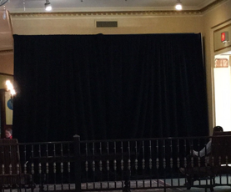

Slide 20
What can WE do?

Slide 21
What can WE ALL do?
Continue to explore our understanding of equity
Shift to “embracive” versus “inclusive” culture work
Webinars, podcasts, learning opportunities that help sharpen our tools on this issue
Leverage the power of the Canopy Summit Page to communicate, share and build capacity
Upload stories to Civic Network
Weigh in on what you need for the coming year
Learning Community Dialogue
Talk to your small group to generate ideas you would find helpful in supporting your efforts.

