Slide 1
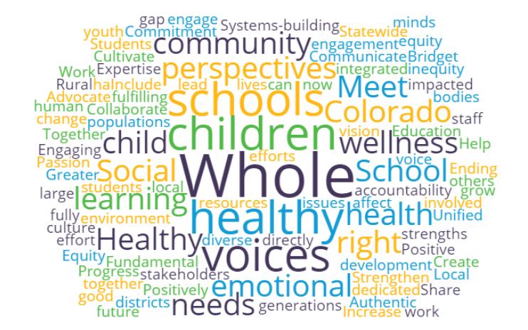
Healthy Schools
Collective Impact
About Us
Healthy Schools Collective Impact (HSCI) is a collaborative effort with a purpose: to improve health outcomes for all Colorado children and youth by supporting school cultures and environments to integrate health and wellness equitably for all students and staff.
HSCI works with stakeholders to identify policy, systems, and practice changes at the statewide and local level to support schools and get them the health and wellness resources they need to engage the whole child and, in turn, bolster academic achievement.
Why We Exist
Fewer than half of Colorado districts have not adopted nutrition-promoting policies
One program or organization cannot address large-scale issues on its own. Our impact goes further when we work together toward a common agenda.
Colorado students receive an average of only 2 physical activity sessions per week
1 in 5 districts annually screen students to identify social, emotional, & behavioral health needs
2 in 5 Colorado schools do not perform hearing and vision screenings for every grade
Statistics provided by the 2015-16 Smart Source Survey which reaches 25% of Colorado school districts.
HSCI’s vision is that all Colorado youth are healthy and reach their full potential.

Slide 2
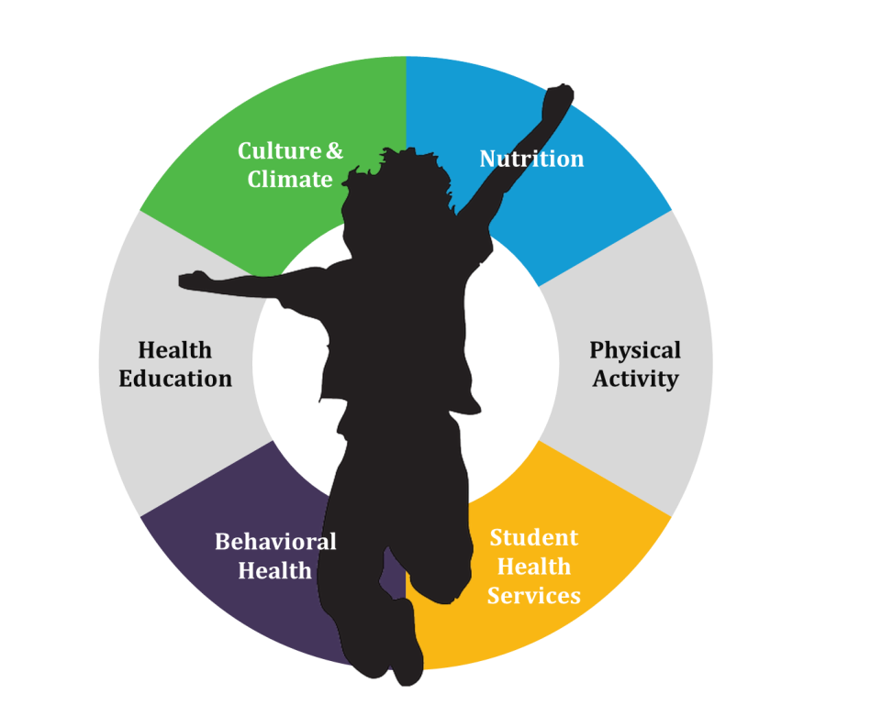
Our Structure
The diagram below reflects our new structure and ways people like you can get involved!
STEERING COMMITEE
ADVISORY GROUPS
WORK GROUPS
Work Group Rep Council
Professional Development
Communications, Marketing & Engagement
HEALTHY SCHOOLS NETWORK
SPRINT GROUP
Data Systems, Research & Evaluation
Policy
OTHER
SUB-
COMMITTEES
Local
Advisory Council
Funders Table
Other Work Groups
BACKBONE SUPPORT
EVALUATION TEAM
Each group in this structure plays an important role in HSCI efforts.
As new people join the effort, we are committed to ensure the composition of each group reflects the diversity and uniqueness of the people HSCI aims to reach, including students, parents/guardians, and educators.
Get Involved
HSCIColorado.com
E-mail: hello@HSCIColorado.com
Twitter & Instagram: @hscicolorado
Facebook: Colorado Healthy Schools Collective Impact
Alison McCarthy, HSCI Backbone Organization
Phone: (303) 455-1740 x 125
HSCI’s vision is that all Colorado youth are healthy and reach their full potential.

